Slide 1
Jiang, Zhengxin Janet; Lee, Fung King Jackie
The Education University of Hong Kong

Slide 2
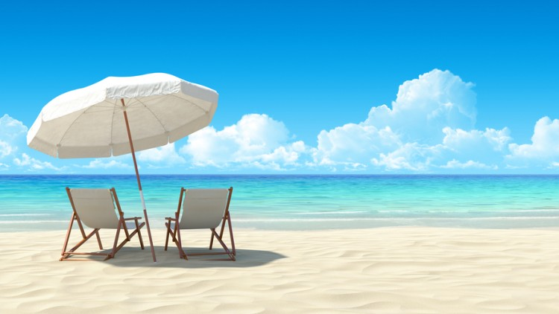
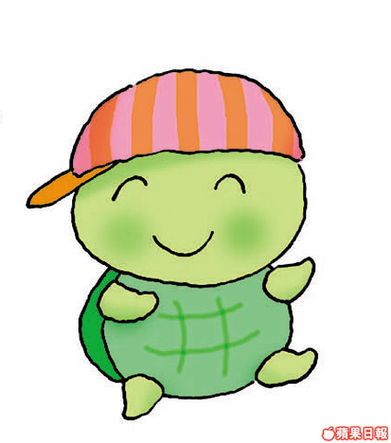
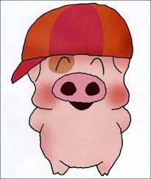
McDull, I’m planning to travel overseas in the coming vacation. What about you?
Me too, Ah Fai! Let’s find out where to go!

Slide 3
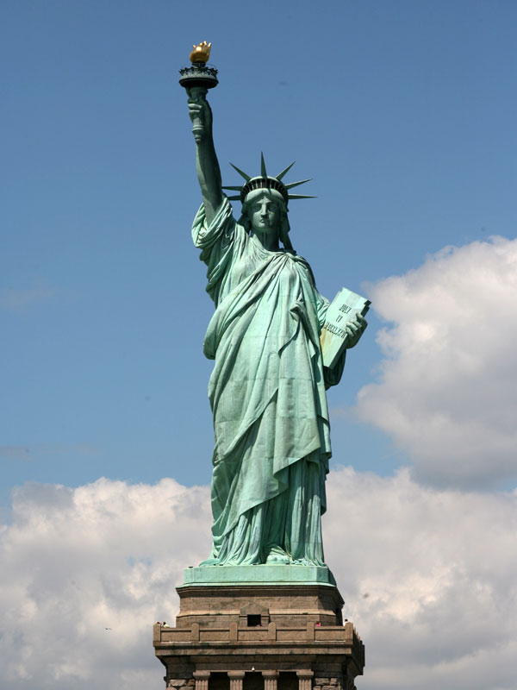
What about the US? There is the Statue of Liberty.
The Statue of Liberty? I’m not interested in it. It’s just a statue.

Slide 4
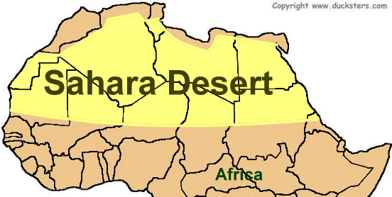
What about the Sahara? It is a desert. It is in Africa.
I am afraid of wild animals in Africa!

Slide 5
What about Italy? We can try very delicious pizza there!
Oh! I didn’t know that pizza is an Italian food!

Slide 6
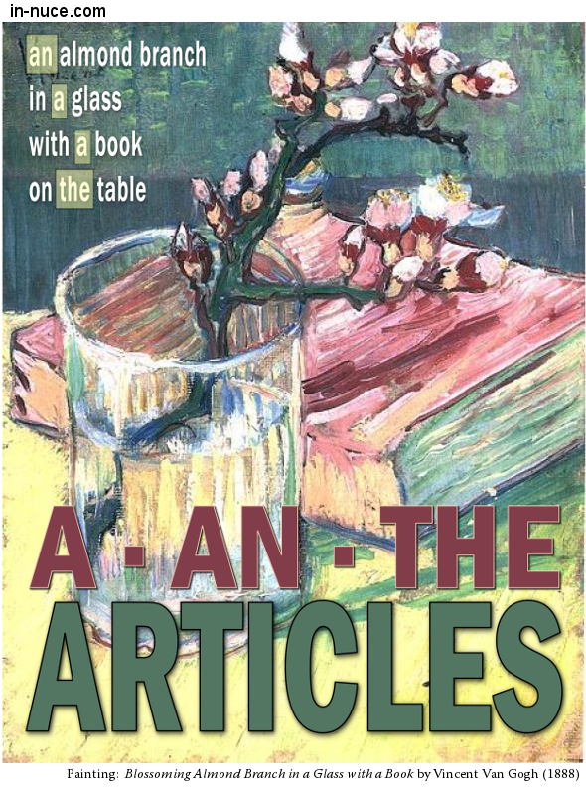
Articles “a”, “an” & “the”
the Statue of Liberty
the US
the Sahara
a statue
a desert
an Italian food
X Africa
X Italy

Slide 7
McDull, I’ve decided to visit the UK with my mum!

Slide 8
Ah Fai’s email to McDull about his trip in the UK
From the room, we have a great view of (13) the River Thames and (14) the Houses of Parliament
Outside, (15) the weather is fine.
(17) The Tube is one of the world’s biggest transit systems.
She’s (19) the eldest daughter of my mum’s sister Aunt Julia. Aunt Julia is (20) the Head of the Department of Mathematics at (21) a secondary school in London.

Slide 9
she speaks three languages and also plays (22) the piano. Yesterday, she took me to one of her favourite places - (23) the British Museum.
It’s (26) a colourful map of (27) the UK.

Slide 10
No. | English | Chinese
13. | the River Thames | 泰晤士河
14. | the Houses of Parliament | 國會大廈
15. | the weather | 天氣
16. | the sky | 天
17. | The underground system / The Tube | 地下鐵路系統
19. | the eldest daughter | 最大的女兒
20. | the Head of the Department of Mathematics | 數學科主任
22. | (plays) the piano | 彈鋼琴
23. | the British Museum | 英國博物館
27. | the UK | 英國

Slide 11
English | Chinese
(1) a really good hotel | (1) 一間很好的酒店
(2) a Chinese restaurant | (2) 一間中式餐廳
(3) an Italian restaurant | (3) 一間意大利式餐廳
(4) a steak restaurant | (4) 一間牛排餐廳
(8) a fitness centre | (8) 一所健身中心
(9) an indoor swimming pool | (9) 一個室內游泳池
(12) a great view | (12) 一個很好的景觀
(18) a university student | (18) 一個大學生
(21) a secondary school | (21) 一所中學
(24) a present | (24) 一份禮物
(26) a colourful map | (26) 一幅彩色的...地圖

Slide 12
Ah Fai, I have written an email to you. It is about my trip in Maldives.

Slide 13
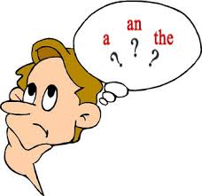
When to use “a”, “an” & “the”
Your teacher will read the email twice. Listen carefully the first time your teacher reads it, and take notes when your teacher reads the email again.
In groups of four, write the full email based on the notes taken. Pay special attention to the use of articles ‘a’, ‘an’ and ‘the’.

Slide 14
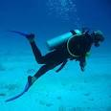
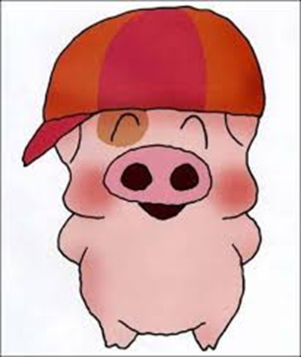
Text for Dictogloss
Hi Ah Fai,
I learnt that you had a great time in the UK. Enjoy the rest of your trip!
My father and I arrived in Maldives yesterday. I’m in a holiday resort now. It’s not an ordinary resort. It’s a resort room built above the sea! This is the first time I have stayed in a resort room like this. There’s no swimming pool in the resort because we can go swimming in the sea under our beds.
I really enjoy staying here. The beach is so beautiful. The sand is white and soft. The water is clear. I can spend my whole day lying on the beach.
Dad and I will go scuba diving tomorrow. We’ll dive under the sea. Don’t worry about our safety. A coach will be with us under the water. Hopefully, I can see many colorful fishes and even touch them!
I’ve sent you a postcard, and I’ll bring you a souvenir. Bye!
McDull

