Slide 1
The Bad Good Manners Book (by Babette Cole)
Jiang, Zhengxin
The Education University of Hong Kong

Slide 2
What rules do we have in the classroom?

Slide 3
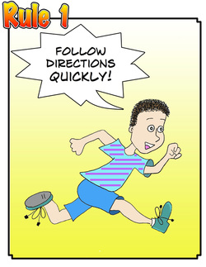
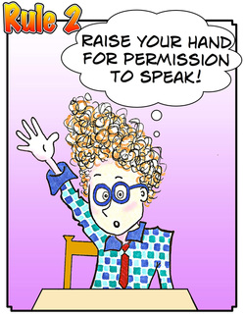
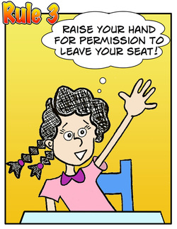

Slide 4
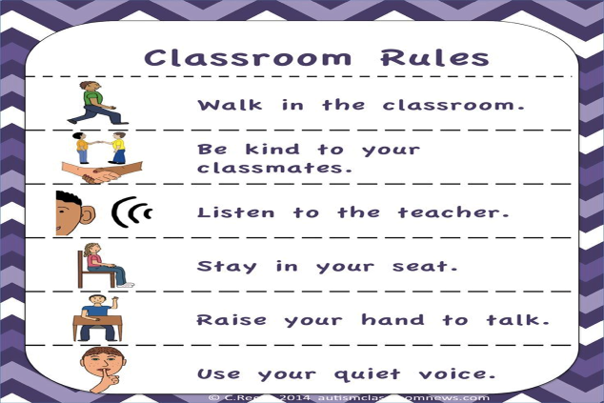
Classroom Manners

Slide 5
Read The Bad Good Manners Book together. https://www.youtube.com/watch?v=xkp5PpIhdsc
Activity 1 Copy the rules onto your Worksheet if you have the same rules. at home.

Slide 7
Activity 2 According to the book, what shouldn’t you do?
Don’t leave the tap on in the bathroom.
Don’t fill the sink up with hairs.
Don’t bung the loo up with papers.
Don’t leave your toys on the stairs!
Don’t mess around in the kitchen.
Don’t dress up the dog or the cat!
Don’t have a shampoo with a big tube of glue.
Don’t tell your mum that she’s fat.
Don’t
+ verb

Slide 8
Activity 2 According to the book, what shouldn’t you do?
Don’t leave the tap on in the bathroom.
Don’t fill the sink up with hairs.
Don’t bung the loo up with papers.
Don’t leave your toys on the stairs!
Don’t mess around in the kitchen.
Don’t dress up the dog or the cat!
Don’t have a shampoo with a big tube of glue.
Don’t tell your mum that she’s fat.
a. Sentences 1-8 start with the word “_______”, and it is followed by a/an _____________
(*noun / verb / adjective / adverb).
Don’t
verb

Slide 9
Activity 2 According to the book, what should you do?
09. Do try to dress yourself properly.
10. Do put the right shoes on your feet.
11. Do try to mind your own business.
12. Do tidy your terrible room.
Do
+ verb

Slide 10
Activity 2 According to the book, what should you do?
Do try to dress yourself properly.
Do put the right shoes on your feet.
Do try to mind your own business.
Do tidy your terrible room.
b. Sentences 9-12 start with the word “_____________”, and it is followed by a/an ________________
(*noun / verb / adjective / adverb).
Do
verb

Slide 11
13. Brush your hair, clean your teeth, wash your hands!
c. Can we add “Do” at the beginning of sentence 13?
Activity 2
Do
verb
Notes:
20 minutes

Slide 12
d. Can we take away “Do” at the beginning of sentences 9-12?
09. Do try to dress yourself properly.
10. Do put the right shoes on your feet.
11. Do try to mind your own business.
12. Do tidy your terrible room.
(Do)
+ verb

Slide 13
Do you have any other rules at home?
Finish Activity 3.

Slide 14
Share your Manners’ list with your partner. Are your partner’s home rules good rules to follow?

Slide 15
Now exchange the rules with your partner. Are the rules written correctly?

Slide 16
In the book, can you find…? - Words with “oo” (e.g. good) - Words with “ee” (e.g. teeth)

Slide 17
Pronunciation game Read the following words. Are they read in the same way?
Bathroom
Loo
Shampoo
Feet
Teeth
Peep
Good
Book
/ʊ/
/u:/
/i:/

Slide 18
Vowel Digraph game

Slide 19
Group representative:
Raise your hand if you can read the sentence. The first one who raises the hand will be chosen.
Read the sentence aloud to the class.
If the sentence is correctly read, the group will gain 10 points.
If the sentence is NOT correctly read, the group will lose 10 points.

Slide 20
Put your boots in the right place.
/u:/

Slide 21
Vacuum the floor to keep it clean.
/i:/

Slide 22
Don’t eat food in your bedroom.
/u:/

Slide 23
Go to sleep early at night.
/i:/

Slide 24
Tidy up your room; don’t make it a zoo.
/u:/

Slide 25
/i:/
Brush your teeth after eating sweet food.
/u:/
/i:/

Slide 26
Jazz Chants

Slide 27
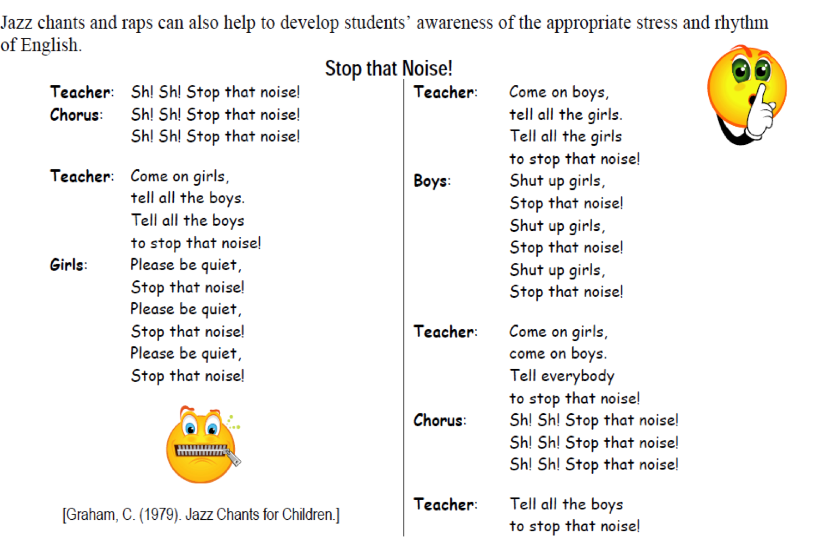

Slide 28
Extended Task What are the manners in public places?

Slide 29
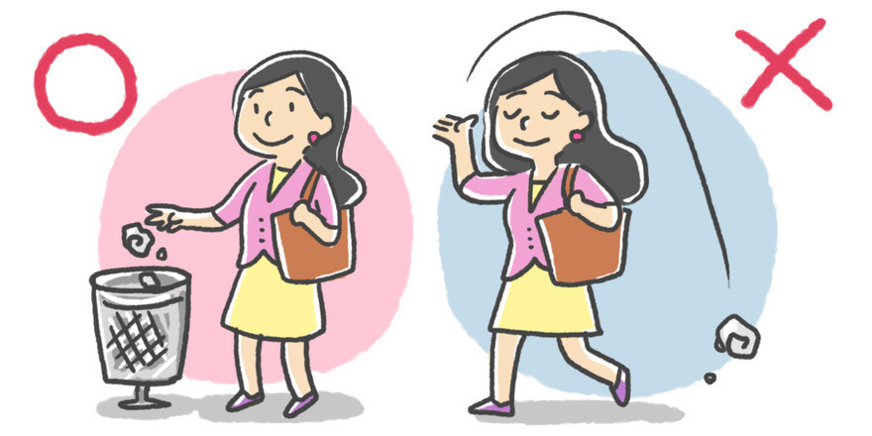
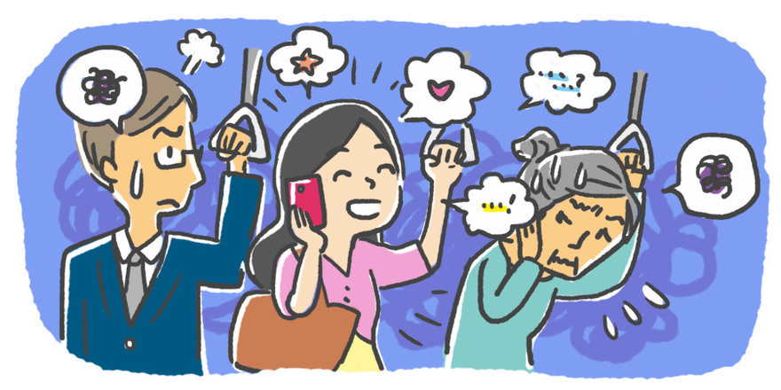
Create a Manners’ Book in public places.
Write at least 6 rules. Include both Dos & Don’ts.
https://www.youtube.com/watch?v=PrXdum3engk

Slide 30
Share your manners book with your groupmates.
Each group compiles their manners book and shares it with the class.

