Slide 1
Let’s Talk about Feeling Sad (by Joy Berry)
Liu, Yihan
The Education University of Hong Kong

Slide 2
Eliza
Bonnie

Slide 3
When do you feel sad?
When does Eliza feel sad?

Slide 4
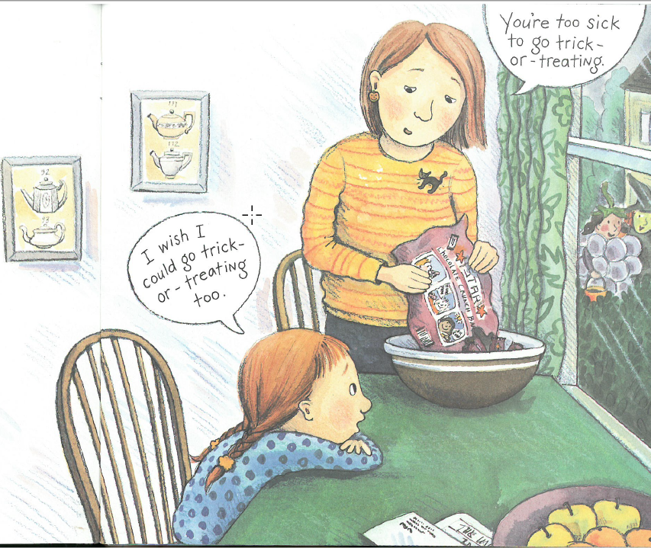
Eliza feels sad when she isn’t able to do something she wants to do.

Slide 5
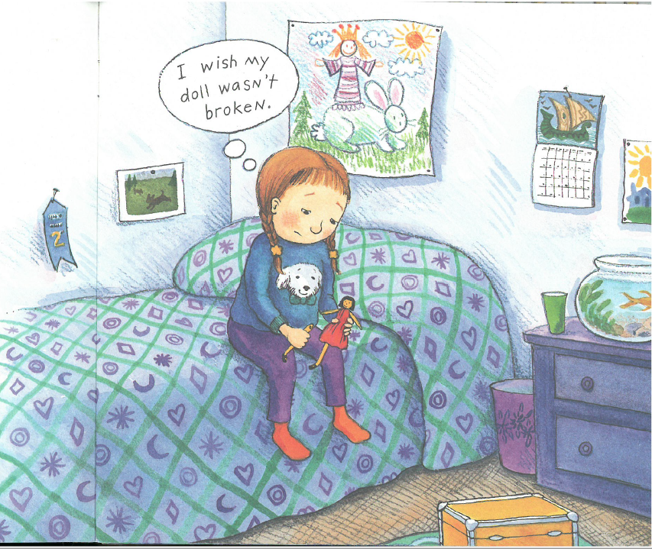
Eliza feels sad when her toy is broken.

Slide 6
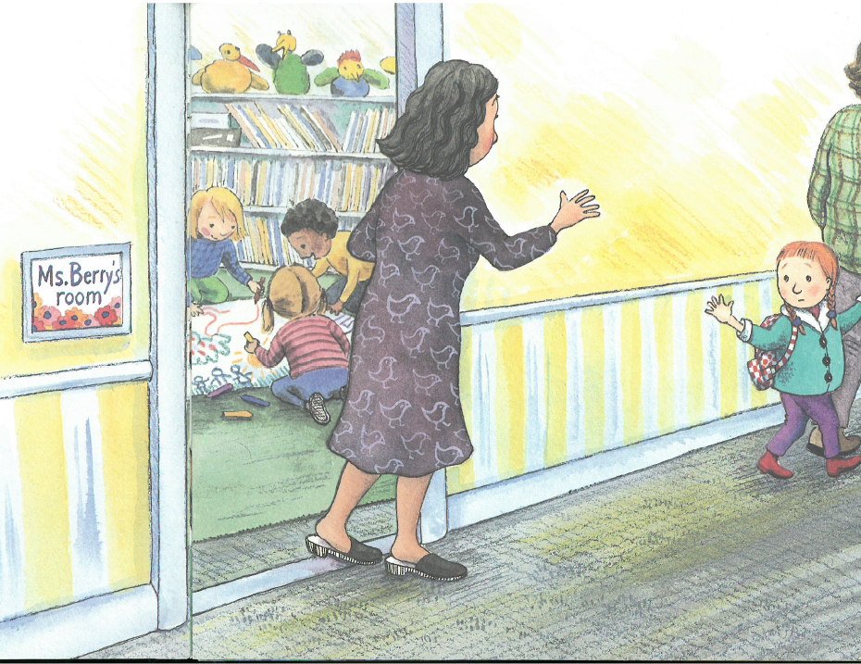
Eliza feels sad when she has to leave a place she really likes.

Slide 7
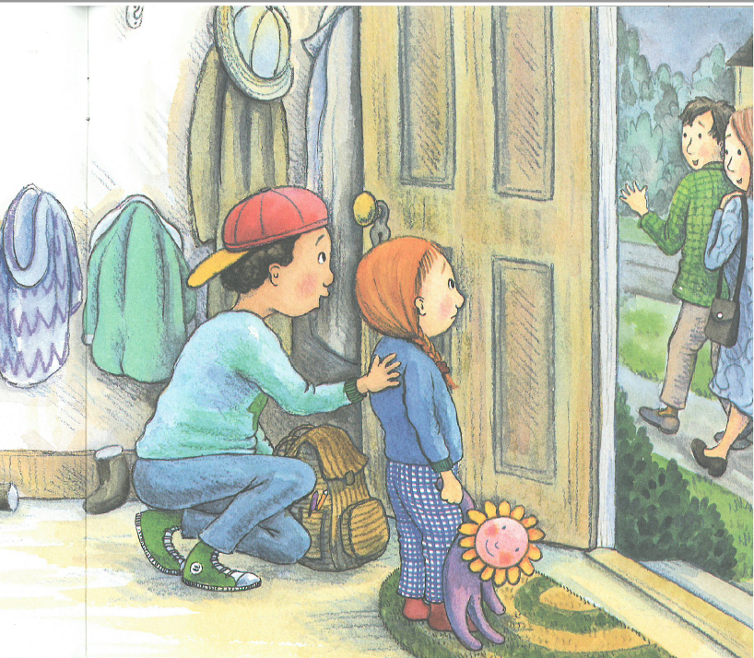
Eliza feels sad when her friends have to leave her.

Slide 8
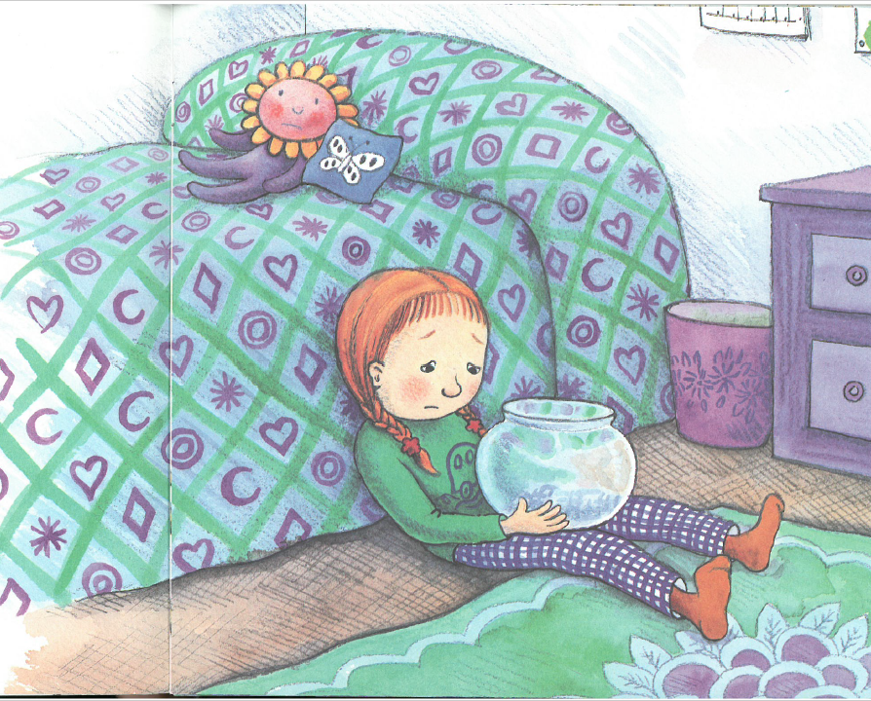
Eliza felt sad when …
My gold fish, I miss you.

Slide 9
What will you do when you feel sad?
What will Eliza do when she feels sad?

Slide 10
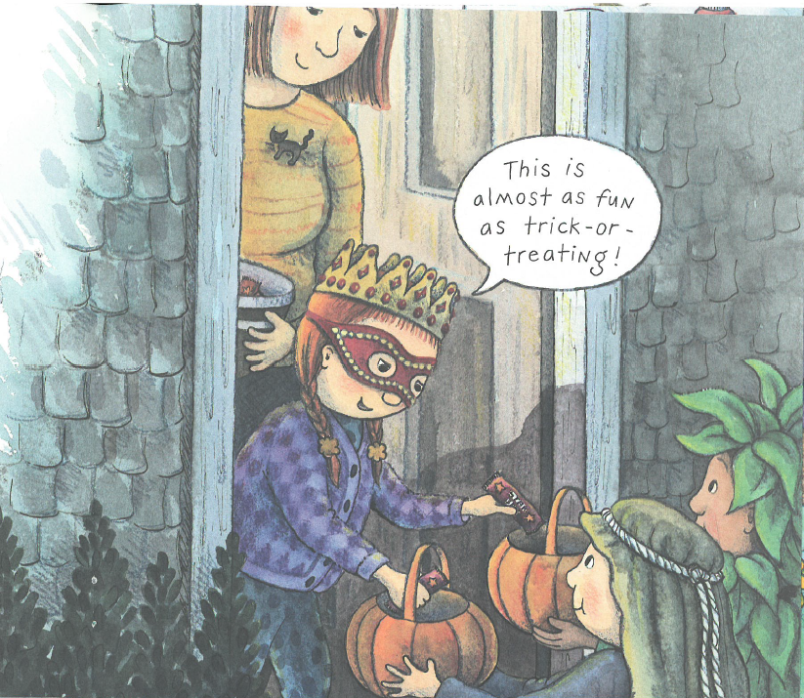
When I feel sad, I will find something else to do.

Slide 11
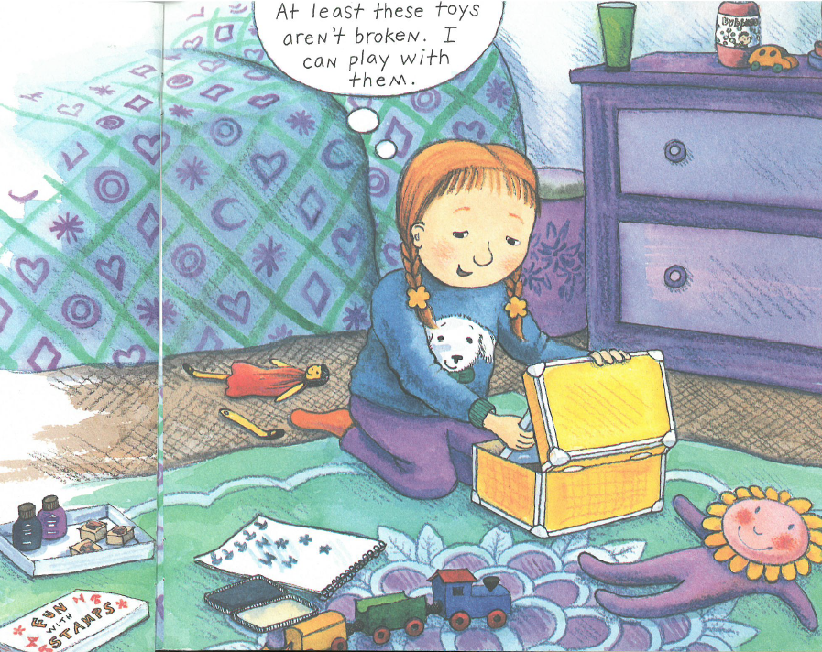
When I feel sad, I will be thankful for the other things I have.

Slide 12
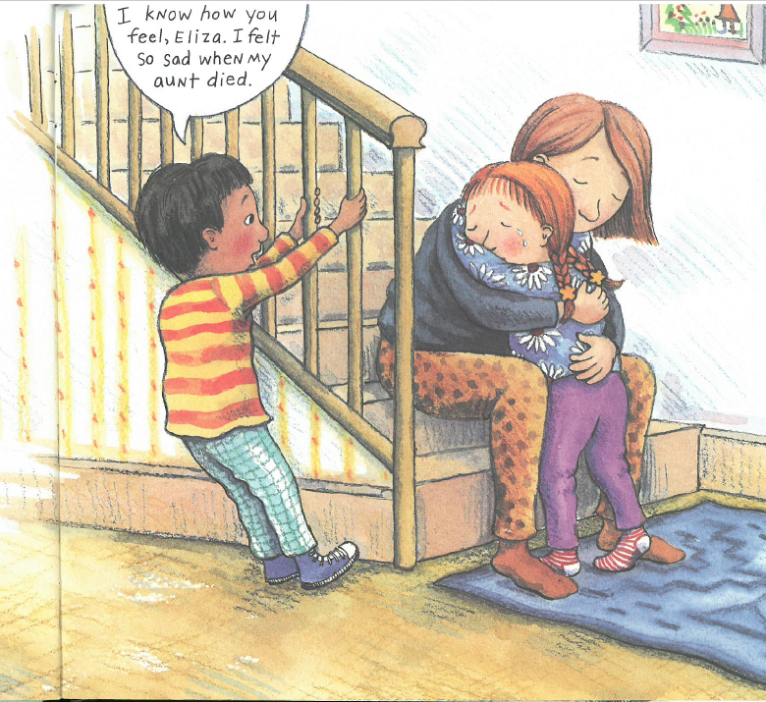
When I am sad, I do not need to hide my sadness.

Slide 13
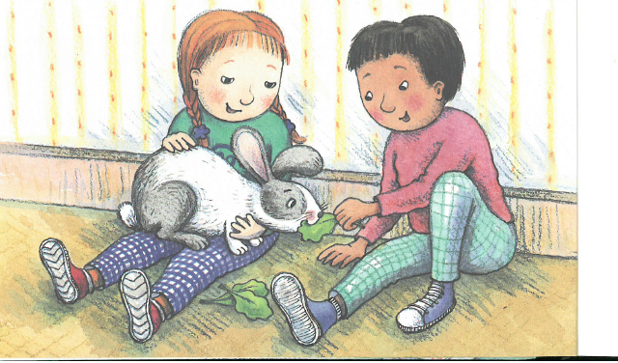
Remember:
Everyone feels sad sometimes. Feeling sad is okay.
Just do things that will make you feel better when you feel sad.

