Slide 1
GERUNDS & TO-INFINITIVES
Au, Lai Yee Naomi; Lee, Fung King Jackie
The Education University of Hong Kong

Slide 2
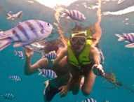
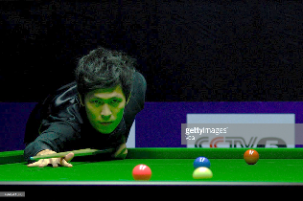
What sport do you like doing?
snorkeling
soccer
fishing
badminton
snooker
swimming

Slide 3
What sport do you like doing?
Gerund / -ing form
I like playing soccer.
I like fishing.
I like swimming.

Slide 4
Gerund / -ing form
G
(Peter / your school)
I am swimming.

Slide 5
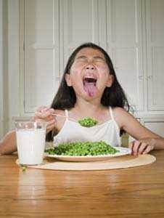
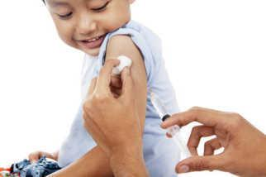
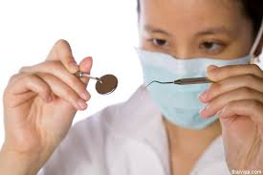
What do you hate to do?
have injections
eat vegetables
see the dentist

Slide 6
What do you hate to do?
to-infinitives
I hate to eat vegetables.
I hate to have injections.
I hate to see the dentist.

Slide 7
Let’s play a game!
1. You have: TWO cards: “G” & “to-i”
2. I will show you different sentences.
3. If you see gerunds, raise the “G” card.
4. If you see to-infinitives, raise the “to-i” card.
DON’T look at the others!

Slide 8
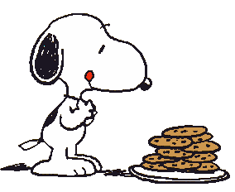
1. Snoopy likes eating biscuits.
2. Ironman tries to catch Snoopy.
3. Steve Jobs wanted to design the iphone 7.
4. Bigbang promised to hold a concert in Hong Kong.

Slide 9
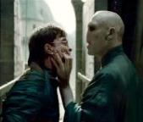
5. Mr. Bean can’t stop laughing.
6. Harry Potter remembers seeing Voldemort when he was small.
7. David Beckham loves playing football very much!
8. Doraemon cannot forget living with Nobi.

Slide 10
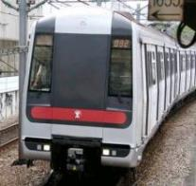
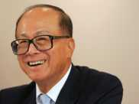
9. MTR never forgets to raise ticket prices.
10. Li Ka Shing doesn’t regret working in the business sector.

Slide 11
What are the verbs following ‘like’ and ‘love’?.
To-infinitives
a) I like to wash my hair daily.
b) I like washing my hair daily.
c) I love to eat noodles.
Gerunds
d) I love eating noodles.

Slide 12
What are the verbs following ‘like’ and ‘love’?.
To-infinitives
a) I like to wash my hair daily.
b) I like washing my hair daily.
c) I love to eat noodles.
Gerunds
d) I love eating noodles.

Slide 13
Compare the following sentences. Do they have similar meanings?
a) I like to wash my hair daily.
b) I like washing my hair daily.
c) I love to eat noodles.
d) I love eating noodles.
Yes!!

Slide 14
However, some verbs can be followed by either gerunds OR
to-infinitives only.

Slide 15
Finish + G / to-I?
I have finally finished doing my homework!
Joey Yung finished rehearsing for the concert tonight.
We finish washing the dishes at half past eight every night.
I finish reading one book every two weeks.
G

Slide 16
decide
I decided to try and find somewhere to have a sleep.
So she decided to make away with him.
I decided to bake a cake.
I decided to give up my London flat.
I decided to keep up my flat in London and find fairly basic lodgings locally.
to-I

Slide 17
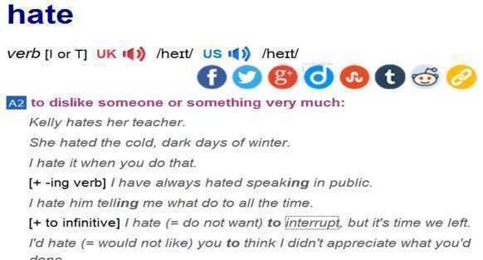
Activity 1 Are these verbs followed by gerunds or to-infinitives?
hate
G
to-I

Slide 18
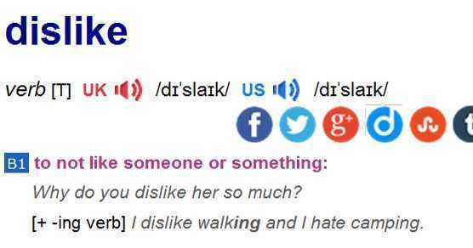
Activity 1 Are these verbs followed by gerunds or to-infinitives?
2. dislike
G

Slide 19
Activity 1 Are these verbs followed by gerunds or to-infinitives?
agree
aim
avoid
can’t help
choose
consider
deny
enjoy
mind
promise
refuse
suggest
The bank has agreed to lend me £5,000.
I aim to be a millionaire by the time I'm 35.
We should avoid looking at the sun directly.
It is awful, but I can’t help laughing.
Katie chose to stay away from work that day.
You can consider selling the house.
Neil denies breaking the windows.
I enjoy meeting people and seeing new places.
I don’t mind having a dog in the house.
He promised to call me every week.
On cold mornings the car always refuses to start.
I suggested putting the matter to the committee.

Slide 20
Verbs followed by G only | Verbs followed by to-I only | Verbs followed by G or to-I with similar meanings | Verbs followed by G or to-I with different meanings
dislike, avoid | agree | like
can’t help | aim | love
consider | choose | hate
deny | promise
enjoy | refuse
mind
suggest
What about this last column?

Slide 21
Some verbs can be followed by gerunds and to-infinitives, BUT with different meanings.

Slide 22
Activity 2

Slide 23
remember
Please remember to bring your book next time.
You are sick. Remember to take enough rest.
I remember seeing you before. You look familiar to me.
I remember lending you $1,000. You must remember to return the money to me soon.

Slide 24
Remember + gerund? +to-infinitive?
You remember that you did something in the past.
Need to do something / Not forget to do something
Gerund? To-infinitive?

Slide 25
Wow! The weather is very nice today. I should go out and get some fresh air.

Slide 26
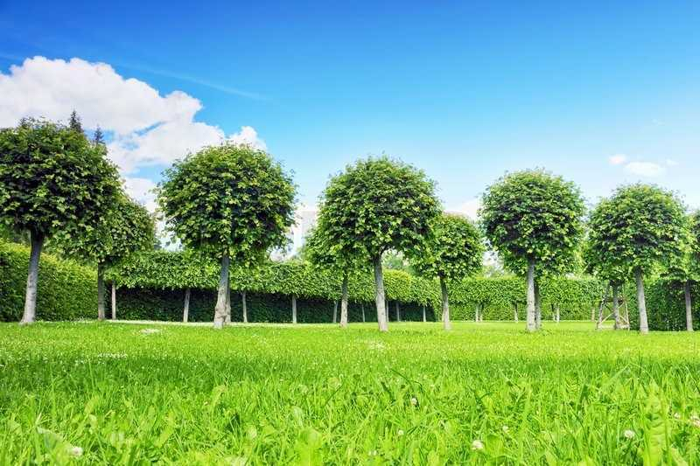
Did I close the door after I left my house?
Yes, of course I did.
Ms Wong remembered closing the door.
(close)

Slide 27
Wow! The weather is very nice today. I should go out and get some fresh air.

Slide 28
Ms Wong hasn’t closed the door!
Ms Wong must remember
to close the door.
(close)

Slide 29
Remember + gerund? +to-infinitive?
You remember that you did something in the past.
Need to do something / Not forget to do something
Remember + G
Ms Wong remembered closing the door.
Remember + to-I
Ms Wong must remember to close the door.

Slide 30
forget
Don’t forget to turn off the lights.
I forgot to do my homework and was punished.
I forgot doing my homework, and I did it again. Silly me!
I won’t forget seeing her. She is so charming.

Slide 31
Forget + gerund? +to-infinitive?
Unable to remember something that happened
Not remember to do something
Gerund? To-infinitive?

Slide 32
Wow! The weather is very nice today. I should go out and get some fresh air.

Slide 33
Uh oh. Did I close the door after I left my house?
Ms Wong forgot closing the door.
A. Ms Wong closed the door, but she doesn’t remember it.
(close)
B. Ms Wong didn’t close the door. She did not remember to close the door.

Slide 34
Forget + gerund? +to-infinitive?
Unable to remember something that happened
Not remember to do something
Forget + G
Ms Wong forgot closing the door.
Gerund? To-infinitive?

Slide 35
Wow! The weather is very nice today. I should go out and get some fresh air.

Slide 36
Uh oh. Did I close the door after I left my house?
A. Ms Wong closed the door, but she doesn’t remember it.
Ms Wong forgot to close the door.
(close)
B. Ms Wong didn’t close the door. She didn’t remember to close the door.

Slide 37
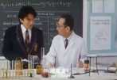
Some more examples
forget + gerund
forget + to-infinitive
The teacher forgot asking Chau Sing Sing his name.
What is your name?
Chau Sing Sing.
What is your name?
The student forgot to do his homework.
Notes:
Video for forget+gerund example: https://drive.google.com/file/d/0BzGserN7sE-jd1E1NTVGSWhKOUE/view?usp=sharing

Slide 38
Forget + gerund? +to-infinitive?
Unable to remember something that happened
Not remember to do something
Forget + G
Ms Wong forgot closing the door.
Forget + to-I
Ms Wong forgot to close the door.
Gerund? To-infinitive?

Slide 39
regret
The thief regretted stealing money.
I regret watching this movie! What a waste of time!
I regret to inform you that you have failed the examination.
I regret to tell you that your application is unsuccessful.

Slide 40
Regret + gerund? +to-infinitive?
You did something and you wish you hadn’t done it.
You are sorry to tell someone something.
Gerund? To-infinitive?

Slide 41
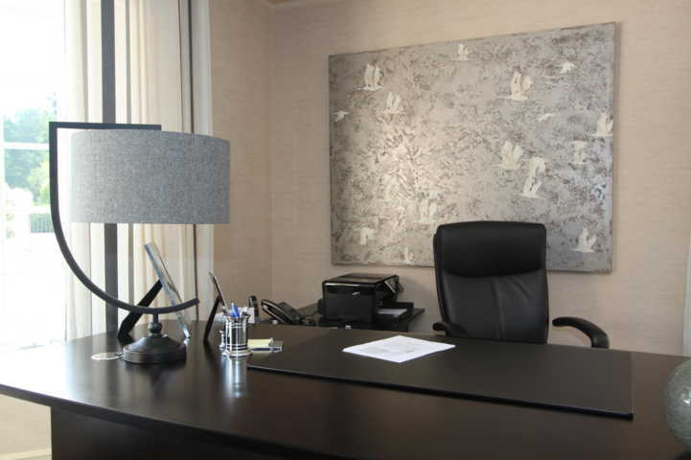
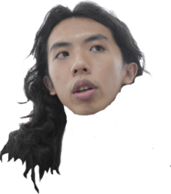
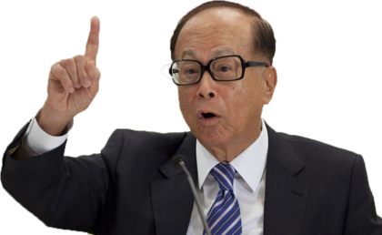
Peter, I am sorry you are fired!
Peter, I regret to tell you that you are fired!
(tell)

Slide 42
But I helped you earn one billion dollars this year.

Slide 43
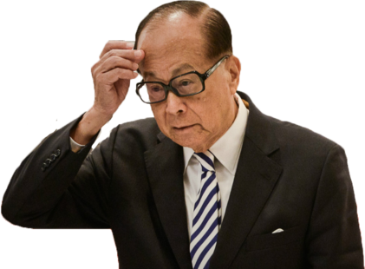
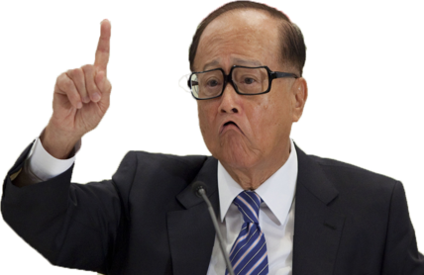
One billion dollars! Oh no!
I really shouldn’t have fired him.
Mr. Lee regrets firing Peter.
(fire)

Slide 44
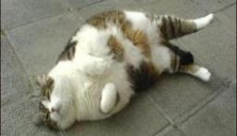
Some more examples
regret + gerund
regret + to-infinitive
I don’t feel well. I regret eating too much at the buffet.
I regret to tell you that you are fired.

Slide 45
Regret + gerund? +to-infinitive?
You did something and you wish you hadn’t done it.
You are sorry to tell someone something.
Regret + G
The boss regrets firing Peter..
Regret + to-I
I regret to tell you that you are fired.

Slide 46
stop
Please stop writing. The time is up.
People should stop smoking for their health.
The police stopped to check the cars on the road.
A lot of people stopped to take photos of 忌廉哥 when they passed by.

Slide 47
Stop + gerund? +to-infinitive?
You do one thing, and then you stop.
You do one thing, and then you stop so that you can do something else.
Gerund? To-infinitive?

Slide 48
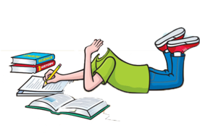
Hmm, imperatives.
That’s easy!
5:00

Slide 49
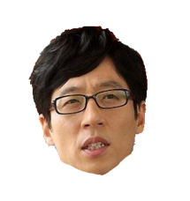
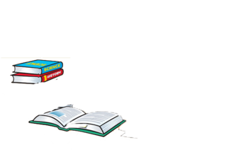
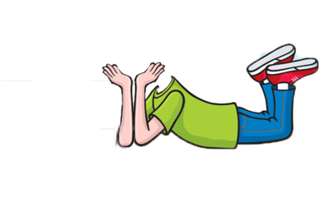
Sweetie, please come to the kitchen to help me!
5:15
Johnny stopped to help in the kitchen at 5:15.
Johnny was doing homework at 5:00.
At 5:15, his mother asked him to help
with the kitchen work.
(help)

Slide 50
Hmm, imperatives.
That’s easy!
5:00

Slide 51
Done!
5:30
Johnny was doing homework at 5:00.
He finished doing it at 5:30.
Johnny stopped doing homework at 5:30.
(do)

Slide 52
Some more examples
stop + gerund
stop + to-infinitive
The food is so delicious I can’t stop eating.
But my mum says, ‘Stop eating snacks!’
The flowers smell so good that the kid stops to smell them.

Slide 53
Stop + gerund? +to-infinitive?
You do one thing, and then you stop.
You do one thing, and then you stop so that you can do something else.
Stop + G
Stop + to-I

Slide 54
Activity 4
Watch“Mr. Bean – The Exam” https://www.youtube.com/watch?v=OBLRjm79apo&feature=youtu.be
Fill in the blanks using correct verb forms.

Slide 55
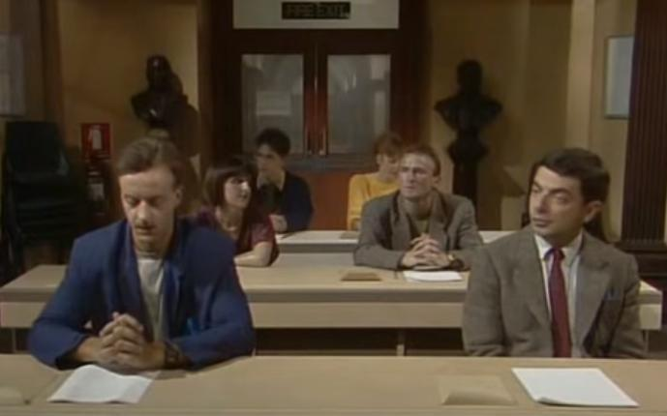
VIDEO “Mr. Bean – The Exam”
Notes:
YouTube video 3
(00:00-03:32)
(https: //youtu.be/OBLRjm79apo)

Slide 56
We can see Mr. Bean drive dangerously. A car driver has to _____________________ (stop, drive) | 1
to prevent his car from turning upside down. This is funny in the video, but not so much if it | 2
happens in reality. I ______________________ (remember, be) a bad driver myself when I first got | 3
my driver’s license. Now I believe drivers should always _____________________ (remember, be) | 4
responsible and drive safely. | 5
stop driving
remember being
remember to be

Slide 57
remembers to lock
It is funny that Mr. Bean ____________________________ (remember, lock) his car but | 7
__________________________________ (forget, take) the key with him when he arrives. | 8
 | 9
Mr. Bean sits next to a man in the examination hall. He _________________________ (regret, tell) | 10
him that the man seems to have studied something wrong for the exam. | 11
forgets to take
regrets to tell

Slide 58
Before the exam starts, Mr. Bean doesn’t ________________________ (stop, take out) his pens. I | 13
understand how important it is to bring enough pens. I ________________________________ | 14
(remember, not bring) any pens when I took my first public exam. Because of this, I will never | 15
________________________________ (forget, take) my pencil case wherever I go. | 16
stop taking out
remember not bringing
forget to take

Slide 59
Activity 4 Writing Time

Slide 60
Situation
Your school is organizing a writing competition. Its theme is “That Unforgettable Moment”. You have been invited to participate in this competition and write about your experiences.

Slide 61
Rules of the competition
You must include any of the following four words:
forget
Stop
Remember
Regret
with gerunds/to-infinitives

Slide 62
Let’s take a look at one example –
Ms Wong’s Unforgettable Moment!

Slide 63
Wow! The weather is very nice today. I should go out and get some fresh air.
One day, Ms Wong went
for a walk.

Slide 64
Uh oh. Did I close the door after I left my house?
Sadly, she forgot to close
the door.

Slide 65
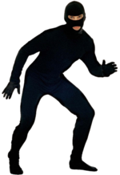
Sweet! I’m going to steal a lot of things from this house.
As a result, Ms Wong lost $500,000 that day. She regretted not closing the door.

Slide 66
Who wants to share his/her work?

Slide 67
WRAPPING UP

Slide 68
CAN YOU MATCH THE STRUCTURES WITH THE MEANINGS?

Slide 69
CAN YOU MATCH THE COMBINATIONS AND THE MEANINGS?

Slide 70
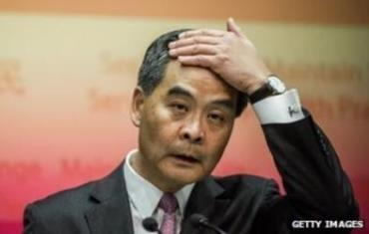
CHOOSE THE RIGHT ANSWER
Chief Executive Leung Chun-ying has said he "regrets" ____________controversial remarks last week.
to make
making
Source: http://www.news100hk.com/news/cy-leung-says-he-regrets-controversial-remarks-about-low-income-voters-55978

Slide 71
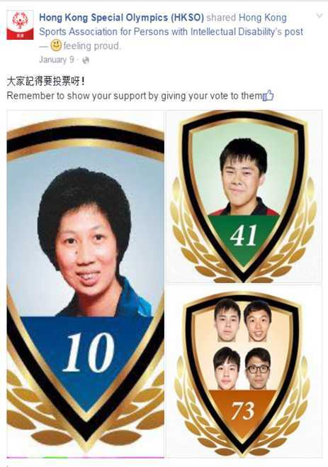
CHOOSE THE RIGHT ANSWER
?
showing
to show
Source: https://www.facebook.com/permalink.php?story_fbid=1072374646114494&id=121169804568321

Slide 72
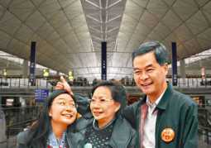
CHOOSE THE RIGHT ANSWER
CY Leung’s youngest daughter, Leung Chung-yan,
forgot _____________ her carry-on baggage.
to bring
bringing
Source: http://news.rthk.hk/rthk/en/component/k2/1254936-20160417.htm

Slide 73
CHOOSE THE RIGHT ANSWER
?
to broadcast
broadcasting

Slide 74
Verbs followed by G only | Verbs followed by to-I only | Verbs followed by G or to-I with similar meanings | Verbs followed by G or to-I with different meanings
dislike, avoid | agree | like
can’t help | aim | love
consider | choose | hate
deny | promise
enjoy | refuse
mind
suggest
remember
forget
regret
stop
What about this last column?

Slide 75
GERUNDS AND TO-INFINITIVES
After the lesson, we have:
learnt that gerunds and/or to-infinitives follow some verbs
written a text about an unforgettable moment with verbs forget/remember/stop/regret + gerund or to-infinitives
Good job!

