Slide 1
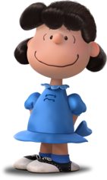
Let’s go to school with Charlie and Lucy!
Gerunds and Infinitives
Mak, Tin Lun Colin; Lee, Fung King Jackie
The Education University of Hong Kong

Slide 2
Charlie and Lucy are good friends. They are studying overseas together. Let’s go to school with them!
Charlie
Lucy

Slide 3
Good morning, Lucy!
Good morning, Charlie!
Where do you like to sit in the English lesson later? Would you like to sit with me?
Yes! I’d love to sit next to you! Let me take my bag first.

Slide 4
I like to learn Mathematics, too. But my favourite subject is English. I like studying English.
Let’s learn English!
Lucy, which subject do you like best? I enjoy having Mathematics lessons.

Slide 5
In recess…
No, I am sorry. I practise playing the piano in recess.
Charlie, do you want to play games together?

Slide 6
In recess…
Thank you, Lucy! I will invite you to come to my performance!
It’s ok. I can’t wait to watch you play the piano!

Slide 7
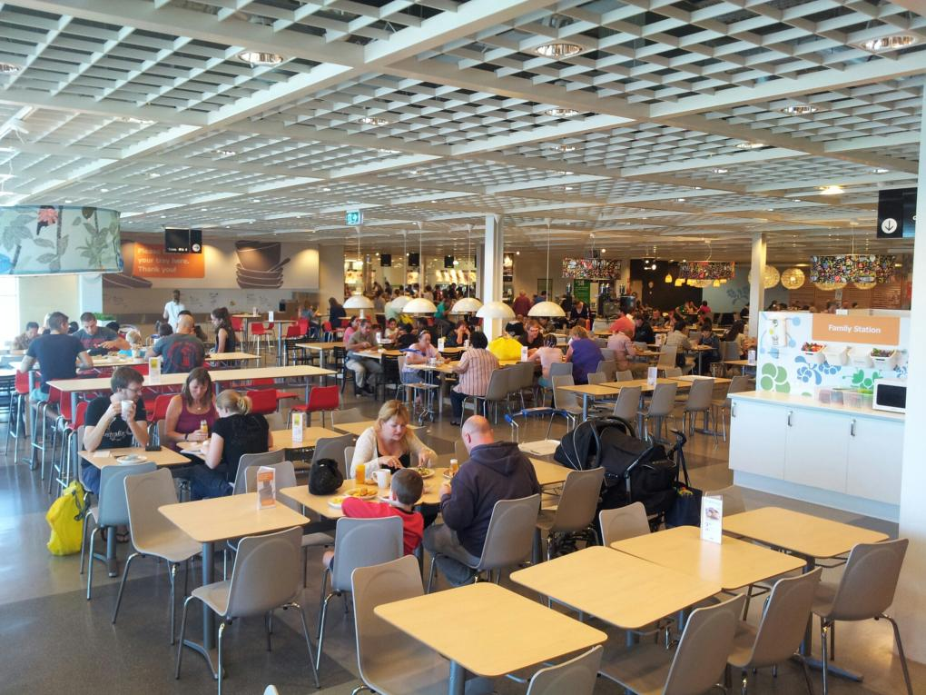
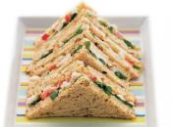
During lunch…
Charlie, what do you want to have for lunch?
Do you mind having sandwiches?
It’s fine!

Slide 8
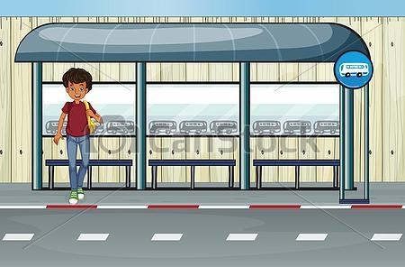
After school
Lucy, your bag looks very heavy. Let me help you.
No problem!
Oh, thank you, Charlie!

