Slide 1
I am Fire (by Jean Marzollo)
Cheng, Baoqiong Paula;
Li, Zijia Sharon
The Education University of Hong Kong

Slide 2
Cover Page
What is on the candle?
Read this book about “fire uses” & “fire safety”.

Slide 3
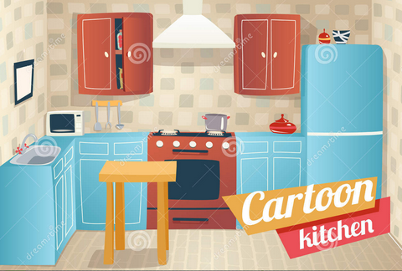
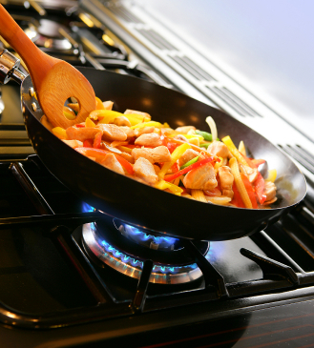
What can fire do?
cook food
kitchen

Slide 4
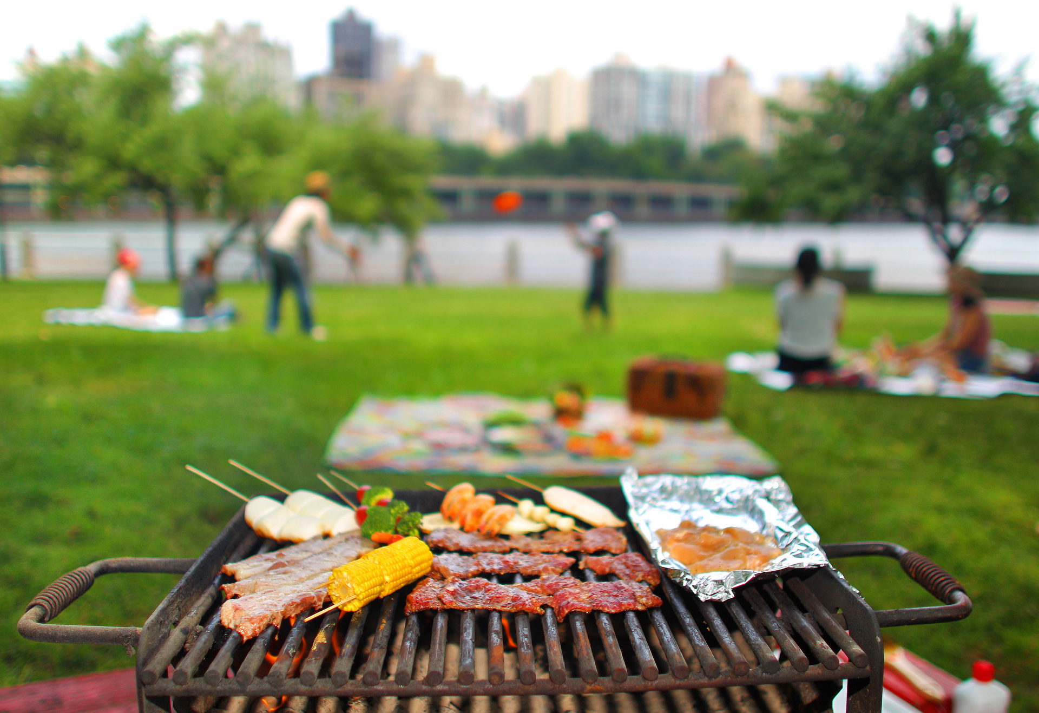
What can fire do?
barbeque (BBQ)

Slide 5
What can fire do?

Slide 6
https://www.youtube.com/watch?v=Yo5a22-qgq4
Let’s find out what the author says about fire uses!

Slide 7
P. 4
Fire heats your soup.

Slide 8
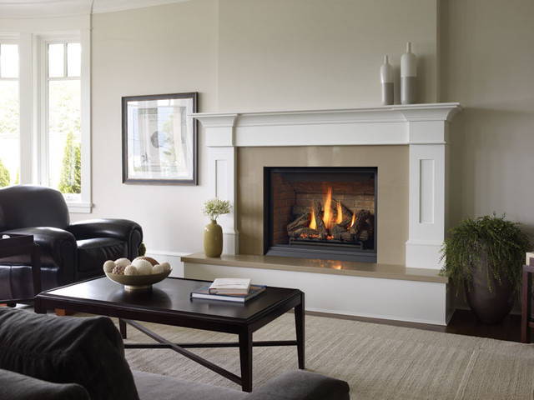
P. 5
Fire warms your rooms.

Slide 9
P. 6
Fire lights your life.

Slide 10
P. 4
Fire heats your soup.

Slide 11
P. 5
Fire warms your rooms.

Slide 12
P. 6
Fire lights your life.

Slide 13
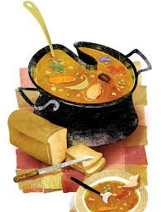
(verb) heat soup/milk make something hot or warm
e.g. My mother heats chicken soup in the pot.

Slide 14
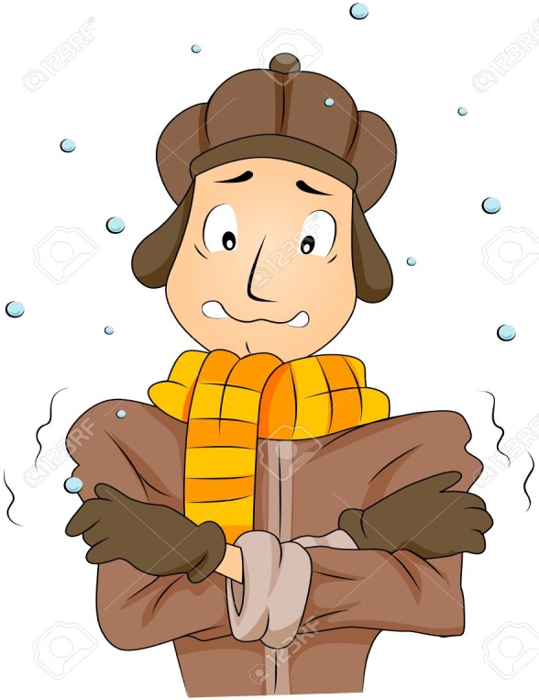
(verb) warm one’s room/body
stop feeling cold and start to feel hotter
e.g. The blanket warms my body.

Slide 15
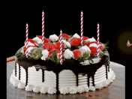
(verb) light matches/candles make something start to burn
matches
e.g. Tim lights candles on his birthday cake.

Slide 16
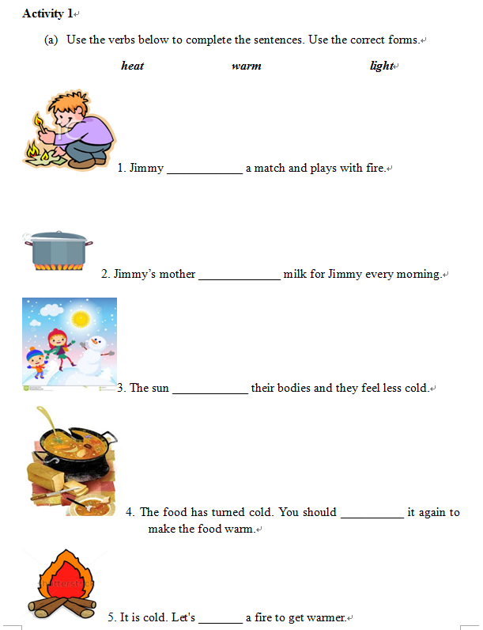

Slide 17
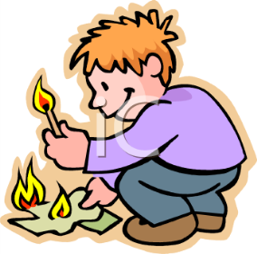
Use the verbs below to complete the sentences. Use the correct forms.
heat warm light
lights
1. Jimmy ____________ a match and plays with fire.

Slide 18
Answers for Activity 1 (a):
heats
2. Jimmy’s mother _____________ milk for Jimmy every morning.
3. The sun ____________ their bodies and they feel less cold.
4. The food has turned cold. You should __________ it again to make the food hot.
5. It is cold. Let's _______ a fire to get warmer.
warms
heat
light

Slide 19
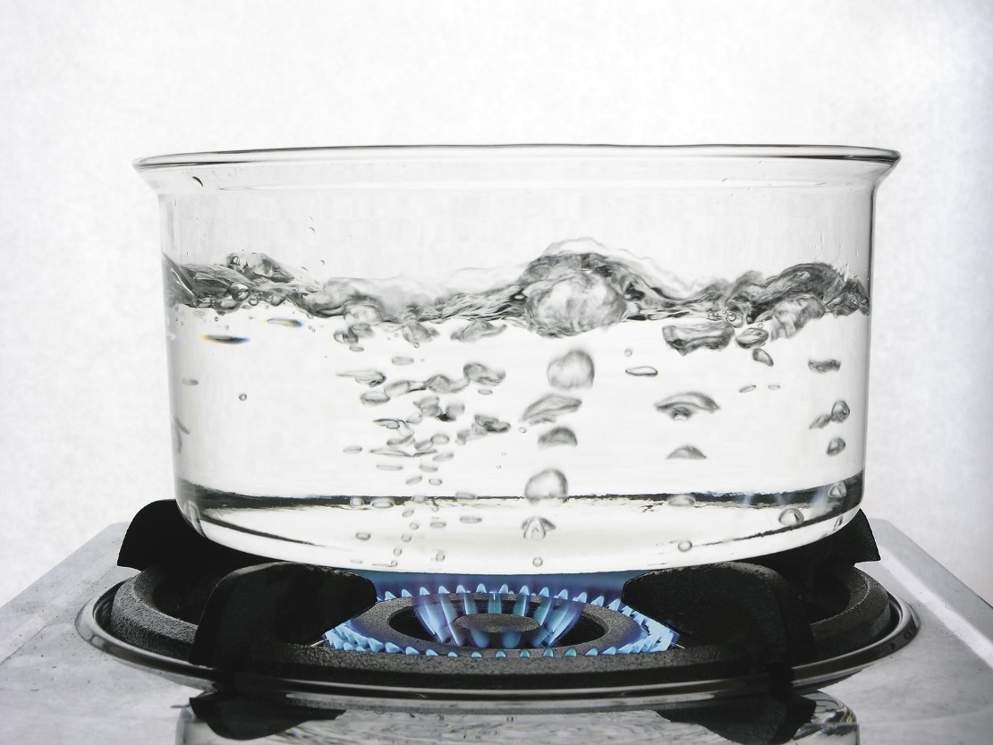
Other uses of fire:
boil water
Gas fire can _____ _____.

Slide 20
Fire can make a ______.
torch

Slide 21
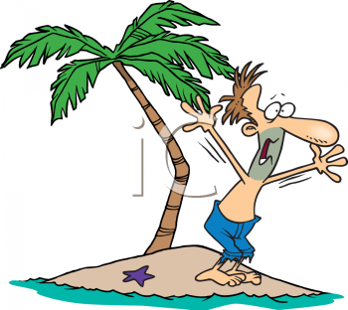
Fire can be a signal for _____.
help

Slide 22
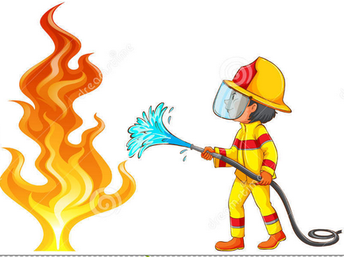
P. 7
But watch out! Fire can be harmful.

Slide 23
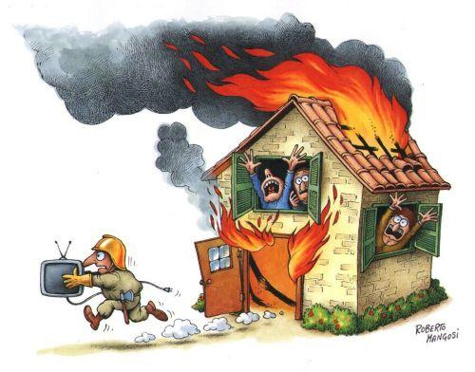
watch out = be careful
e.g. Watch out! The house is on fire.

Slide 24
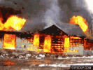
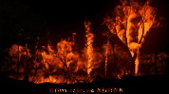

Slide 25
Fire is dangerous!

Slide 26
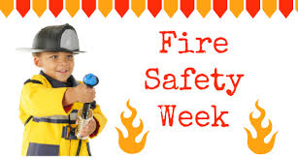
What should we do to prevent fire?

Slide 27
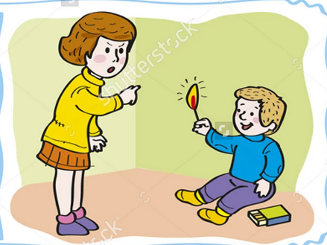
(verb) prevent fire stop something from happening
e.g. Mother tells Tom not to play with matches to prevent fire.

Slide 28
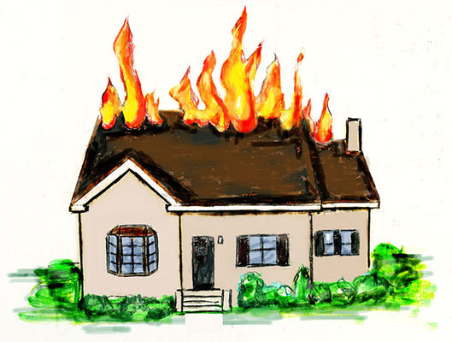
What should you do to prevent fire at home?

Slide 29
p.8
Children can help to prevent fires.
If you find matches,
give them to a grown-up.
Do not try to light them.
What should you do?

Slide 30
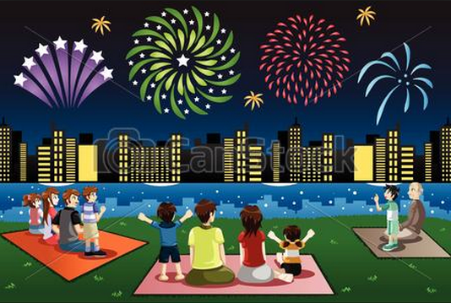
p. 9
Watch fireworks with a grown-up. Stay way back.

Slide 31
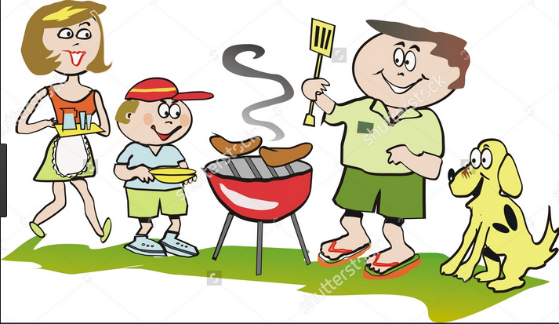
p. 10
Fire is hot.
Don't touch fire.
Don't touch hot things. Just look.
Should you touch fire or hot things?

Slide 32
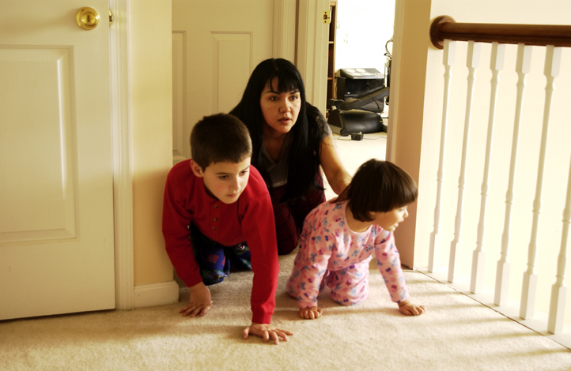
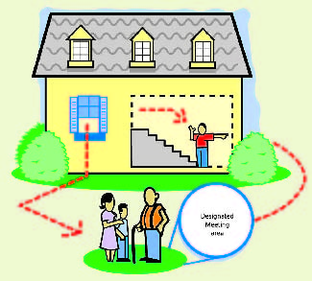
p. 11
What are they doing?

Slide 33
p. 12
Have a place to meet.

Slide 34
p. 13
Practice fire drills at school, too.

Slide 35
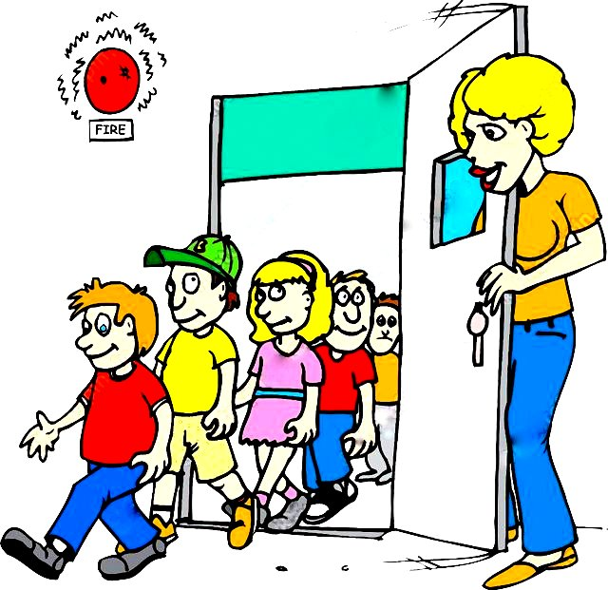
(verb) practise fire drills to do an activity regularly
e.g. Students practise fire drills with teachers.

Slide 36
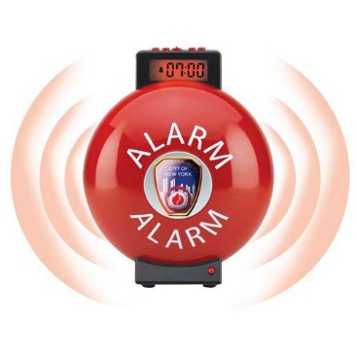
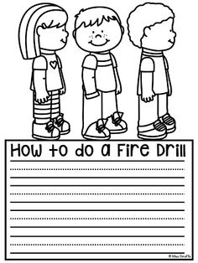
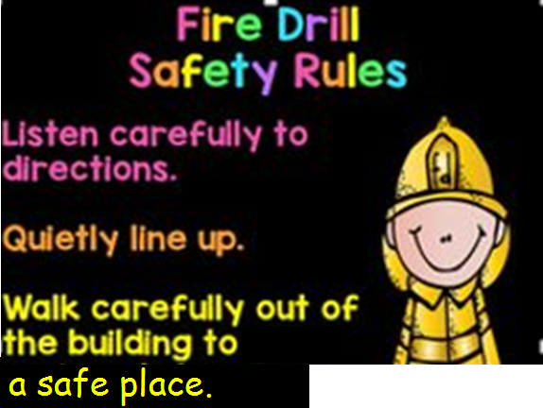
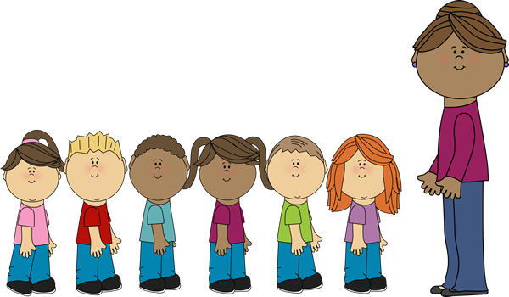

Slide 37
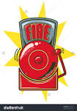
When a fire breaks out, what should we do?

Slide 38
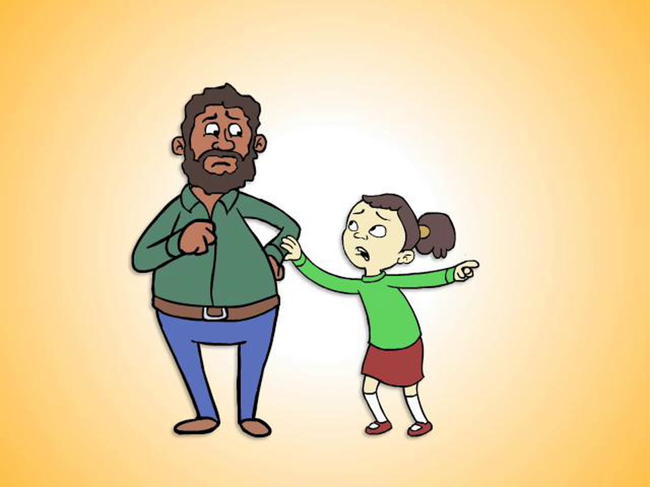
p. 14
If you see a fire start,
tell a grown-up quickly.

Slide 39
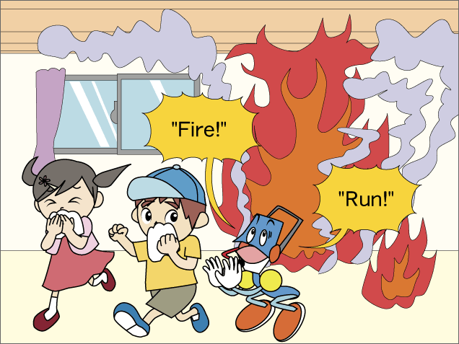
p. 15
If you are inside a building that's on fire, go out.

Slide 40
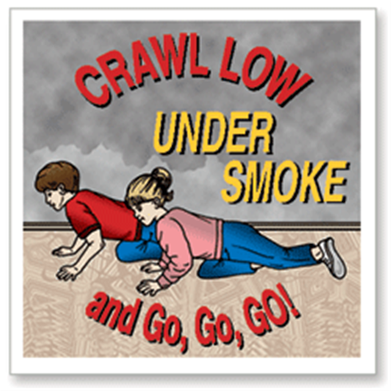
p. 15
If there is smoke, crawl under it. Stay low and go.
Don't go back inside.

Slide 41
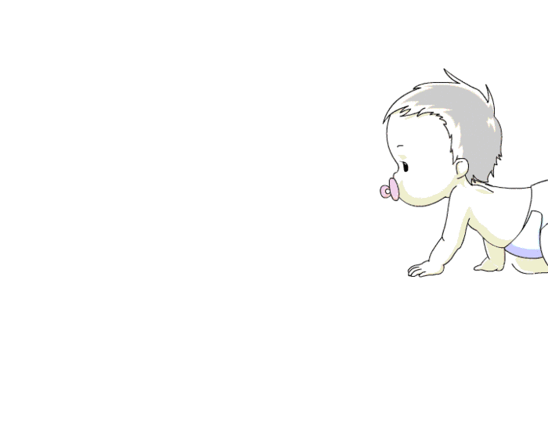
(verb) crawl under smoke to move forward on hands and knees

Slide 42
p. 16
If your clothes are on fire,
stop where you are.
Drop to the ground.
Roll over and over to smother the flames.
Remember these three words.
Stop. Drop. Roll.

Slide 43
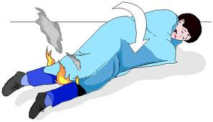
（verb）smother a fire to make a fire stop burning by covering it with something.

Slide 44
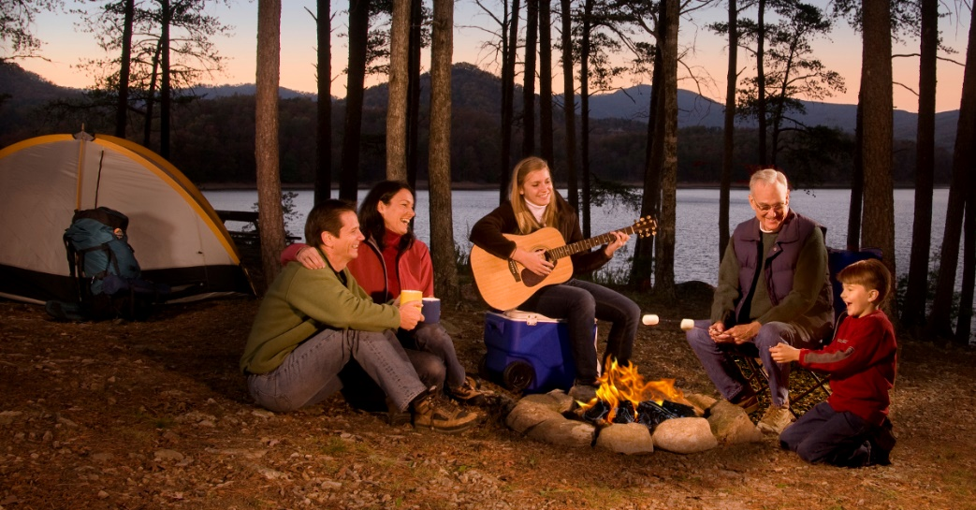
p. 17
If you want to know more about fire, ask a grown-up.

Slide 45
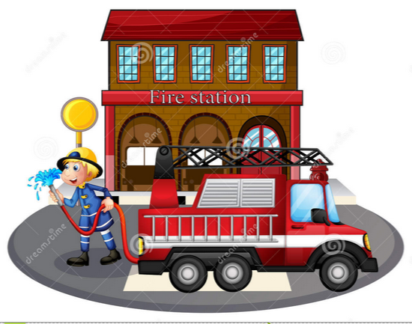
p. 18
Learn how to call the fire department where you live.

Slide 46
Revision
When a fire breaks out, what should we do?

Slide 47
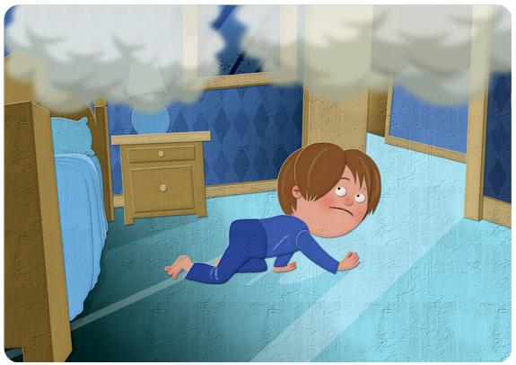
e.g. If the house is on fire, children should crawl under the smoke towards the door.

Slide 48
If your clothes are on fire,
stop where you are
drop to the ground
roll over and over
e.g. When your clothes are on fire, stop where you are, drop to the ground and roll over and over until the fire is out.

Slide 49
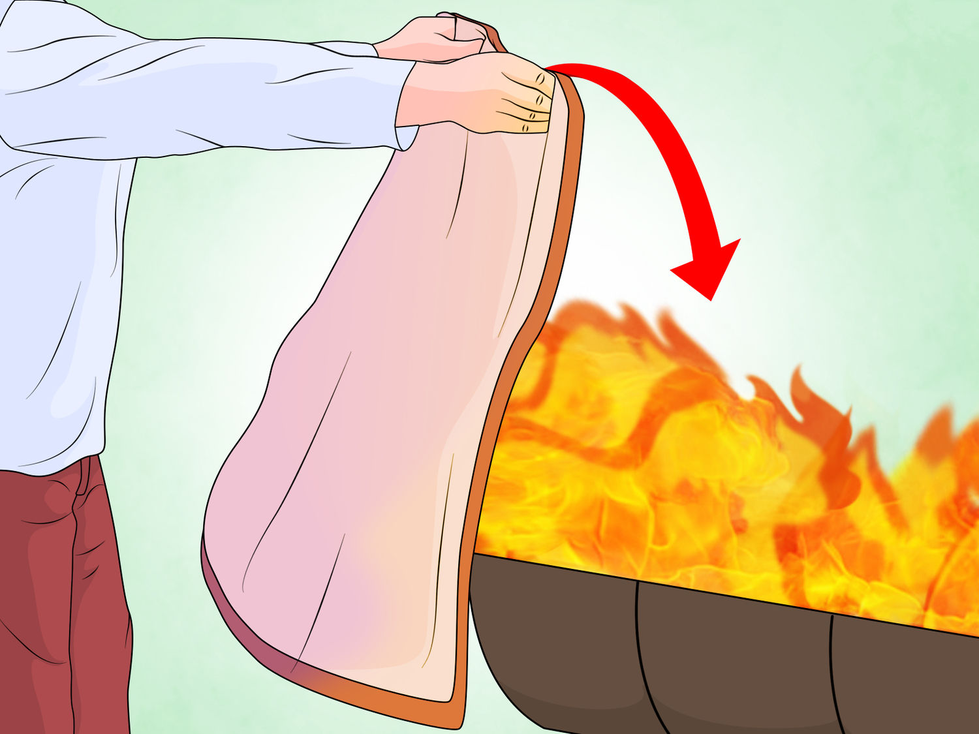
e.g. Tim’s father used a fire blanket to smother the fire.

Slide 50
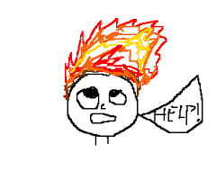
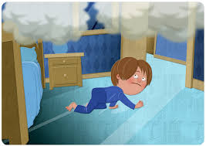
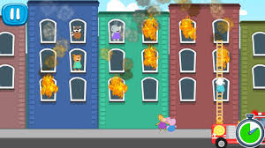
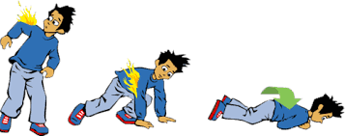
Fire Song
See a fire
Tell a grown-up
There is smoke
Crawl and go
A building on fire
go outside
Clothes on fire
Stop, drop, and roll

Slide 51
Bingo game
Prepare several sets of cards with different sentences on each card.
Give one card to each student.
Teacher reads out the selected verbs one by one.
Ss check if the verbs can fill in the blank in each sentence.
The student who first completes all the sentences on the card should say ‘Bingo!’ and then read aloud the sentences.
Other students decide whether the answers are correct.

Slide 52
Bingo Game
Examples:
Card 1
Fire is harmful, so we should learn how to _____ fire.
Students ______ fire drills at school once a month.
Children should ______ under the fire when the house is on fire.
Card 2
When your clothes are on fire, _____ where you are.
When your clothes are on fire, ______ to the ground.
When your clothes are on fire, ______ over and over.

Slide 53
Bingo Game
Card 3
Children should not ______ matches by themselves.
Two cups of hot milk _______ my body.
My parents _______ chicken soup in the pot.

Slide 54
Activity 2 (a) What should/shouldn't you do with fire? The first two have been done as examples.
Do √ | Don't ×
1. Give the matches to a grown-up. | 1. Don't touch fire.
2. | 2.
3. | 3.
4. | 4.

Slide 55
Do √ | Don't ×
1. Give the matches to a grown-up. | 1. Don't touch fire.
2. Watch out!
2. Do not try to light them (matches).
3. Watch fireworks with a grown-up.
3. Don’t touch hot things.
4. Stay way back.
4. Don’t go back inside.
5. Practice fire drills at home.
6. Tell a grown-up quickly.
7. Stay low and go.
Check Your Answers
8. Go out.
9. Drop to the ground.
10. Roll over and over to smother the flames.
11. Ask a grown-up.
12. Learn how to call the fire department.

Slide 56
Do √ | Don't ×
1. Give the matches to a grown-up. | 1. Don't touch fire.
2. Watch out!
2. Do not try to light them (matches).
3. Watch fireworks with a grown-up.
3. Don’t touch hot things.
4. Stay way back.
4. Don’t go back inside.
5. Practice fire drills at home.
6. Tell a grown-up quickly.
7. Stay low and go.
8. Go out.
9. Drop to the ground.
10. Roll over and over to smother the flames.
11. Ask a grown-up.
12. Learn how to call the fire department.

Slide 57
Activity 2 (b) 1.When you tell people not to do something, you can start the sentence with (Do / Don’t). 2.When you tell people to do something, you can start the sentence with a (verb / noun).

Slide 58
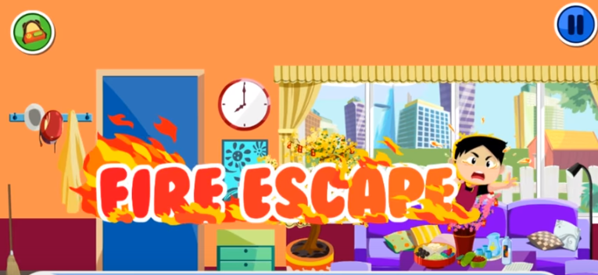
Let’s watch a video about fire safety! (https://www.youtube.com/watch?v=qM8jW4sRfRk&t=1s from 4’20’’ to 11’05’’)

Slide 59
Activity 3
When there is fire
(1) Try to extinguish (put out) the fire.
Shout to alert people.
Cry and wait until the flame is off.
(2) Find the way out immediately.
Hide inside a refrigerator.
Find Saving Pig and bring it together.
×
√
×
√
×
×

Slide 60
Activity 3
When there is smoke
(3) Use a wet towel to cover your mouth and nose.
Cover your mouth. Breathe with your nose.
Do nothing and breathe as usual.
(4) Find the phone and call Mom.
Stay low and creep along the wall.
Stand up and run out.
√
×
×
×
√
×

Slide 61
Activity 3
If there is lots of fire outside the door
(5) Open the door and run away immediately.
Hide under the bed.
Find a wet cloth and cover your mouth and nose.
(6) Keep running out.
Close the door and block it with wet clothes.
Open the door and wait for help.
Call 119 (the emergency number).
×
×
√
×
√
×
√

Slide 62
Activity 3
When there is fire on your clothes
(7) Use your hands to put out the flame.
Lie down and roll back and forth to put out the flame.
×
√

Slide 63
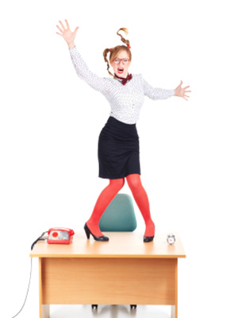
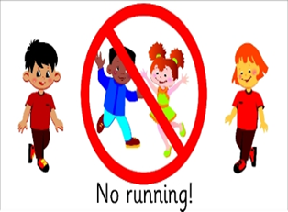
(1) School Safety
Safety measures

Slide 64
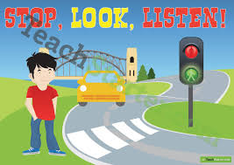
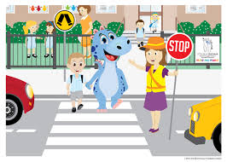
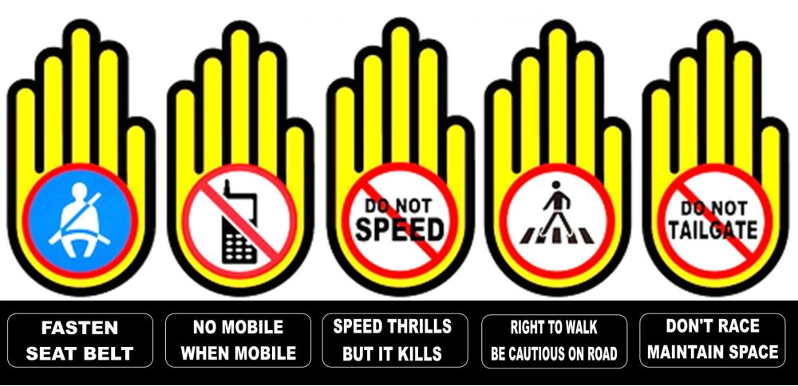
(2) Road Safety

Slide 65
(3) Water Safety

Slide 66
Let’s design a poster!
_________ safety tips
do
don’t

