Slide 1
Lesson 1: Move our hands and legs!
Imperatives – Junior Primary
(Giving Instructions)
POON, Ka Chun Jason; LEE, Fung King Jackie
The Education University of Hong Kong

Slide 2
Listen to a song!
You are going to listen to Hokey Pokey.
Listen, follow and do the actions!

Slide 3
Hokey Pokey
https://www.youtube.com/watch?v=iZinb6rVozc (00:13 – 02:28)

Slide 4
Hokey Pokey
On Worksheet 1, circle ALL the VERBS.
What have you noticed?

Slide 5
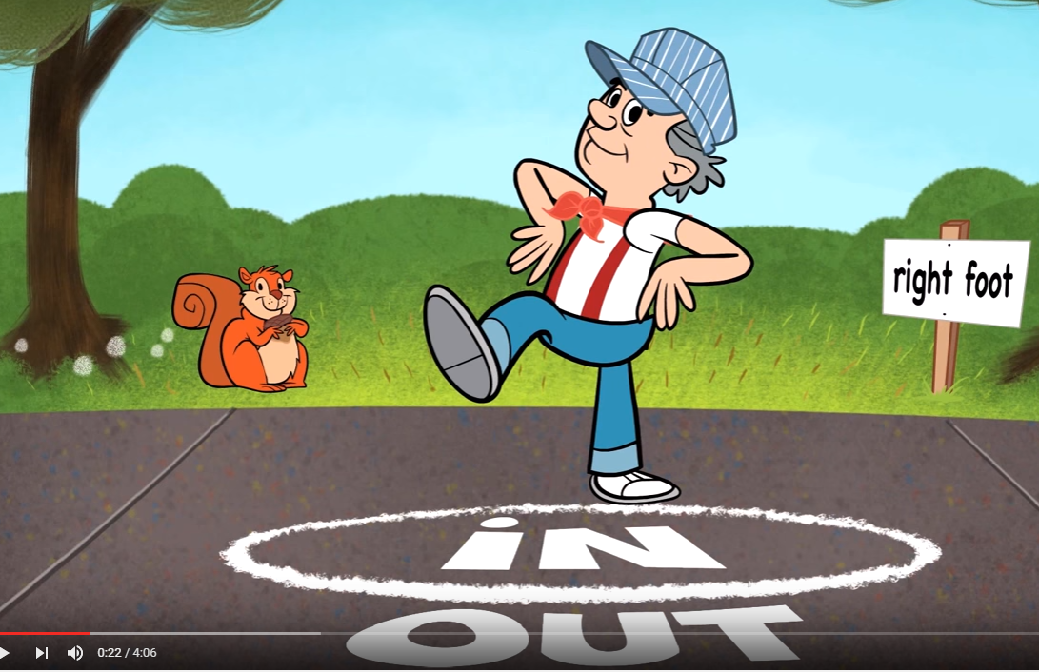
Hokey Pokey
Put your right foot in,
Put your right foot out;
Put your right foot in,
And shake it all about.
Do the Hokey-Pokey,
And turn yourself around.
That's what it's all about!

Slide 6
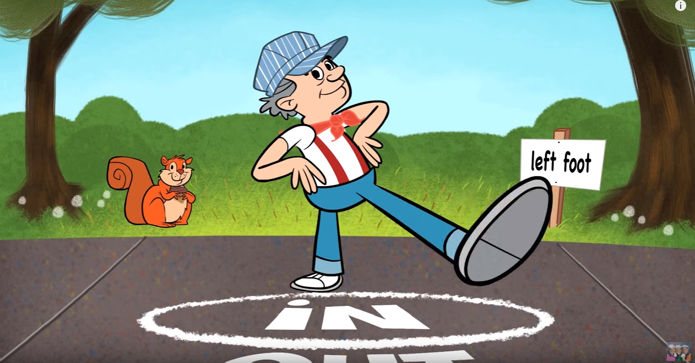
Hokey Pokey
Put your left foot in,
Put your left foot out;
Put your left foot in,
And shake it all about.
Do the Hokey-Pokey,
And turn yourself around.
That's what it's all about!

Slide 7
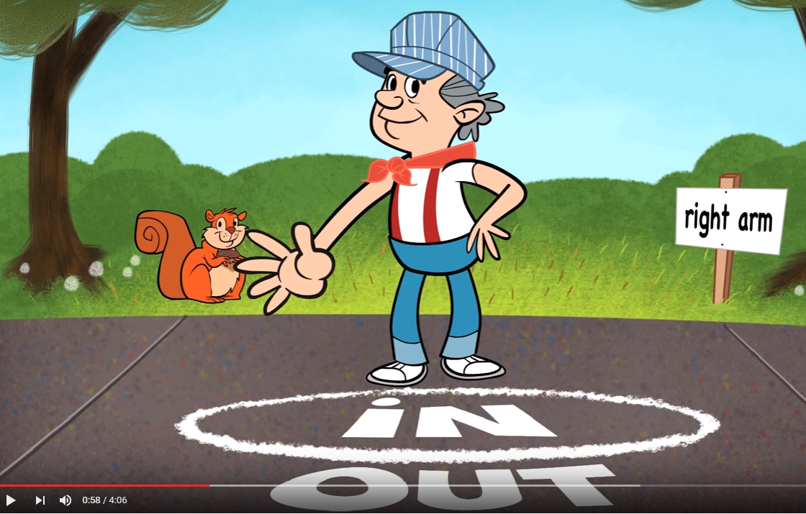
Hokey Pokey
Put your right arm in,
Put your right arm out;
Put your right arm in,
And shake it all about.
Do the Hokey-Pokey,
And turn yourself around.
That's what it's all about!

Slide 8
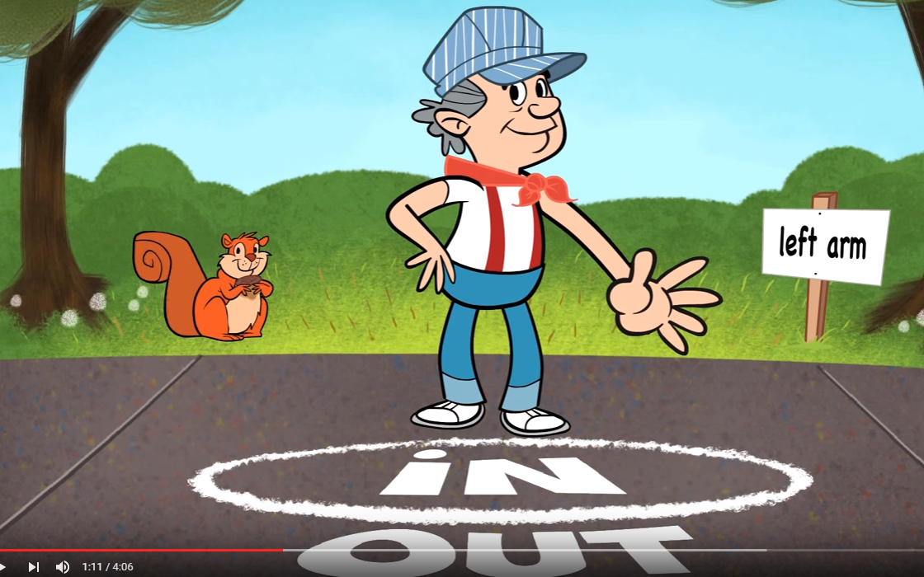
Hokey Pokey
Put your left arm in,
Put your left arm out;
Put your left arm in,
And shake it all about.
Do the Hokey-Pokey,
And turn yourself around.
That's what it's all about!

Slide 9
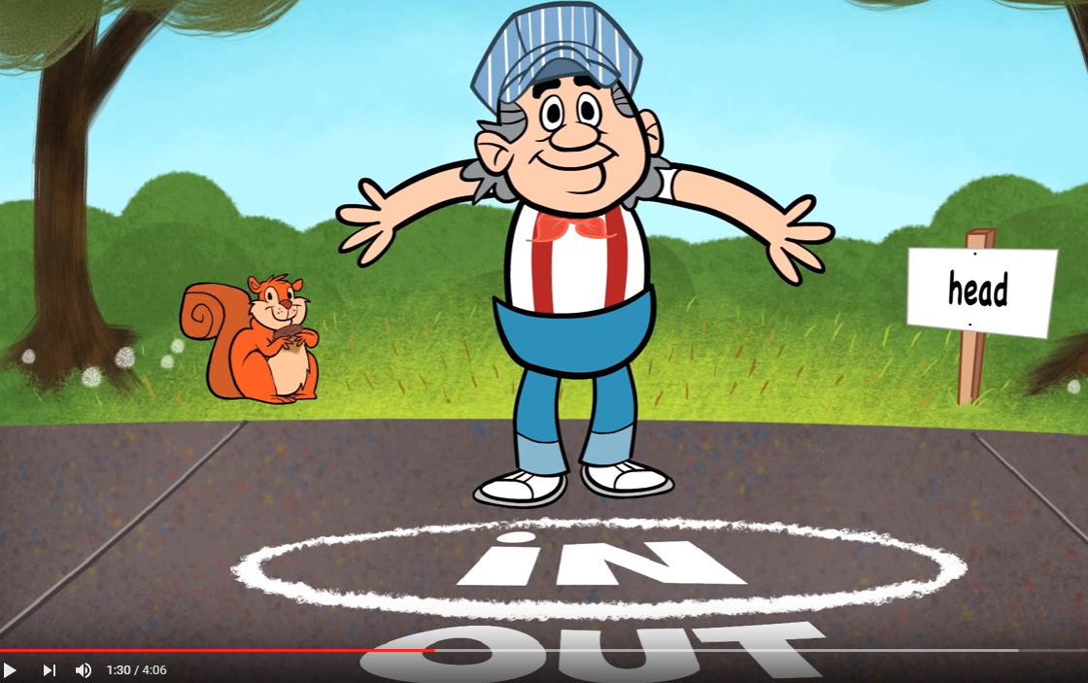
Hokey Pokey
Put your head in,
Put your head out;
Put your head in,
And shake it all about.
Do the Hokey-Pokey,
And turn yourself around.
That's what it's all about!

Slide 10
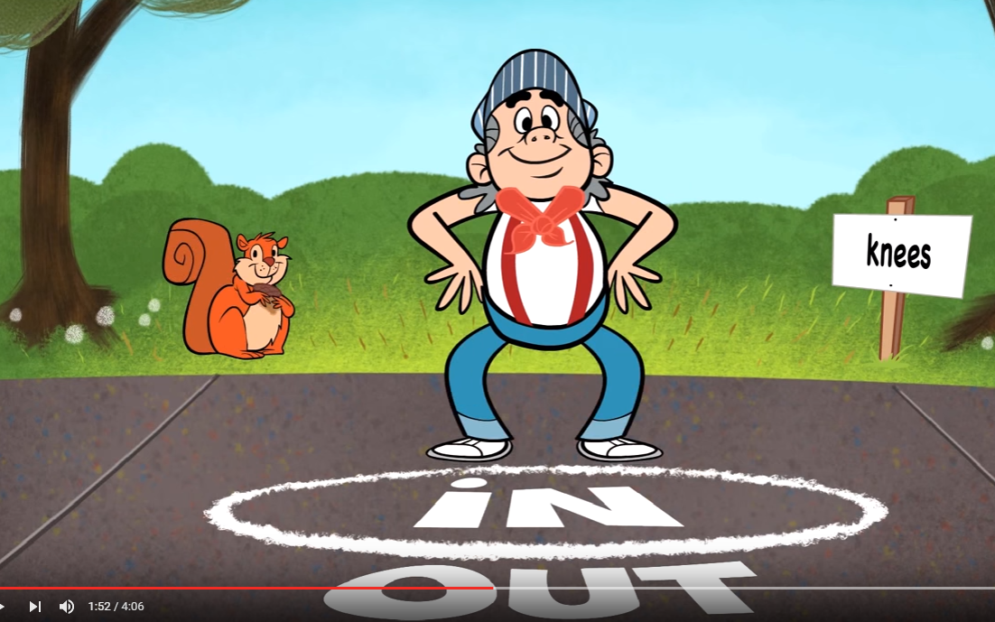
Hokey Pokey
Put your knees in,
Put your knees out;
Put your knees in,
And shake them all about.
Do the Hokey-Pokey,
And turn yourself around.
That's what it's all about!

Slide 11
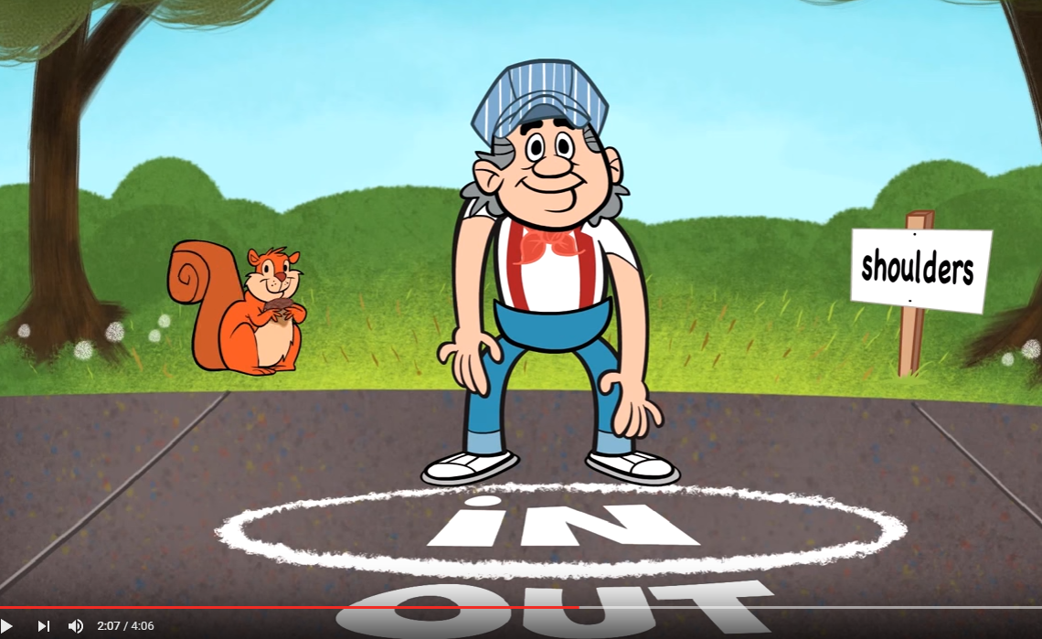
Hokey Pokey
Put your shoulders in,
Put your shoulders out;
Put your shoulders in,
And shake them all about.
Do the Hokey-Pokey,
And turn yourself around.
That's what it's all about!

Slide 12
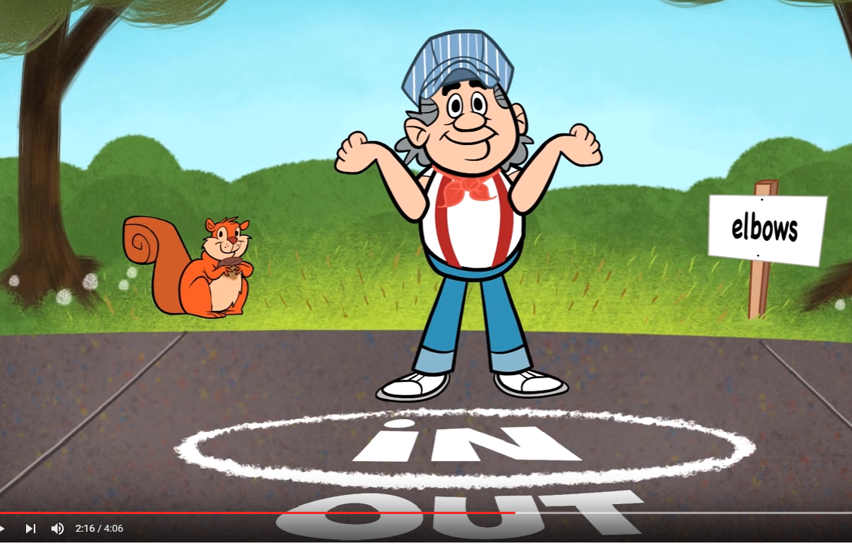
Hokey Pokey
Put your elbows in,
Put your elbows out;
Put your elbows in,
And shake them all about.
Do the Hokey-Pokey,
And turn yourself around.
That's what it's all about!

Slide 13
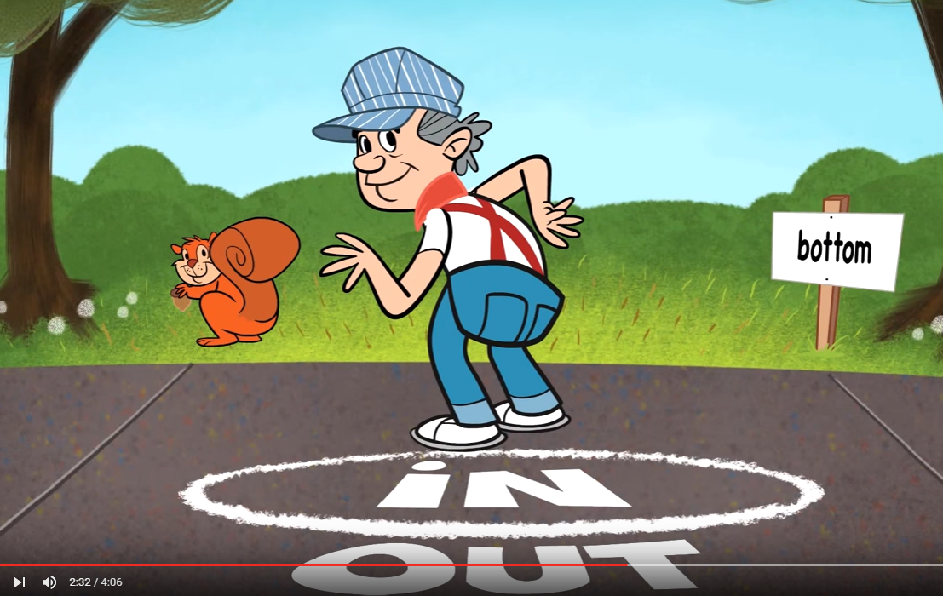
Hokey Pokey
Put your bottom in,
Put your bottom out;
Put your bottom in,
And shake it all about.
Do the Hokey-Pokey,
And turn yourself around.
That's what it's all about!

Slide 14
(verb) + …
To tell somebody what to do, we may start the sentence with a base verb,
Examples:
Keep quiet.
Open your book and turn to page 4.

Slide 15
Brainstorming…
What can you do with your hands, arms, legs and feet?
Learn some action verbs!

Slide 16
beckon with my hand

Slide 17
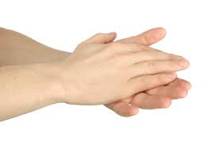
clap my hands

Slide 18
jump

Slide 19
knock

Slide 20
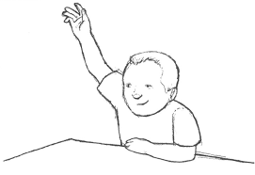
put up my hand

Slide 21
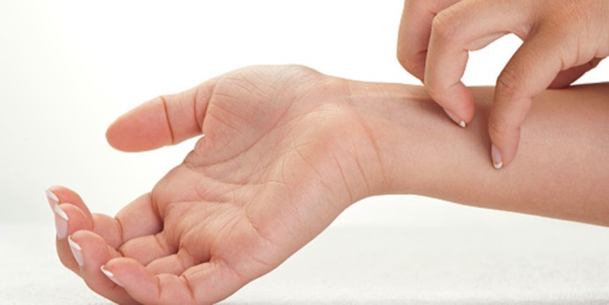
scratch my skin

Slide 22
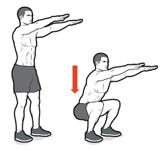
squat (down)

Slide 23
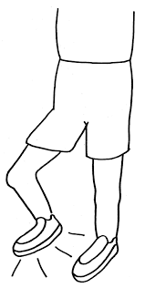
stamp my feet

Slide 24
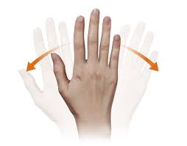
wave my hand

Slide 25
Worksheet 2
Match the action verbs with the pictures.
beckon
clap
jump

Slide 26
Worksheet 2
Match the action verbs with the pictures.
knock
put up
scratch

Slide 27
Worksheet 2
Match the action verbs with the pictures.
squat
stamp
wave

Slide 28
Game: “Someone Says”
Listen to your teacher’s or a classmate’s instructions and do the actions.
Remember: Start each instruction with a base verb!
e.g. Mr Poon says, ‘Put up your hand.’

Slide 29
Worksheet 3
Read the sentences.
Fill in the blanks with the correct forms of the verbs given.

Slide 30
Worksheet 3
Many students are shouting their answers in their seats. “____________ your hand first,” said Mr. Chan.
Angel has a mosquito bite. “Don’t ____________ it, Angel!” said her mother.
Put up
scratch

Slide 31
Worksheet 3
Charlie wants to call Don, but Don cannot hear. “____________ him over with your hand,” said Miss Lam.
Kenny is waiting for the bus no. 25. His mum sees the bus coming. “Kenny, the bus is coming. ___________ your hand!” said his mum.
Beckon
Wave

Slide 32
Worksheet 3
Jack goes back to the classroom. “____________ the door before you come in,” said Miss Chow.
Knock

Slide 33
Activity: “Listen and Do”
Each of you will get a paper strip.
Write down an instruction with a verb you know or you have just learned in the lesson.

Slide 34
Activity: “Listen and Do”
You must write in a complete sentence!
Your sentence should begin with a verb!
The action can be done by students in class.
The action must not be dangerous, e.g. X fight, X kick, X hit, …

Slide 35
Activity: “Listen and Do”
Put the strip into your teacher’s bag.
I will draw some strips, or invite you to come out and draw them.
Read the instruction to the class.

Slide 36
Activity: “Listen and Do”
Some of you will be chosen and do the action following the instruction.
The others have to judge if the action is correctly done.
Here we go!

Slide 37
Worksheet 4 (Homework)
Read the sentences.
Fill in the blanks with the correct forms of the verbs given.

Slide 38
We have learned …
We may use ‘(verb) + …’ to tell others what to do.
We use the base form of the verb.

