Slide 1
Lesson 2: Visiting Disneyland Park
Imperatives - Primary
(Giving Directions)
POON, Ka Chun Jason; LEE, Fung King Jackie
The Education University of Hong Kong

Slide 2
Have you ever…
asked someone for directions?
e.g. How can I go to … from here?
met someone who doesn’t know the way?
e.g. How can I go to … from here?
How did you reply?

Slide 3
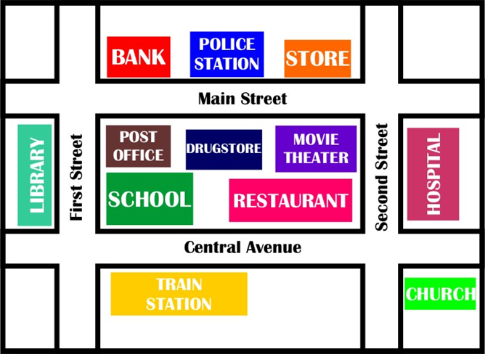
Have you ever read a map?
When do you need a map?
Store
Library
School
Restaurant
Train Station
Church
http://nadyo-nadyo.blogspot.hk/2010_12_03_archive.html

Slide 4
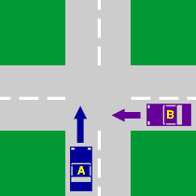
walk straight along

Slide 5
turn left

Slide 6
turn right

Slide 7
take the first turning (on your left/right)

Slide 8
take the second turning (on your left/right)

Slide 9
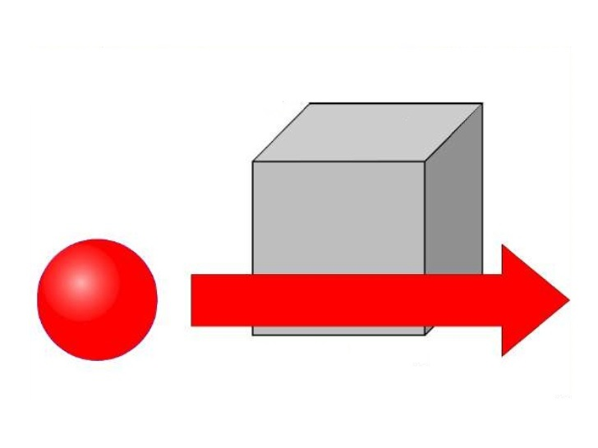
go past

Slide 10
How to give directions (I)
Store
Library
School
Restaurant
Train Station
Church
How can I get to the library from the church?

Slide 11
How to give directions (I)
Store
Library
School
Restaurant
Train Station
Church
Get out of the church and turn left.

Slide 12
How to give directions (I)
Store
Library
School
Restaurant
Train Station
Church
Walk straight along Central Avenue.

Slide 13
How to give directions (I)
Store
Library
School
Restaurant
Train Station
Church
Go past the restaurant and the school.

Slide 14
How to give directions (I)
Store
Library
School
Restaurant
Train Station
Church
Turn right into First Street.

Slide 15
How to give directions (I)
Store
Library
School
Restaurant
Train Station
Church
The library is on your left.

Slide 16
How to give directions (II)
Store
Library
School
Restaurant
Train Station
Church
How can I get to the school from the store?

Slide 17
How to give directions (II)
Store
Library
School
Restaurant
Train Station
Church
Get out of the store and turn left.

Slide 18
How to give directions (II)
Store
Library
School
Restaurant
Train Station
Church
Take the first turning on the right.

Slide 19
How to give directions (II)
Store
Library
School
Restaurant
Train Station
Church
Walk straight along Second Street.

Slide 20
How to give directions (II)
Store
Library
School
Restaurant
Train Station
Church
Turn right into General Avenue.

Slide 21
How to give directions (II)
Store
Library
School
Restaurant
Train Station
Church
Go past the restaurant.

Slide 22
How to give directions (II)
Store
Library
School
Restaurant
Train Station
Church
The school is on your right.

Slide 23
Activity 1
Read the map on Worksheet 1.
Fill in the blanks with suitable words to give directions.
Hint:
Start your direction with a base verb!

Slide 24
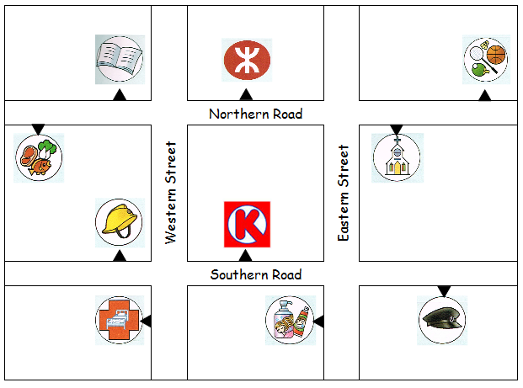
Activity 1

Slide 25
Activity 1 – Q1
Get out of the sports centre and turn right. Walk straight along Northern Road. Take the second turning on the left. Walk straight along Western Street. The hospital is on your right.

Slide 26
Activity 1 – Q2
Get out of the fire station and turn left. Walk straight along Southern Road. Go past the convenience store. Turn left into Eastern Street. Take the first turning on the right. Go past the church. The sports centre is on your left.

Slide 27
Activity 1 – Q3
Get out of the library and turn left. Walk straight along Northern Road. Take the second turning on the right. Walk straight along Eastern Street. The supermarket is on your right.

Slide 28
Activity 1 – Q4
Get out of the church and turn left. Take the first turning on the left. Walk straight along Eastern Street. Turn left into Southern Road. Walk straight along the road. The police station is on your right.

Slide 29
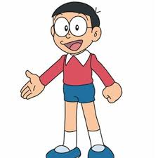
Activity 2
You are Sue and Noby. You are visiting Disneyland Park together!
You want to take photos with some cartoon characters. But you don’t know where they are!

Slide 30
In Disneyland Park

Slide 31
Activity 2
Get into pairs.
One of you gets Worksheet 2A.
One of you gets Worksheet 2B.
You get different maps.
Read your own map.
Do NOT read your friend’s map!

Slide 32
Activity 2
Find out who Noby / Sue wants to take photos with.
Be ready to take turns to ask questions and give directions.

Slide 33
Activity 2
Ask your friend for the directions. Follow the instructions to find the characters.
Complete the map by putting down the names of the cartoon characters in the circles.
Excuse me. Where can I find …?

Slide 34
Activity 2
When your partner asks you for directions, give him/her instructions to find the characters. Use the information given in your map.
Hint:
Start your direction with a base verb!

Slide 35
Activity 2
Don’t forget to choose the shortest route!
Let’s start!

Slide 36
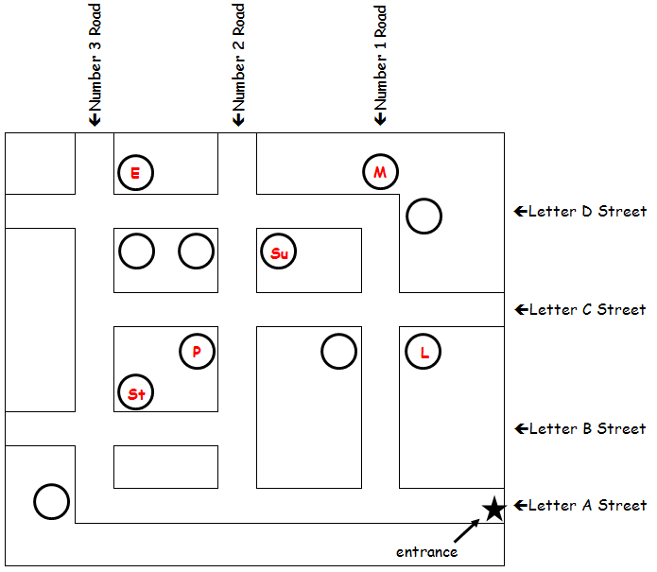
Activity 2: Answers
E
M
Su
P
L
St

Slide 37
Activity 2: Worksheet 2C
You and your partner have completed the map now.
Some cartoon characters do not know where their friends are and want to find them.
Can you help them to find their friends? Work with a partner, and give the correct directions.

Slide 38
Activity 2: Worksheet 2C
Excuse me. We want to find Stitch. Which direction should we go?

Slide 39
Activity 2: Worksheet 2C
???

Slide 40
Activity 2: Worksheet 2C
Walk straight along Letter D Street. Go past Sulley. Then, turn left into Number 3 Road. Walk straight along the road. You will see Stitch on your left.

Slide 41
Activity 2: Worksheet 2C
Excuse me. We want to find Little Green Man.
Which direction should we go?

Slide 42
Activity 2: Worksheet 2C
???

Slide 43
Activity 2: Worksheet 2C
Walk straight along Letter D Road. Take the second turning on the right. Walk straight along Number 1 Road.
Little Green Man is on your left.

Slide 44
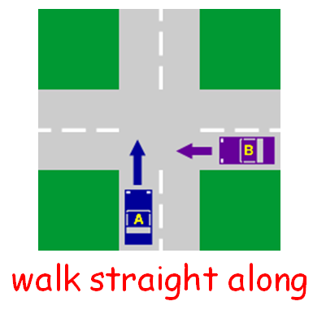
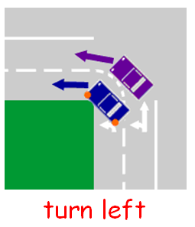
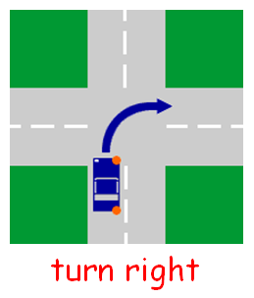
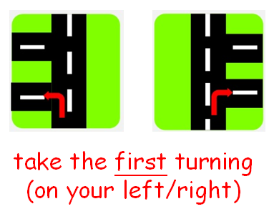
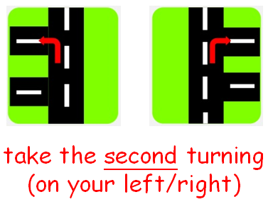
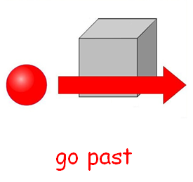
What have we learned today?
We have learned how to give directions!

