Slide 1
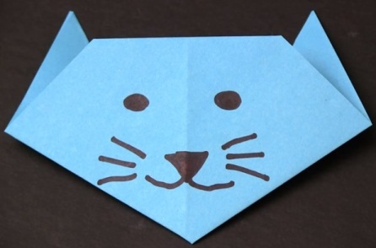
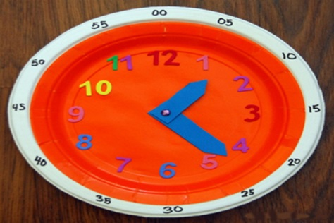
Lesson 3: Make it ourselves!
Imperatives - Primary
(Giving Instructions & Writing Procedures)
POON, Ka Chun Jason; LEE, Fung King Jackie
The Education University of Hong Kong

Slide 2
Activity 1: Watch the video!
https://www.youtube.com/watch?v=V2R_s9nsaF4

Slide 3
Let’s discuss…
What was made in the video?
How did the person make it?
What thing(s) did s/he use?
A paper cat face.
First, s/he folded the paper step-by-step. Then, s/he drew the cat’s face.
A piece of square paper and a marker.

Slide 4
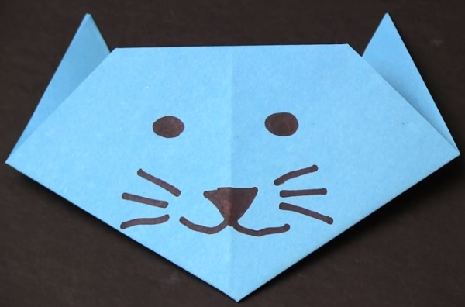
Let’s discuss…
Now you want to teach your friend how to make a paper cat face. But you cannot show him/her this video.
What should you do? How will you teach your friend?

Slide 5
Let’s discuss…
We need to tell our friends the steps of making the paper cat face.
We show each step to help them understand how to make it.

Slide 6
Step 1: Fold the paper in half twice.

Slide 7
Step 2: Unfold the paper.

Slide 8
Step 3: Fold a small triangle.

Slide 9
Step 4: Fold again to make the ear.

Slide 10
Step 5: Do the same for the other side.

Slide 11
Step 6: Flatten the cat face.

Slide 12
Step 7: Turn it over and get the face.

Slide 13
Step 8: Draw the eyes, nose and mouth.

Slide 14
Step 9: Colour the cat.

Slide 15
Activity 2: What is this?

Slide 16
Let’s brainstorm…
What is this?
How can you make it?
What do you need to make it?

Slide 17
Pay attention now!
Your teacher is going to make the clock in front of you!
Look at your teacher carefully.

Slide 18
Your task!
Get ready for Worksheet 1.
You are going to write a procedure text.
It tells you how to make something.
We will do it together!

Slide 19
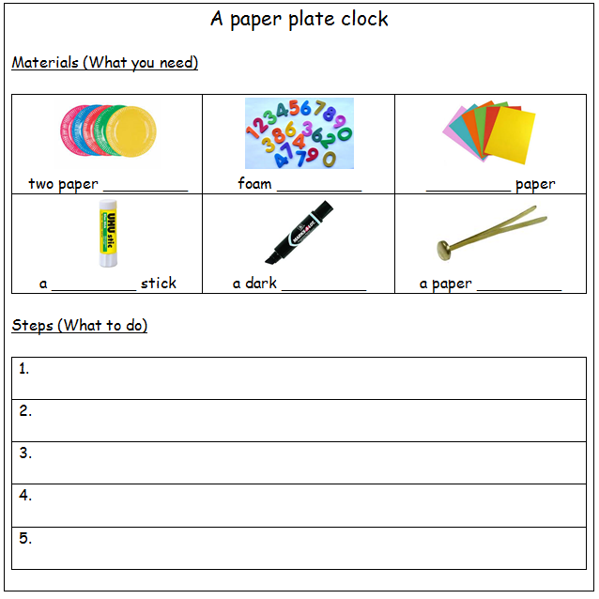

Slide 20
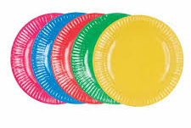
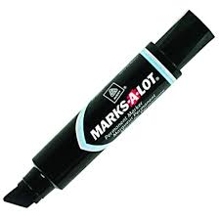
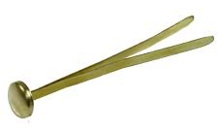
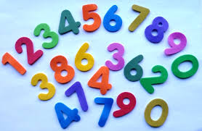
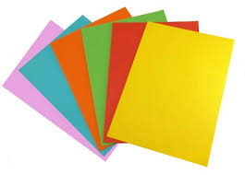
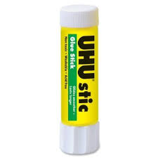
Materials
What are on the teacher’s desk?

Slide 21
paper plates

Slide 22
foam numbers

Slide 23
colour paper

Slide 24
a glue stick

Slide 25
a marker

Slide 26
a paper fastener

Slide 27
Steps
Look at your teacher carefully now!
“What is this step?”
Write down the steps of making the clock on the worksheet.
Hint:
Start each sentence with a base verb!

Slide 28
Steps
Glue the two plates together, one on top of the other.
Stick the numbers in the proper places.
Write out the minutes with the marker.

Slide 29
Steps
Cut out the hour and minute hands using the coloured paper.
Fasten them to the centre of the plate.

Slide 30
Extended Activity: Show and Tell
What can you make?
Surf the Net and find some information, if needed.
Show us something and teach us how to make it.
Write down the materials and steps required.
Complete Worksheet 2 and share your work with us in the next lesson!

