Slide 1

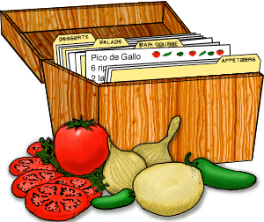
Imperatives (Lesson 1) -
give instructions
Recipes
Jiang, Zhengxin Janet; Lee, Fung King Jackie
The Education University of Hong Kong

Slide 2


A group of foreign visitors is visiting the school for cultural exchange.
You will share with each other your favourite dish / a dish that can best represent the local culture.

Slide 3
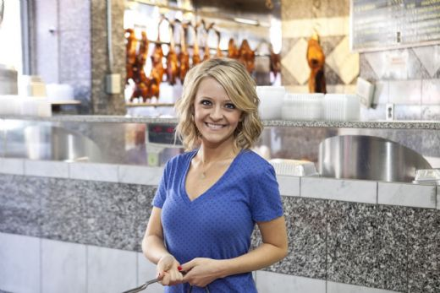


1) Kelsey, one of the visitors, will show you how to cook her favourite dish. Read the recipe. What is the dish she will cook?
Lemon Baked Salmon

Slide 4

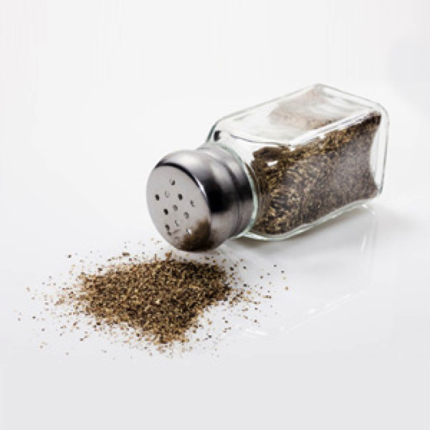
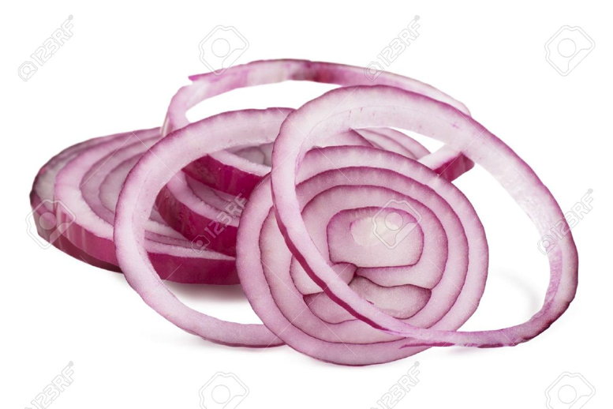
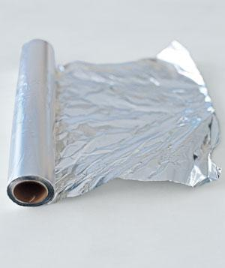
Do you know ...?
Salmon fillet
onion slices
ground pepper
foil

Slide 5

2) You want to learn how to cook the dish. Complete the recipe given while watching Kelsey’s demonstration.
(0:53- 5:05’: https://www.youtube.com/watch?v=MlUxP4gY7M8)

Slide 6


3) What information can be found in a recipe?
A recipe tells you how to cook a dish. In a recipe we can find the name of the dish, ingredients and steps to cook the dish.

Slide 7
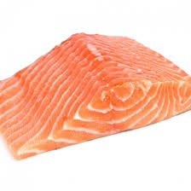
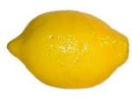


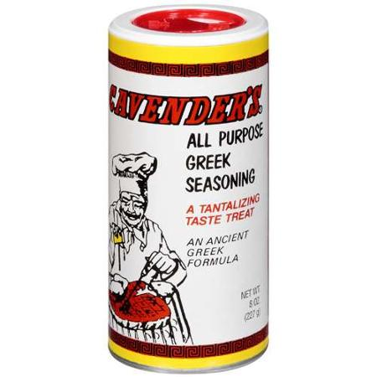
Recipe – Lemon Baked Salmon
Ingredients:
1 salmon fillet
1 lemon
1/2 onion
Salt
Fresh ground pepper
Greek seasoning

Slide 8
Steps
Put the salmon fillet on the foil.
Season salt, fresh ground pepper and Greek seasoning on the salmon fillet.
Squeeze lemon juice onto the salmon fillet.
Layer onion slices on top of the salmon.
Top the fillet with 3 lemon slices.
Fold foil up over the salmon, twist the ends and seal tightly.
Bake for 25 minutes at 325 degrees.

Slide 9
4) Read the steps. What is the first word in each step?
Put, Season, Squeeze, Layer, Top, Fold, Twist, Seal & Bake – verbs in base form (infinitives)
5) What is the subject of these sentences?
There is no subject. The understood subject is “you”.

Slide 10
Steps
Imperatives – give instructions;
start with a base verb form (infinitive)
Put the salmon fillet on the foil.
Season salt, fresh ground pepper and Greek seasoning on the salmon fillet.
Squeeze lemon juice onto the salmon fillet.
Layer onion slices on top of the salmon.
Top the fillet with 3 lemon slices.
Fold foil up over salmon, twist the ends and seal tightly.
Bake for 25 minutes at 325 degrees.

Slide 11

7) Compare the following instructions.
Which set of instructions is normally found in a recipe? Why?
A. Put the salmon fillet on the foil.
B. Could you please put the salmon fillet on the foil?
C. If you want to taste the delicious lemon-baked salmon, the first step you will need to do is to put the salmon fillet on the foil.
√

Slide 12
7) Compare the following instructions.
Which set of instructions is normally found in a recipe? Why?
A. Season salt, fresh ground pepper and Greek seasoning on the salmon fillet.
B. Could you please season salt, fresh ground pepper and Greek seasoning on the salmon fillet?
C. The next step is to season salt, fresh ground pepper and Greek seasoning on your fresh, salmon fillet. This easy step will definitely make your salmon fillet very delicious. This is a step you cannot miss!
√

Slide 13
7) Compare the following instructions.
Which set of instructions is normally found in a recipe? Why?
A. Squeeze lemon juice onto the salmon fillet.
B. Could you please squeeze lemon juice onto the salmon fillet?
C. Now, we will use lemon. You can cut the lemon into two halves. Then squeeze the lemon. Make sure the lemon juice is on the salmon fillet. This step can make your salmon fillet more delicious!
√

Slide 14

Discussion: When Kelsey is doing the cooking demonstration, why doesn’t she use imperatives all the time?

Slide 15

It’s your time to show Kelsey and the visitors how to cook a dish!
No idea about cooking?
  Watch the video and get some ideas, and complete the recipe!
  https://www.youtube.com/watch?v=CjsPTtxpqI4

Slide 16
Chinese Rice Porridge
Ingredients:
Frozen jasmine rice
Pre-cooked meat
Green onions
Chicken broth
Dried scallops
Steps:
1. Boil the water and dried scallops.
Add in the frozen rice.
Cook on high heat for 15 minutes.
4. Add pre-cooked meat and chicken broth.
5. Add salt and green onions. Mix them all together.

