Slide 1
Imperatives (Lesson 2) -
give suggestions / advice
Jiang, Zhengxin Janet; Lee, Fung King Jackie
The Education University of Hong Kong

Slide 2
Last lesson…
We learned how to write a recipe and give instructions using imperatives!
This lesson…
We will learn how to give suggestions using various sentence types!

Slide 3
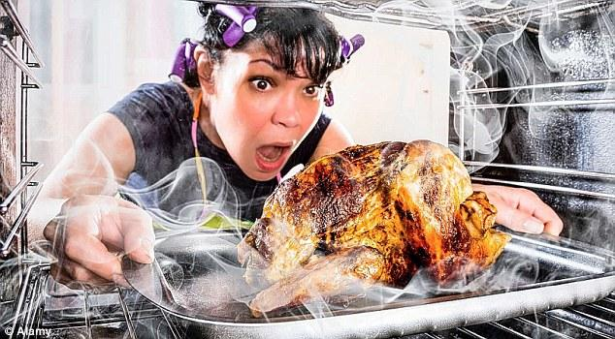
Cooking problems!
You tried some recipes, and found some cooking problems!
You ask your friends Amy and Betty for help. Check what they say!

Slide 4
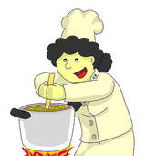
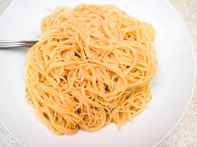
Problem 1
Amy
Cook in a large pot. Use lots of water.
I cooked gummy noodles that stuck together.
Why don’t you use more water? You can cook the noodles in a large pot.
Betty

Slide 5
Problem 2
Amy
Preheat your pan.
My fish fillets turned out soggy, very wet and soft.
You could preheat the pan.
Betty

Slide 6
Problem 3
Amy
Make your oil hot.
My food absorbed too much oil.
If I were you, I would make my oil really hot before panfrying the food.
Betty

Slide 7
1) What sentence type does Amy use in her suggestions?
Imperatives

Slide 8
2) Betty and Amy have given you the same suggestions. But they have used different sentence structures. Whose suggestions sound better to you? Why?

Slide 9
While surfing the internet, you read a post about a boy who feels very stressed and depressed because of heavy schoolwork. Read the reply.

Slide 10
According to Behappy, one should make efforts to be healthy.
John could / should begin with having healthy food to keep healthy.
John could / can / should / ought to do exercise regularly to keep himself energetic.
John could / can / should / ought to play and have fun with his classmates.

Slide 11
To give suggestions
Modal verbs | I, You, He, She, We, etc. | should, could, can, ought to, had better... | Base verb form (e.g. keep, start)
Question form | Why don't’ you …?
Imperative | Have some fun with your friends
Others I know | If I were you, I would …

Slide 12
Read another post on your worksheet and write a reply.
Pay special attention to how to give suggestions.

