Slide 1
Type 1 Conditional
Chau Ka Ying
The Hong Kong Institute of Education

Slide 2
1. When you are unhappy, what will you do?
Who will you turn to?

Slide 3
2.
If you wander off too far,
my love will get you home.
If you follow the wrong star,
my love will get you home. If you ever find yourself,
lost and all alone,
get back on your feet and think of me,
my love will get you home, boy,
my love will get you home.

Slide 4
3.
If you wander off too far, my love will get you home.
If you follow the wrong star, my love will get you home.
If the bright lights blind your eyes, my love will get you home.
If your troubles break your stride, my love will get you home.
If you ever feel ashamed, my love will get you home.

Slide 5
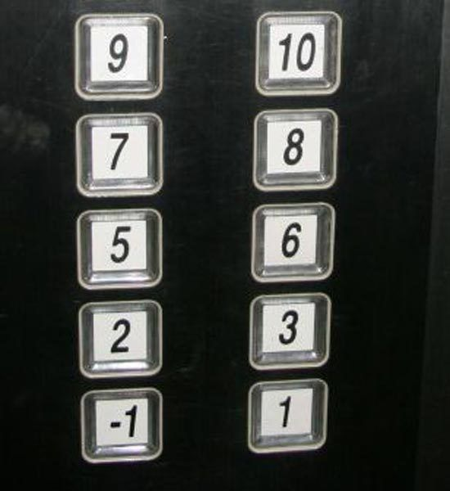
5.
Chinese superstition:
If you live on the , 4th, 14th or 24th floor ,
you will have bad luck.
No 4th floor!!

Slide 6
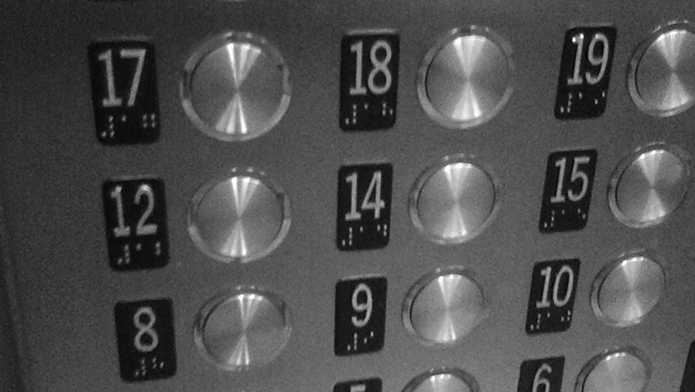
5.
Western superstition:
If you live on the 13th floor , you will have bad luck.
No 13th floor!!

Slide 7
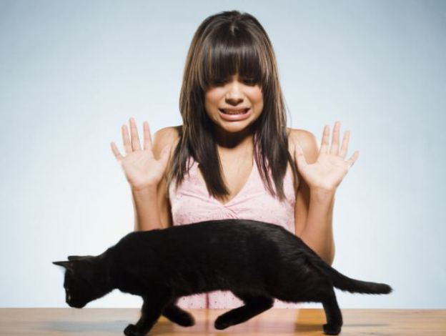
Guess what people think will happen if you face the following situations.
If a black cat _____ (walk) in front of you,
___________________________________.

Slide 8
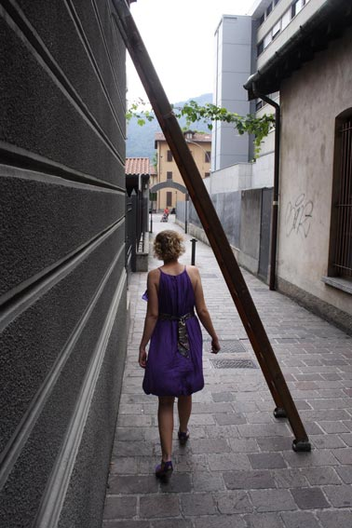
Guess what people think will happen if you face the following situations.
2) If you _______ (walk) under a ladder ,
___________________________________.

Slide 9
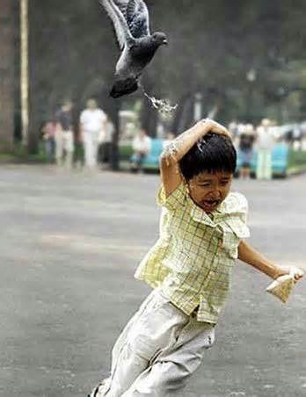
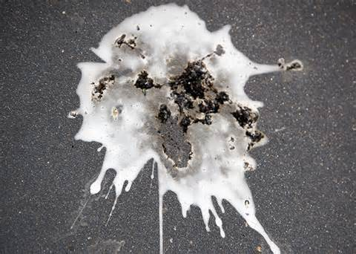
Guess what people think will happen if you face the following situations.
3) If a bird _______ (shit) on you ,
___________________________________.

Slide 10
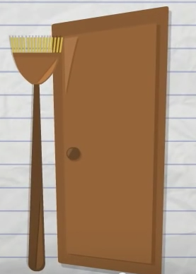
Guess what people think will happen if you face the following situations.
4) If you _______ (put) a broom upside down behind the door , _____________________.

Slide 11
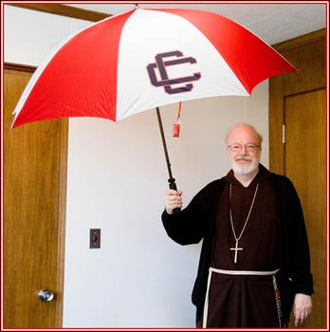
Guess what people think will happen if you face the following situations.
5) If you _______ (open) an umbrella inside your house , _____________________.

Slide 12
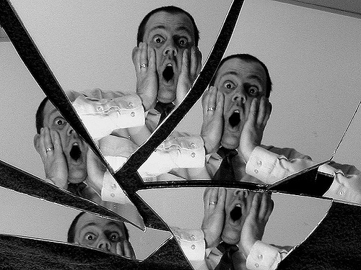
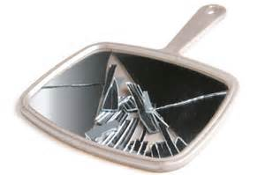
Guess what people think will happen if you face the following situations.
If you _______ (break) a mirror,
__________________________________.

Slide 13
9.
If clause
If you do not study hard,
If you follow the school rules,
If you ever find yourself lost and all alone,
Main clause
you will get failing marks
Oh, Miss Chan will stand by you.
Miss Chan won’t punish you
Miss Chan will stand by you

Slide 14
Miss Chan will stand by you
If you do not study hard, you will get failing marks. If you follow the school rules, Miss Chan won’t punish you. If you ever find yourself lost and all alone, be positive and talk to me, Miss Chan will stand by you, Oh, Miss Chan will stand by you.

Slide 15
10. Song writing
Refer to the melody of the song My Love Will Get You Home. In pairs/groups, choose a topic from the following and rewrite the lyrics using 1st conditional sentences.
1. Chinese superstitions | e.g. If you cut your nails at night, you will meet ghostly things.
2. misbehaviours in schools | e.g. If you don’t do your homework, you will be in trouble.
3. or your creative idea

