Slide 1
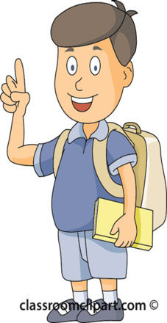
Are you a good child?
Modal Verbs
Senior Primary
Lesson 1
Siu, Ka Ka; Lee, Fung King Jackie
The Education University of Hong Kong

Slide 2
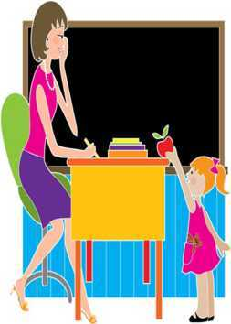
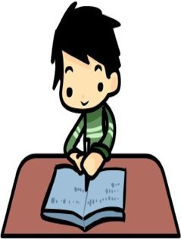
Are you a good child at school?
Good morning!
A good child follows school rules.
Do you say “Good Morning!” to teachers?
Do you finish all homework at home?
Do you raise your hand to answer your teachers’ questions?

Slide 3
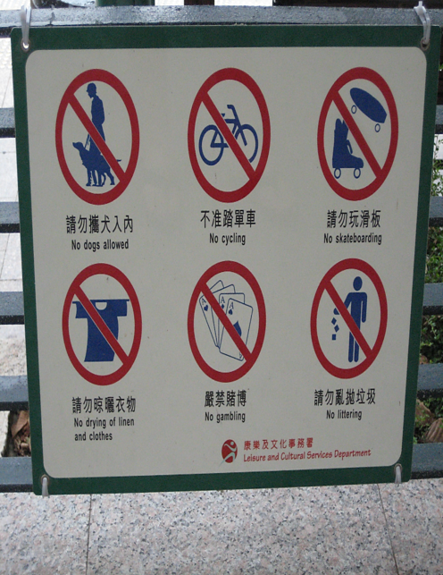
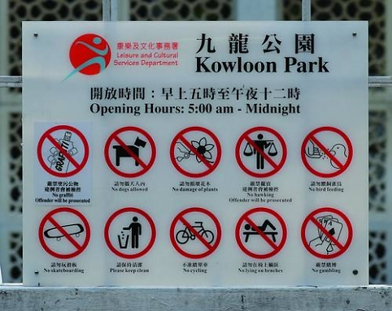
Are you a good child outside school? Do you follow all these signs?

Slide 4
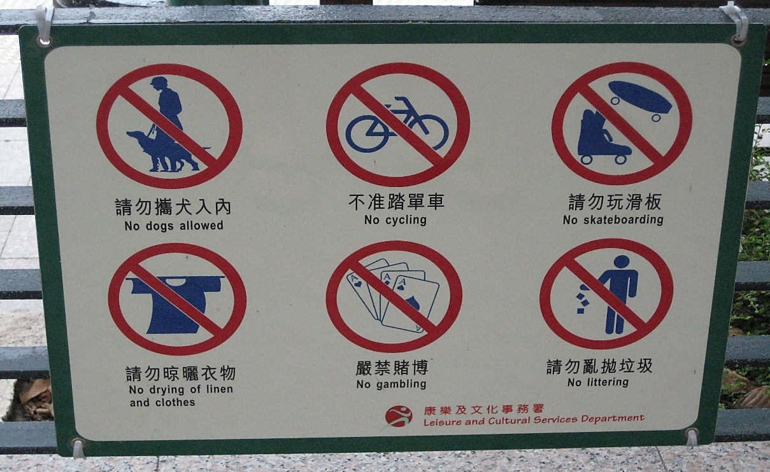
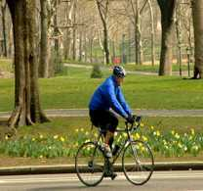
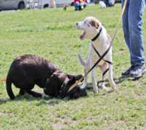
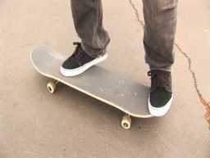
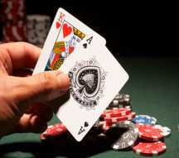
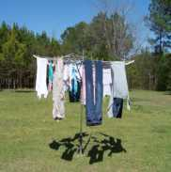
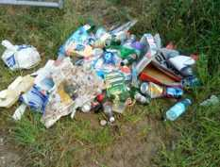
We must not cycle.
We must not bring dogs.
We must not play skateboarding games.
We must not gamble.
We must not dry our linen and clothes.
We must not litter.

Slide 5
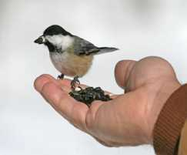
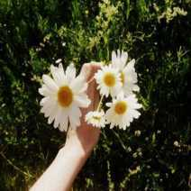
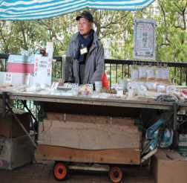
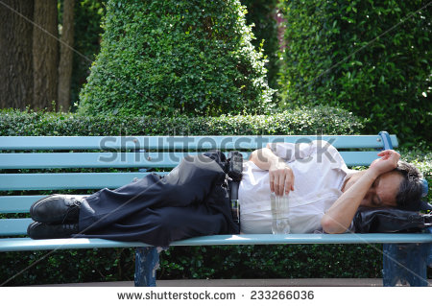
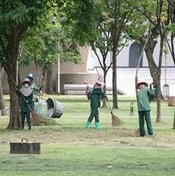
We must not feed the animals.
We must not pick flowers.
We must not hawk.
We must not sleep on the bench.
We must keep clean.

Slide 6
A good child follow signs. Do you know how to talk about signs?
We can use must/must not to talk about signs.

Slide 7
Put the word cards in the correct order.
We ____ ___ ____ .
not
cycle
must
We ____ ___ ____.
must
not
cycle

Slide 8
must
must not
keep clean.
pick flowers.
gamble.
We

Slide 9
Now, let’s play a group game.
1. Sit in groups.
2. Each group will have some word cards and some pictures of signs.

Slide 10
We_______________________.
We_______________________.
must
not
must
not
play skateboarding games
cycle

Slide 11
We_______________________.
We_______________________.
must
not
must
not
bring dogs
pick flowers

Slide 12
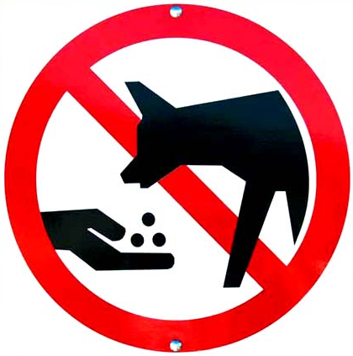
We _____ ____ ______________.
We _____ ____ ______________.
must
not
must
not
feed the animals
gamble

Slide 13
We _____ ____ _____ .
We _____
________ .
must
not
must
litter
keep clean

Slide 14
What other signs do you know?
We must line up.
We must not use the mobile phone.
We must not touch the animals.
We must not spit.
We must not push.

Slide 15
Can you follow all the signs we have learnt today?
You are good children!

Slide 16
We must be good at school and outside school!
We must be good everywhere!

