Slide 1
Modal Verbs
Senior Primary
Lesson 2
School picnic rules
Siu, Ka Ka; Lee, Fung King Jackie
The Education University of Hong Kong

Slide 2
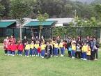
Do you remember the last school picnic?
When was it?
Last September.
Where did you go?
Yuen Long Park.
Did you like it?

Slide 3
Did you listen to what the teachers said?
Did you follow the school picnic rules?

Slide 4
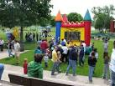
What should you say to your classmates when you see this?
You should say:
We must line up.

Slide 5
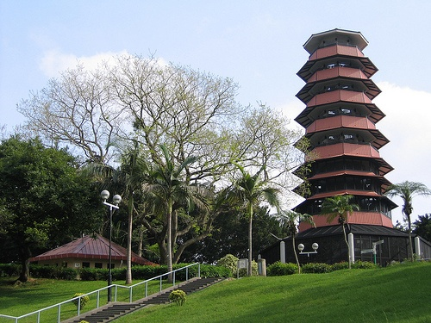
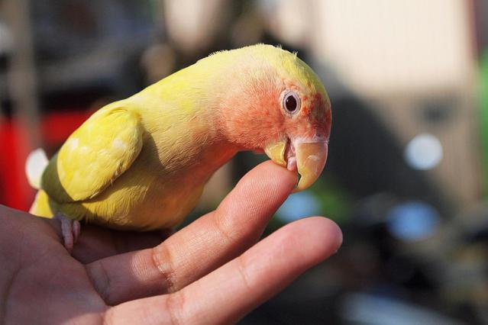
What should you say to your classmates when you see this?
You should say:
We must not touch the animals.

Slide 6
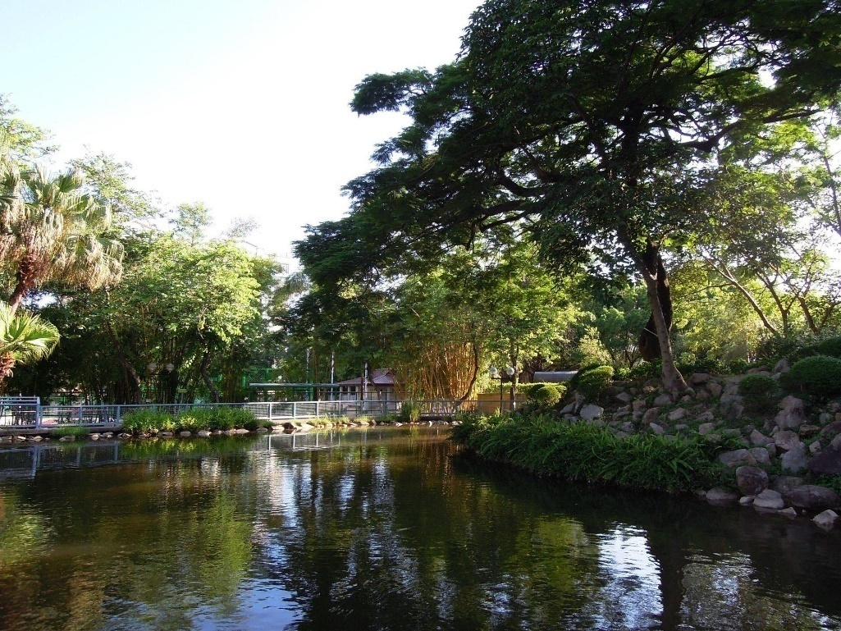
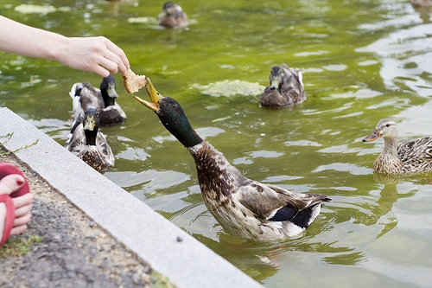
What should you say to your classmates when you see this?
You should say:
We must not feed the animals.

Slide 7
What should you say to your classmate when you see this?
You should say:
We must not litter.

Slide 8
What should you say to your classmate when you see this?
You should say:
We must not push.

Slide 9
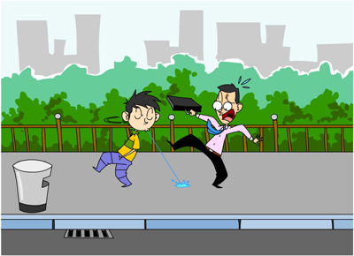
What should you say to your classmate when you see this?
You should say:
We must not spit.

Slide 10
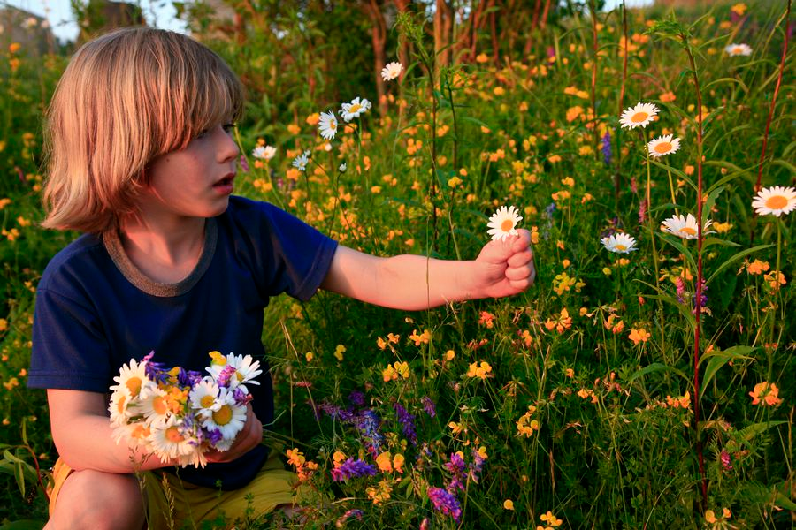
What should you say to your classmates when you see this?
You should say:
We must not pick the flowers.

Slide 11
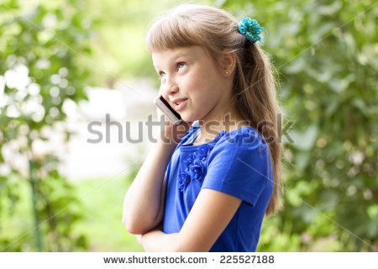
What should you say to the girl when you see this?
You should say:
We must not talk on the phone.

Slide 12
How to play the role play game
1. Your classmate will act out the sentence.
2. Guess what your classmate is doing.
3. Think about the rules.
Use “We must/ must not…”

Slide 13
litter
line up
spit
push
must
feed the animals
must
not
talk on the phone
touch the animals
pick the flowers
Timer

