Slide 1
Modal Verbs (Secondary)
Yeung, Ching Yee Annie; Siu, Ka Ka Katy; Lee, Fung King Jackie
The Education University of Hong Kong

Slide 2
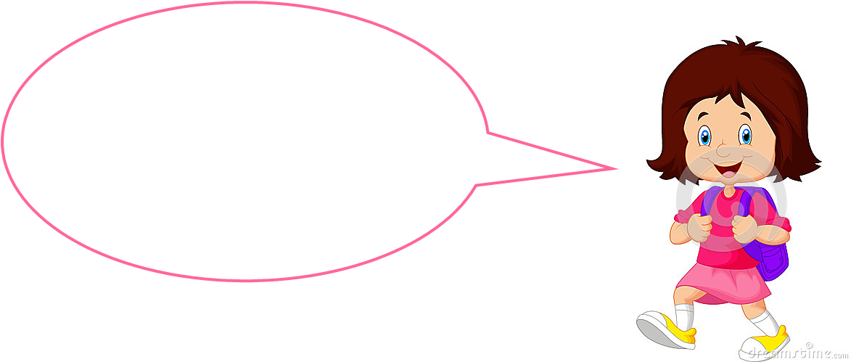
Recap

Slide 3
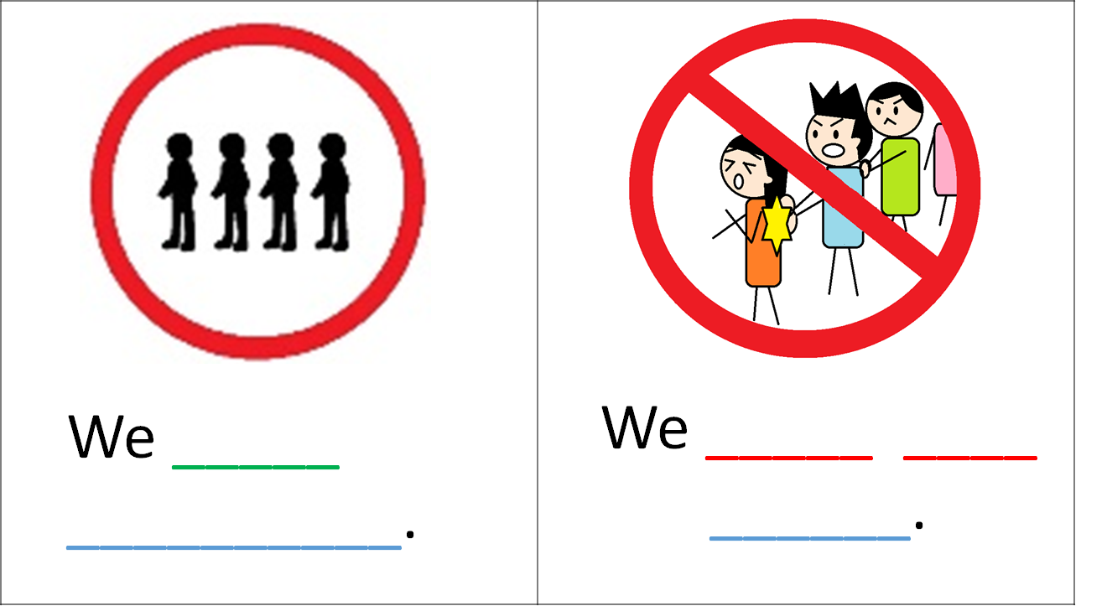

Slide 4
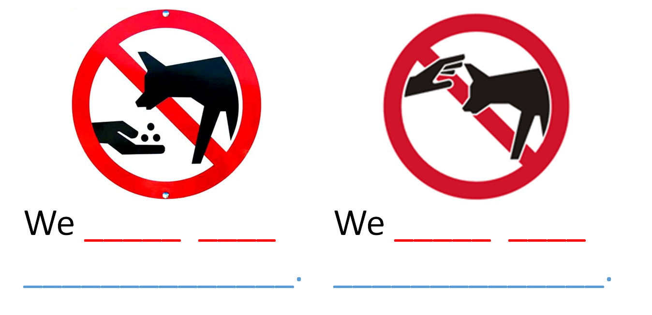

Slide 5
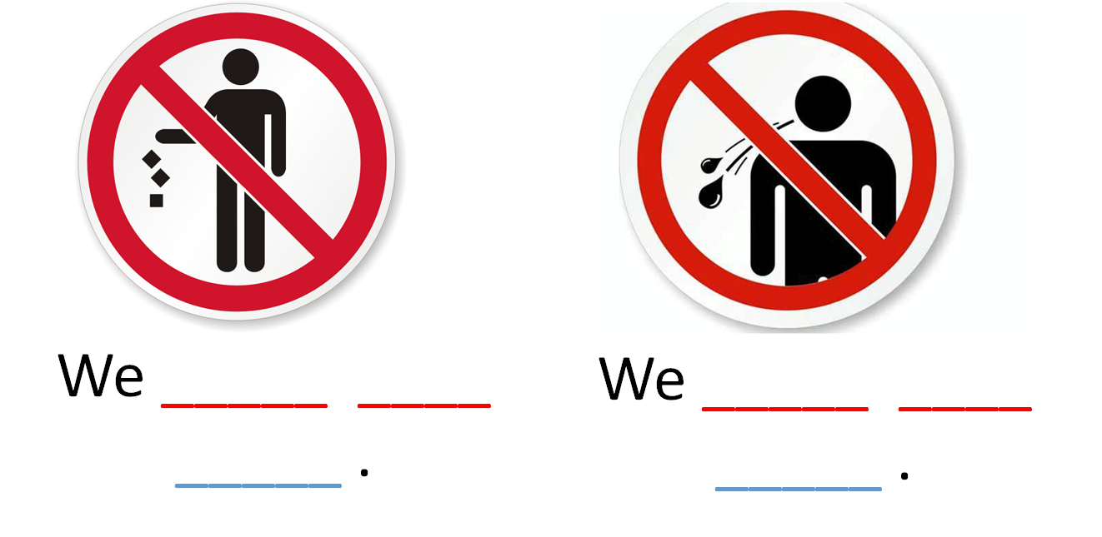

Slide 6

Workshop

Slide 7

Use of ‘must/must not’ to talk about obligations

Slide 8
Use of modal verbs to express possibilities

Slide 9
Police Workshop
Organized by Officer _______

Slide 10


Introduction
Good morning! I’m a senior officer, the person-in-charge of this robbery. You are all new police constables who will help me solve this case. Please wear your staff card.
Before meeting the witnesses, you need to learn in this workshop how to extract clues from the evidence.

Slide 11
Must
To show we are sure something is true and we have reasons for our belief:
e.g.1 It’s getting dark. It must be quite late.
e.g. 2 You haven’t eaten all day. You must be hungry.
We use must have for the past:
e.g.1 They haven’t come yet. They must have missed the bus.
e.g. 2 You look happy. You must have heard about the good news.
Adapted from http://learnenglish.britishcouncil.org/en/english-grammar/verbs/modal-verbs/certain-probable-or-possible

Slide 12
Should
To suggest that something is true or will be true in the future, and to show you have reasons for your suggestion:
e.g. It's nearly six o'clock. They should arrive soon.
We use should have to talk about the past:
e.g. It's nearly eleven o'clock. They should have arrived in London by now.
Adapted from http://learnenglish.britishcouncil.org/en/english-grammar/verbs/modal-verbs/certain-probable-or-possible

Slide 13
Could, Might & May
To show that something is possible in the future, but not certain:
They might come later. (= Perhaps they will come later.)
They may come by car. (= Perhaps they will come by car.)
If we don’t hurry we could be late. (= Perhaps we will be late)
Adapted from http://learnenglish.britishcouncil.org/en/english-grammar/verbs/modal-verbs/certain-probable-or-possible

Slide 14
Might have and Could have
To show that something was possible now or at some time in the past:
e.g.1 It’s ten o’clock. They might have arrived now.
e.g.2 They could have arrived hours ago.
Adapted from http://learnenglish.britishcouncil.org/en/english-grammar/verbs/modal-verbs/certain-probable-or-possible

Slide 15
Level of certainty
___|_______|______|_______|__
might could should must

Slide 16

Congratulations! You have already learnt how to determine the level of possibility of different modal verbs. Now, let’s practise making inferences by studying a robbery case.

Slide 17
Task 1 A police report
It was a sunny day. Three youngsters made an attack upon Mr. Paul Lee, as he was passing the corner of Lung Mun Road, for the purpose of robbing him. Finding that he had no money, they beat him and kicked him until he became insensible, and then ran off. The unfortunate man was subsequently found by a young lady who passed by. She thought the robbers must have beaten the poor man very hard. “He was in blood when I saw him. He could have fought back but there might be more than one robber so he was not able to resist.”
After the lapse of an hour or two, Lee revived sufficiently to leave the hospital. “The three robbers could have kicked me to death. They were horrible,” said Lee.

Slide 18
Can you find any modal verb in the report?

Slide 19
A police report
It was a sunny day. Three youngsters made an attack upon Mr. Paul Lee, as he was passing the corner of Lung Mun Road, for the purpose of robbing him. Finding that he had no money, they beat him and kicked him until he became insensible, and then ran off. The unfortunate man was subsequently found by a young lady who passed by. She thought the robbers must have beaten the poor man very hard. “He was in blood when I saw him. He could have fought back but there might be more than one robber so he was not able to resist. Someone should have seen the beating.”
After the lapse of an hour or two, Lee revived sufficiently to leave the hospital. “The three robbers could have kicked me to death. They were horrible,” said Lee.

Slide 20
Level of certainty
___|_______|______|_______|__
might could should must

Slide 21
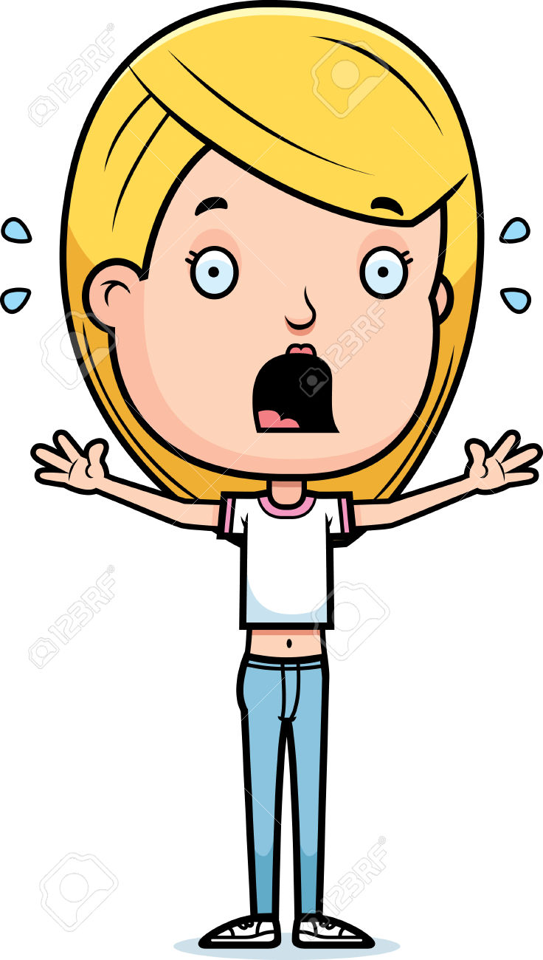
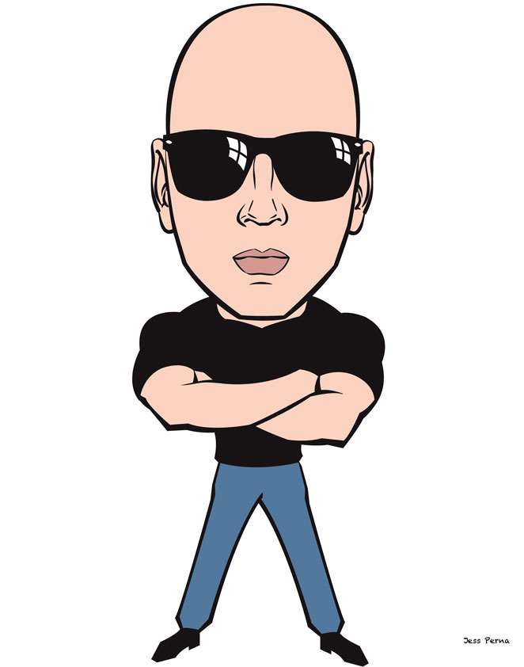
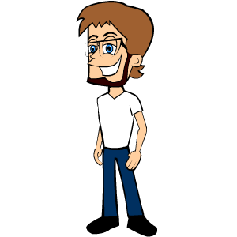
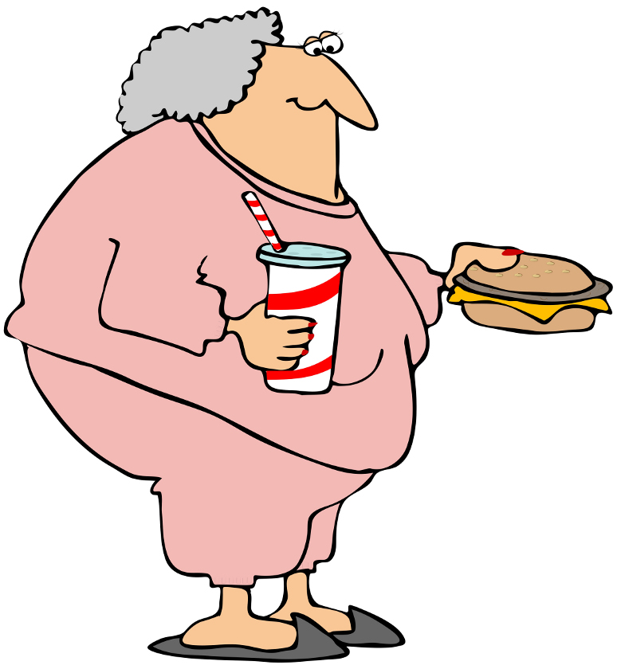
Which witness sounds most certain?
Now, there are 4 witnesses. They are talking about the crime. Can you fill in the blanks?
Mrs. Fung
Miss Tam
Mr. Chan
Mr. Shum

Slide 22
Mrs. Fung
I was sitting in my armchair in the garden that day. Suddenly, I heard some noise. I don’t really remember what noise it was. After a while, I saw some people running out from the corner of Lung Mun Road. I could not see clearly. They ran really fast. I think that there ______ be three men.

Slide 23
Miss Tam
It was such a horrible experience. I just finished shopping with my friends and was walking to the bus stop. Suddenly, three people ran very fast towards me. I was shocked. Then, I saw blood on one of their hands. I looked up to their faces. Two of them were wearing masks and hats. I was sure that all of them were with short hair and were well-built. They wore school uniforms. They ______ be teenage boys.

Slide 24
Mr. Chan
I was on a minibus at that time. I saw three boys running away from the corner of Lung Mun Road. I didn’t see clearly because I was wearing sunglasses. As I remember, they were all wearing white shirts and black trousers. They _______ be students.

Slide 25
Mr. Shum
I was buying a newspaper in 7/11. When I was paying money at the counter, I heard three boys talking behind me. They were talking about money. I looked back and they walked away. Um... there was some blood on their hands… It was strange. So, I guessed they _______ ________ done something bad.

Slide 26
Put the witnesses on the scale according to how certain their evidence was.
Mrs. Fung
Miss Tam
Mr. Chan
Mr. Shum
___|_______|______|_______|__
might could should must

Slide 27
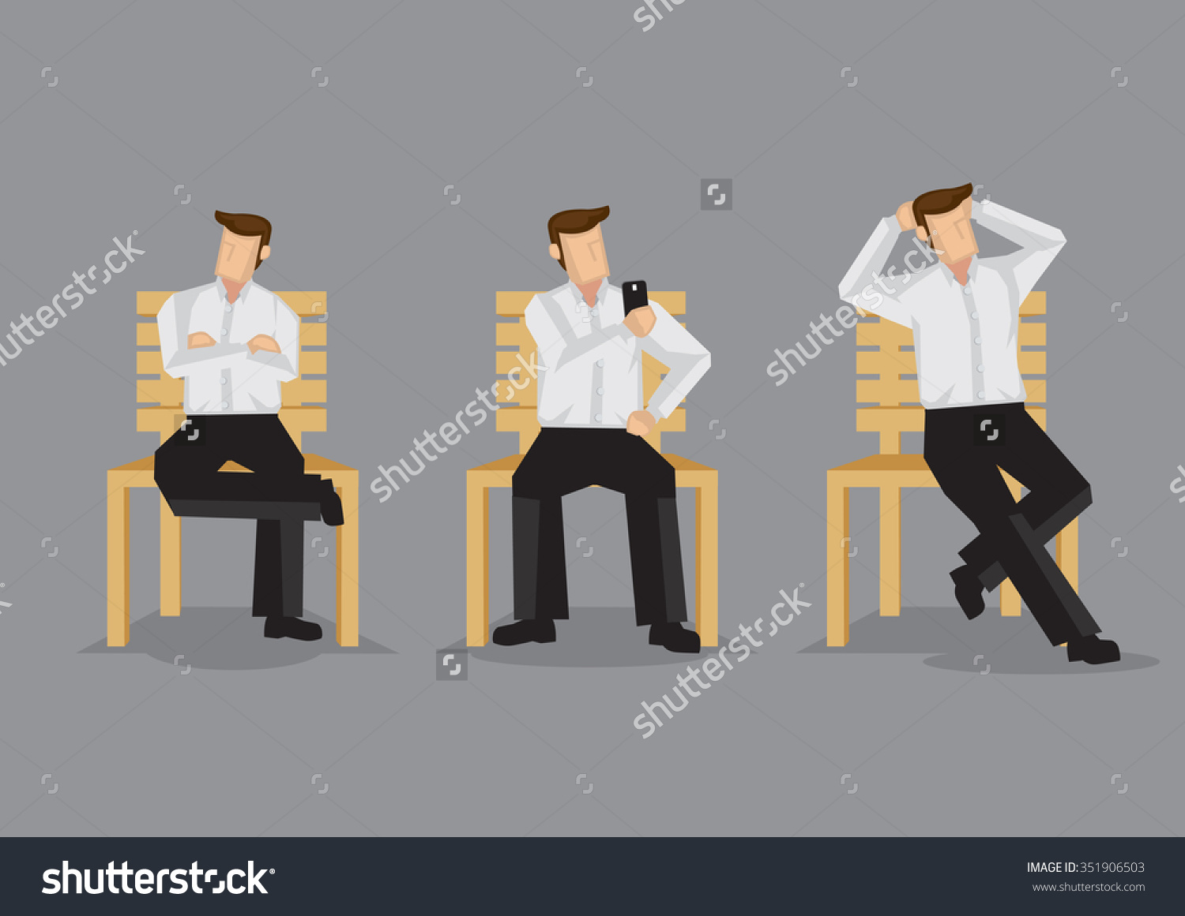
Task 3
Now, the three young boys have been arrested by the police. Think about what they want to say.

Slide 28


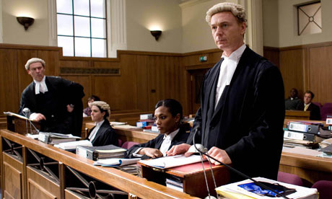

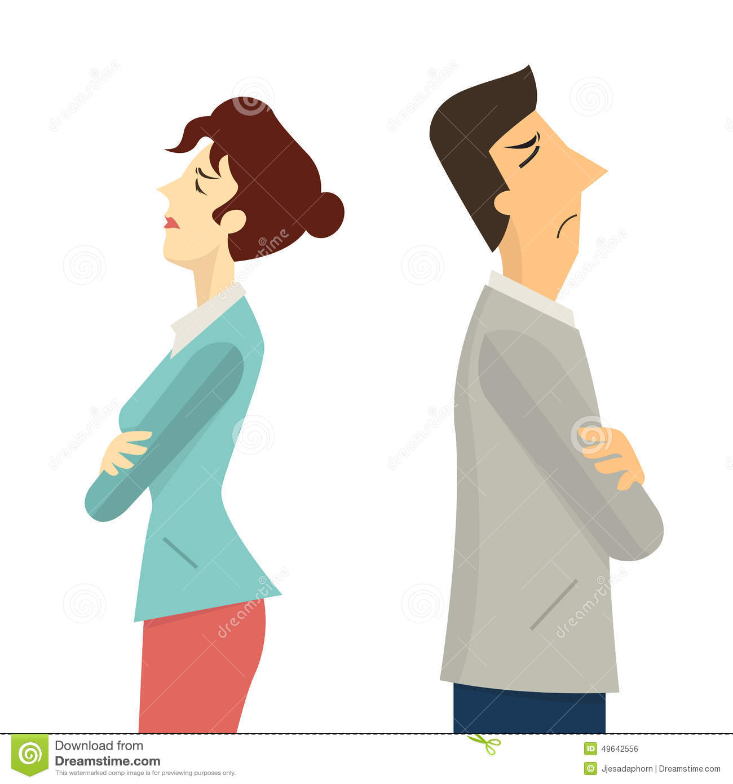
Boy 1

Slide 29
Boy 1
I am lucky. My parents own a company. They _______ have made some profits from their business. They ______ be rich enough to hire a good lawyer for me.

Slide 30
Boy 1
But I have not been home for weeks. Will they get angry with me? Oh, I am not sure now. They _____ refuse to help me...

Slide 31
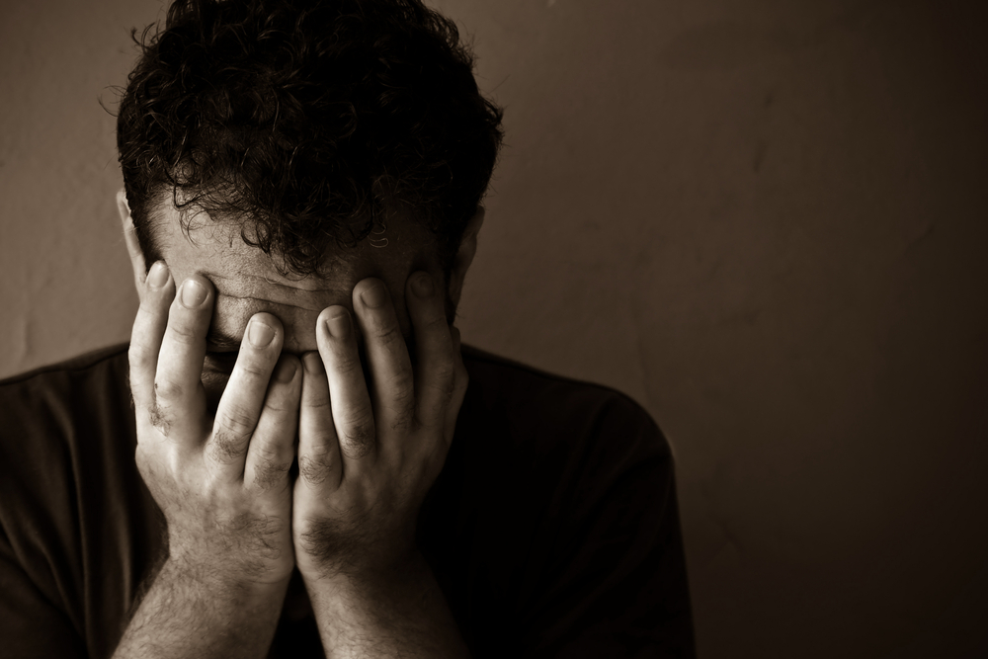

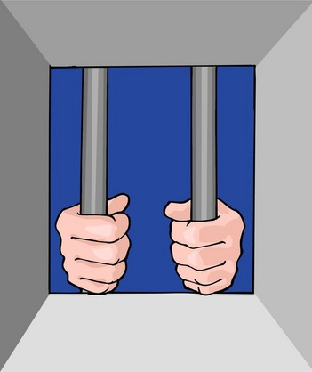

Boy 2

Slide 32
Boy 2
I am finished. I was so stupid!
I _______ not _____ _____ the man.

Slide 33
Boy 2
I have lost contact with my family for so long. I have no money to hire a lawyer. No one will help me. I ______ be put in jail.

Slide 34
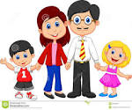
Boy 3
I am so regretful. Why did I join them? I have a great family. They all love me so much. They _____ be very sad when they heard about my stupidity.

Slide 35



Boy 3
Mom cares about me a lot. She _____ have cried. My sister used to admire me. She _____ not do so anymore.

