Slide 1
Number Poems (compiled by John Foster)
Lesson 4 – Zoo Dream
(by John Foster)
Jason Ma and Jason Poon
The Education University of Hong Kong

Slide 2
Do you still remember the actions? Let’s read the poem!

Slide 3
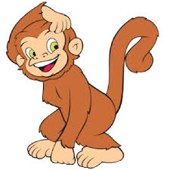
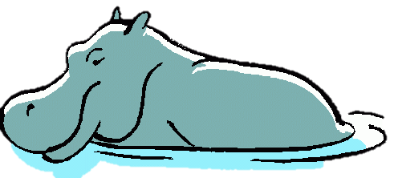
The Zoo Dream
I dreamed I went
to the zoo one day. All the animals
came out to play.
There were
ten whales whistling,
nine hippos hopping,
eight monkeys marching,

Slide 4
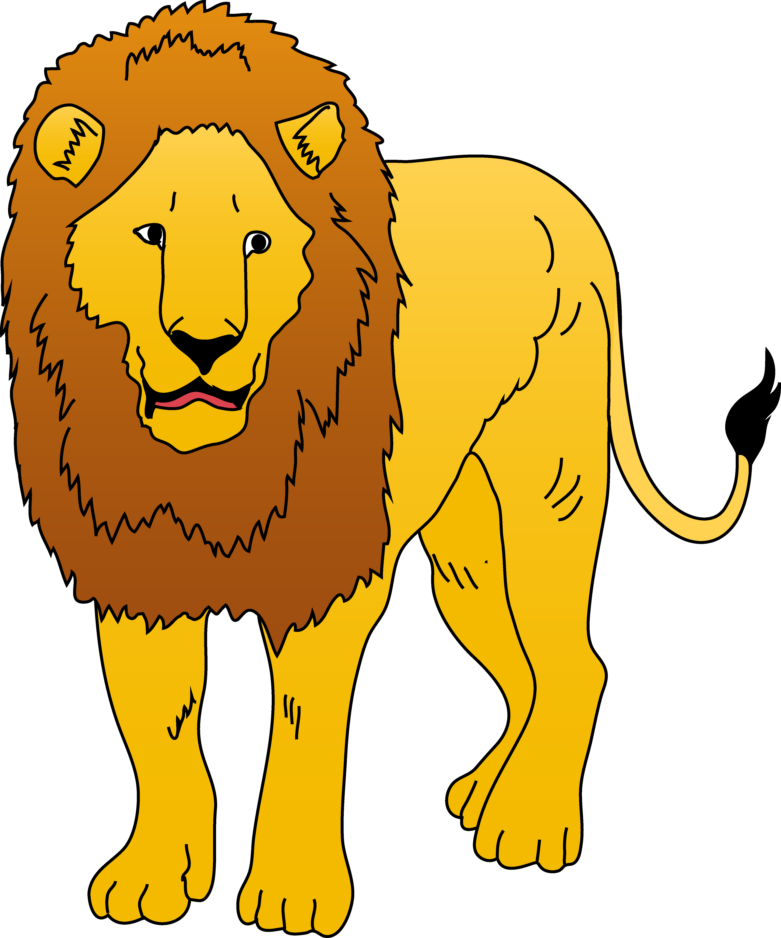
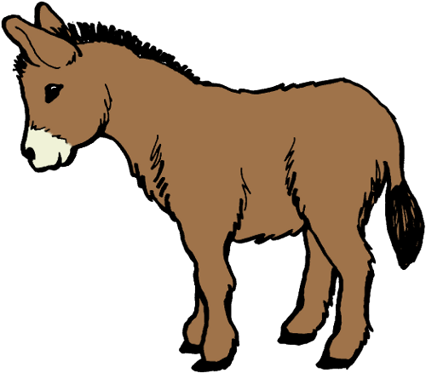
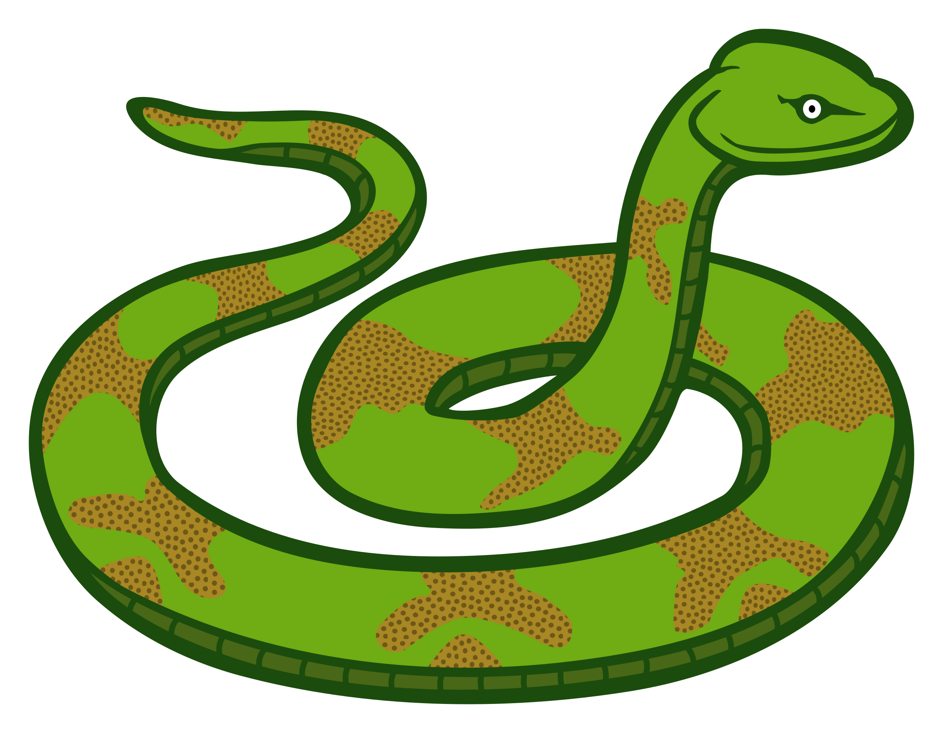
The Zoo Dream Chant
seven lions laughing,
six snakes skipping,
five donkeys dancing,

Slide 5
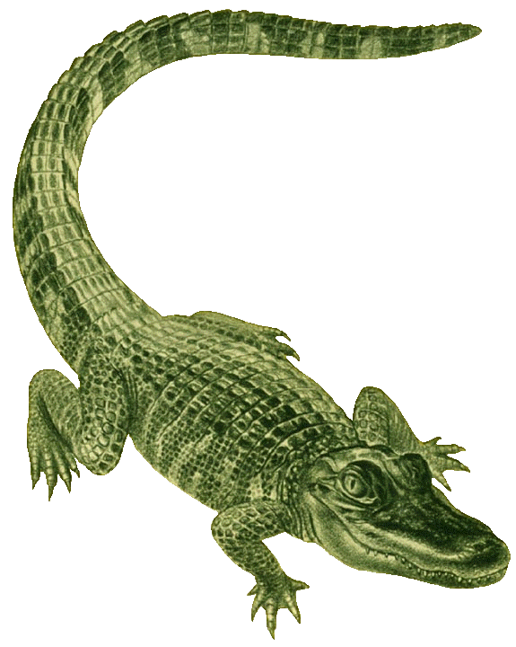
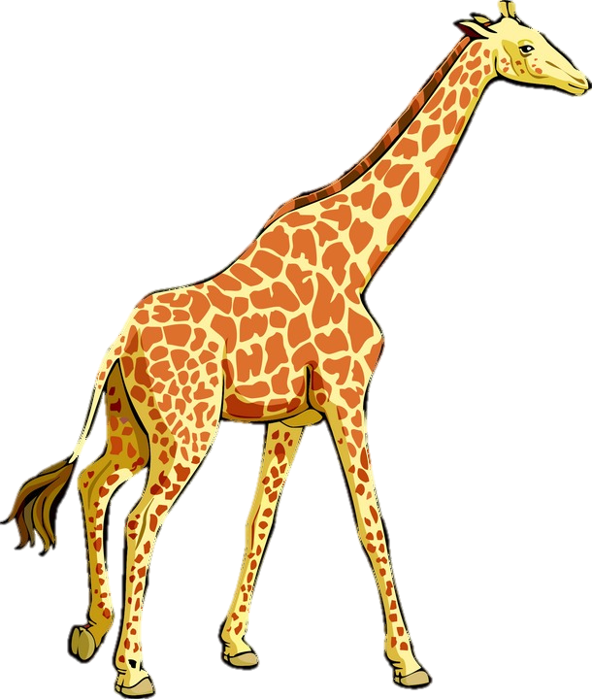
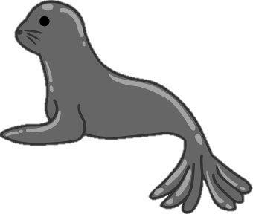
The Zoo Dream Chant
four crocodiles clapping,
three rhinos roaring,
two giraffes giggling,
and one seal snoring!

Slide 6
Students, do you remember the actions?

Slide 7
Let’s play a game!

Slide 8
Lucky Wheel of Action Verbs

Slide 9
Round 1

Slide 10
Round 2

Slide 11
Round 3

Slide 12
Round 4

Slide 13
Round 5

Slide 14
Round 6

Slide 15
Round 7

Slide 16
Round 8
One more game

Slide 17
It’s activity time! What are these people or animals doing?
Activity Sheet 4

Slide 18
Activity 1
Look at the pictures carefully. What are they doing? Finish the sentences with the verbs below.
whistling | hopping | marching | laughing | skipping
dancing | clapping | roaring | giggling | snoring

Slide 19
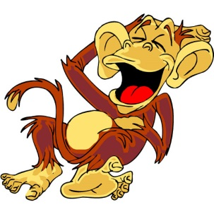
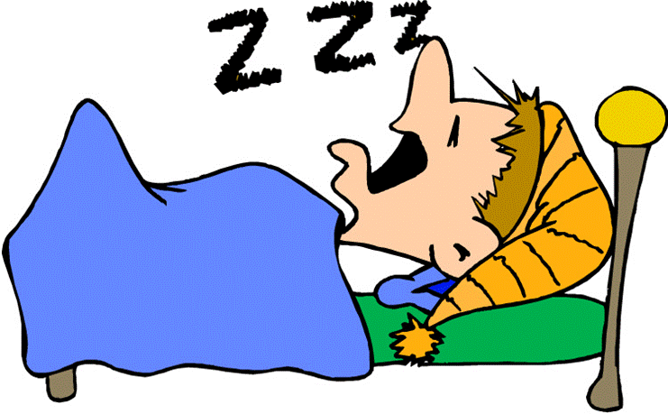
Activity 1
1. What is the monkey doing?
It _____ ___________.
is
laughing
2. What is Ivan doing?
He _____ ___________.
is
snoring

Slide 20
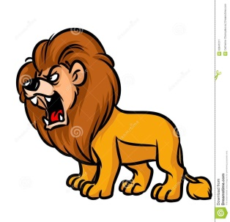
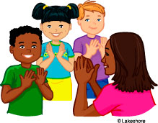
Activity 1
3. What is the lion doing?
It _____ ___________.
is
roaring
4. What are the students doing?
They _____ ___________.
are
clapping

Slide 21
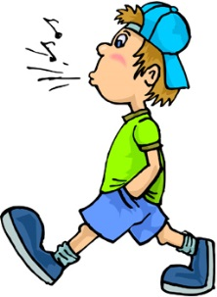
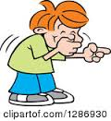
Activity 1
5. What is Ron doing?
He _____ ___________.
is
whistling
6. What is Wilson doing?
He _____ ___________.
is
giggling

Slide 22
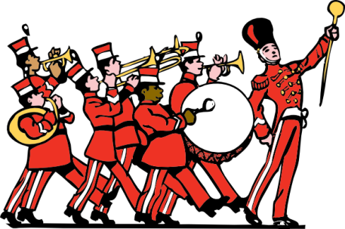
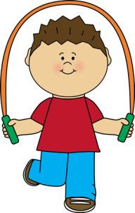
Activity 1
7. What are the musicians doing?
They _____ ___________.
are
marching
8. What is Ben doing?
He _____ ___________.
is
skipping

Slide 23
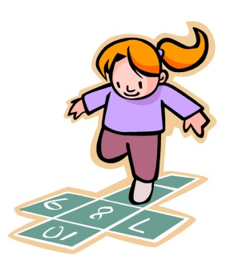
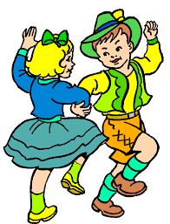
Activity 1
9. What is Amy doing?
She _____ ___________.
is
hopping
10. What are Cindy and Dan doing?
They _____ ___________.
are
dancing

Slide 24
Activity 2
Choose a body action from the poem. Draw the action and write a sentence.
whistling | hopping | marching | laughing | skipping
dancing | clapping | roaring | giggling | snoring

Slide 25
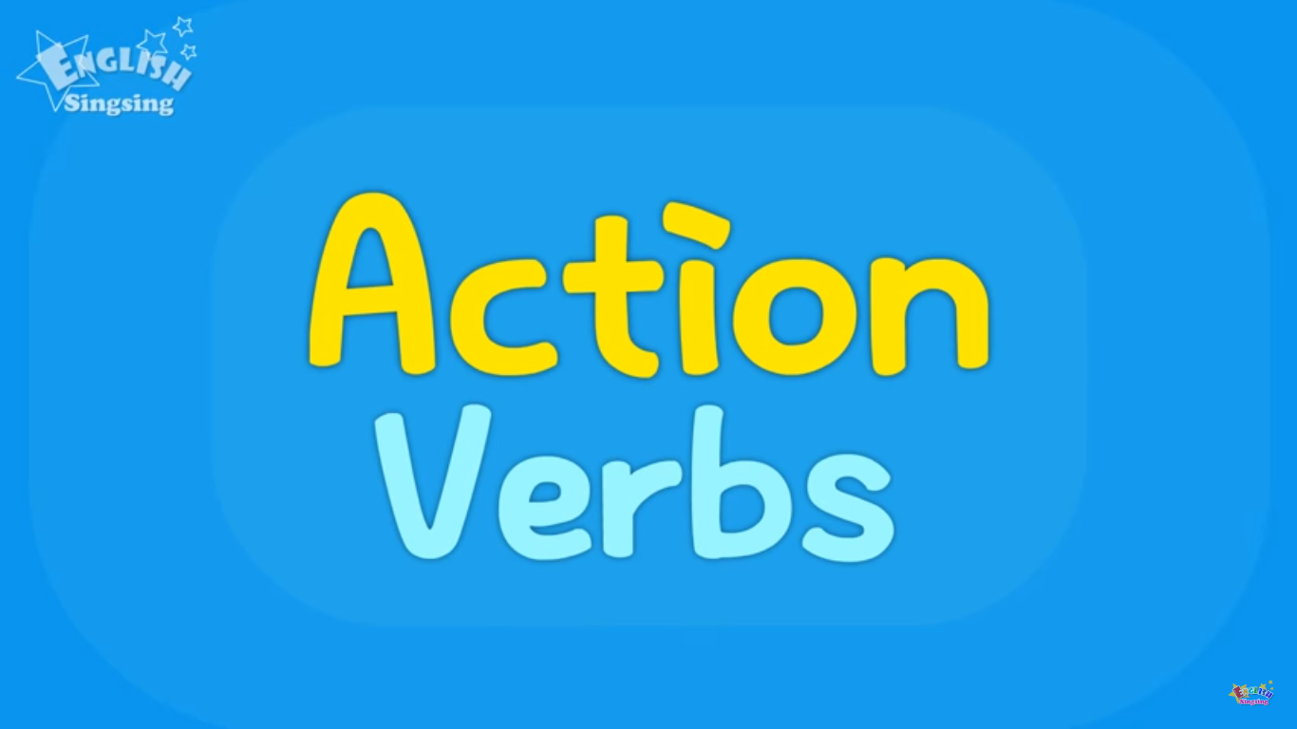
Activity 2
Let’s watch a video about action verbs!
Kids vocabulary – Action Verbs
https://www.youtube.com/watch?v=4c6FyuetSVo

Slide 26
Activity 2
Do you know other body actions?
Draw two actions and write a sentence for each.
You may use verbs you already know or verbs you have just learnt in the video.

