Slide 1
Object pronouns
Siu, Ka Ka Katy; Yeung, Ching Yee Annie; Lee, Fung King Jackie
The Education University of Hong Kong

Slide 2
Let’s watch a video.
https://www.youtube.com/watch?v=XUIL5mFH5y4 (2:45 onwards)

Slide 3
Who is speaking to me?
Subject
Pronoun
Object
Pronoun
Verb

Slide 4
Who is cooking?
Subject
Pronoun
Object
Pronoun
Verb

Slide 5
Who are listening?
Subject
Pronoun
Verb
Object
Pronoun

Slide 6
Who is talking to them?
Subject
Pronoun
Object
Pronoun
Verb

Slide 7
Who are we ? Who are ‘them’?
Object
Pronoun
Subject
Pronoun
Verb

Slide 8
Who are they? Who are ‘us’?
Subject
Pronoun
Verb
Object
Pronoun

Slide 9
I
You
We
They
He
She
It
Subject
Object?

Slide 10
I
You
We
They
He
She
It
me
you
Subject
us
Object
them
him
her
it

Slide 11
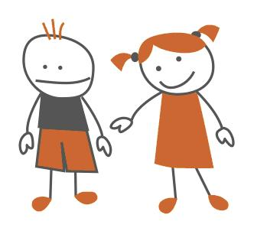
We use a subject pronoun to refer to the subject.
He doesn’t know her very well.
Subject
Verb

Slide 12
We use an object pronoun to refer to an object.
He doesn’t know her very well.
Verb
Object

Slide 13
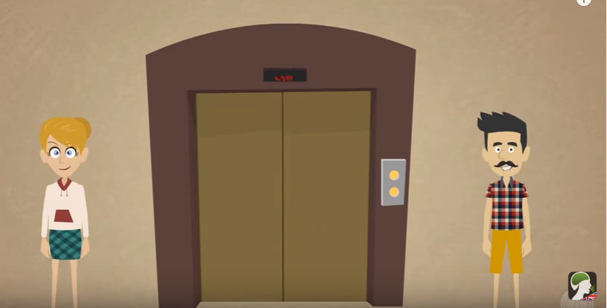
Dictogloss (1)

Slide 14
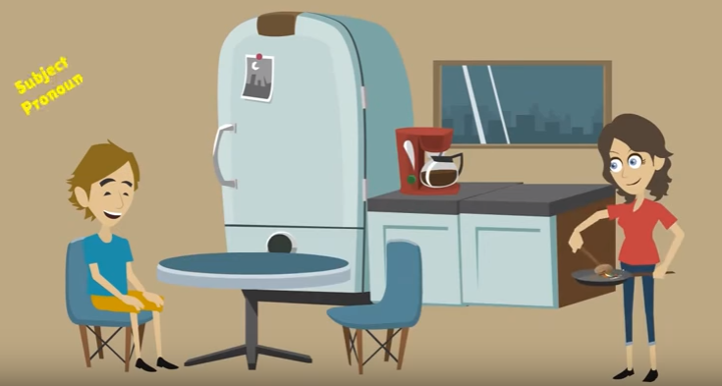
Dictogloss (2)

Slide 15
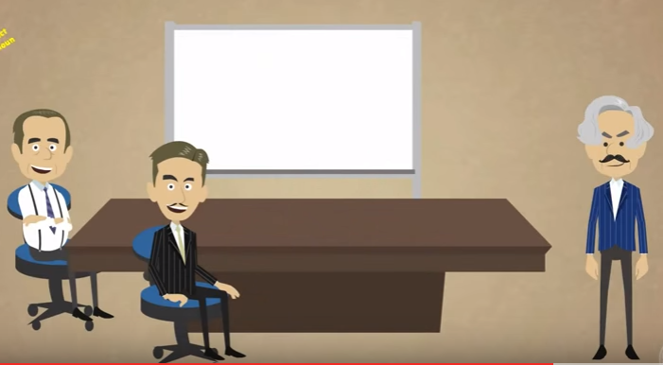
Dictogloss (3)

Slide 16
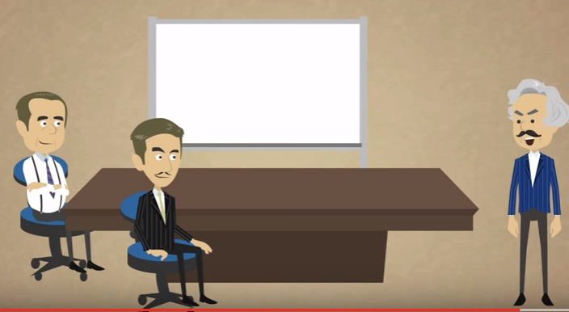
Dictogloss (4)

Slide 17
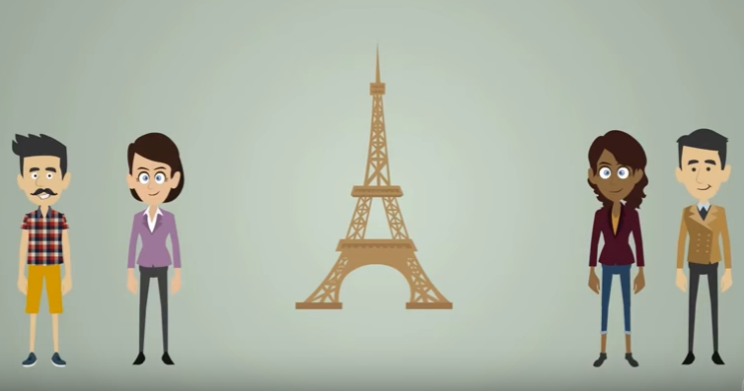
Dictogloss (5)

Slide 18
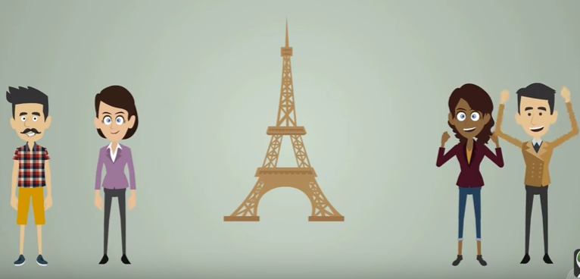
Dictogloss (6)

Slide 19
Riddle games

Slide 20
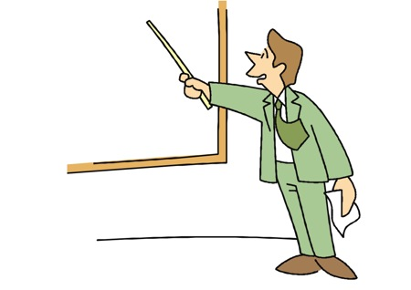
Let’s play a game using pronouns.
Can you talk about a person in this classroom without saying his/her name?
You can use pronouns.
e.g. He teaches us English.

Slide 21
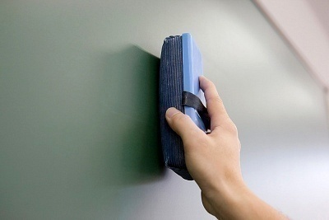
Let’s play a game using pronouns
Can you talk about a thing in this classroom without saying its name?
You can use pronouns.
e.g. We use it to clean the blackboard.

