Slide 1
Lesson 1 Where do you want to travel?
Designed by LI, Man Yee Karena
The Hong Kong Institute of Education

Slide 2
How can you know about the place?

Slide 3
What is this?
Brochure

Slide 4
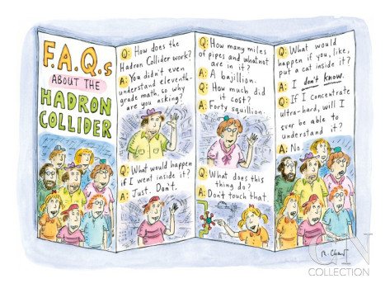
Brochure

Slide 5
-n / -an / -ian | -ish | -ese | Others
Mexico → Mexican | Britain→British | China→ Chinese | Germany → German
Brazil→ Brazilian | Sweden→ Swedish | Japan → Japanese | France → French

Slide 6
India
Indian
Asia
Asian
Europe
European

Slide 7
Ireland
Irish
Scotland
Scottish
Spain
Spanish

Slide 8
Vietnam
Vietnamese
Taiwan
Taiwanese

Slide 9
Thailand
Thai
The Philippines
Filipino/ Philippine

