Slide 1
Lesson 2 Where do you want to travel?
Designed by LI, Man Yee Karena
The Hong Kong Institute of Education

Slide 2
A travel brochure may have:
maps, photos/pictures
headings and sub-headings
paragraphs
bulleted lists

Slide 3
Read the following brochure. Check the following:
Country names and adjectives? Any errors?
Organized?
Easy to read?
Boring?
Pictures?

Slide 4
Korean
Korea Food: Korea food, such as kimchi, is hot since Korea people like eating spicy food. Korea Stone Pot :It is a famous Korea dish. There are rice, vegetables, beef and eggs. It is yummy!
Korea Traditional Clothing :The Korea traditional dress is beautiful and colorful. It is made up of a blouse, a jacket and a skirt. The Korea people in the past wore it during Korea festivals.

Slide 5
Korean
Korea Food: Korea food, such as kimchi, is hot since Korea people like eating spicy food. Korea Stone Pot :It is a famous Korea dish. There are rice, vegetables, beef and eggs. It is yummy!
Korea Traditional Clothing :The Korea traditional dress is beautiful and colorful. It is made up of a blouse, a jacket and a skirt. The Korea people in the past wore it during Korea festivals.

Slide 6
Now read the following brochure, and check the following again:
Country names and adjectives? Any errors?
Organized?
Easy to read?
Boring?
Pictures?

Slide 7
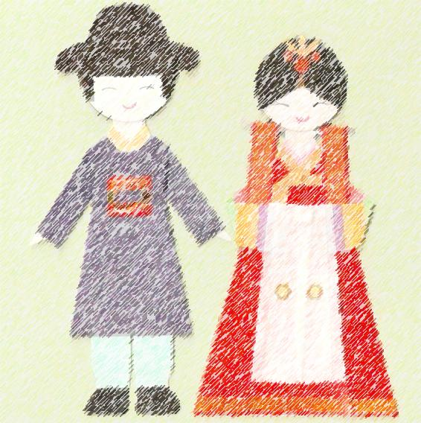
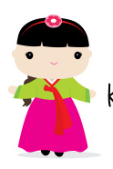
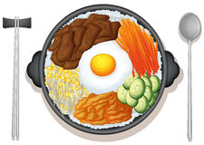
Korea
Korean Food
Korean food, such as kimchi, is hot since Korean people like eating spicy food.
Korean Stone Pot
It is a famous Korean dish. There are rice, vegetables, beef and eggs. It is yummy!
Korean Traditional Clothing
The Korean traditional dress is beautiful and colorful. It is made up of a blouse, a jacket and a skirt. The Korean people in the past wore it during Korean festivals.

