Slide 1
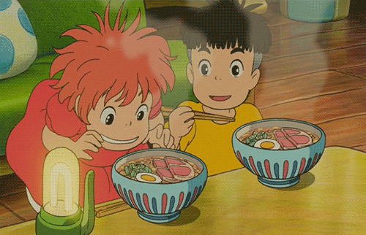
My Dream Food Court
Designed by LI, Man Yee Karena
The Hong Kong Institute of Education

Slide 2
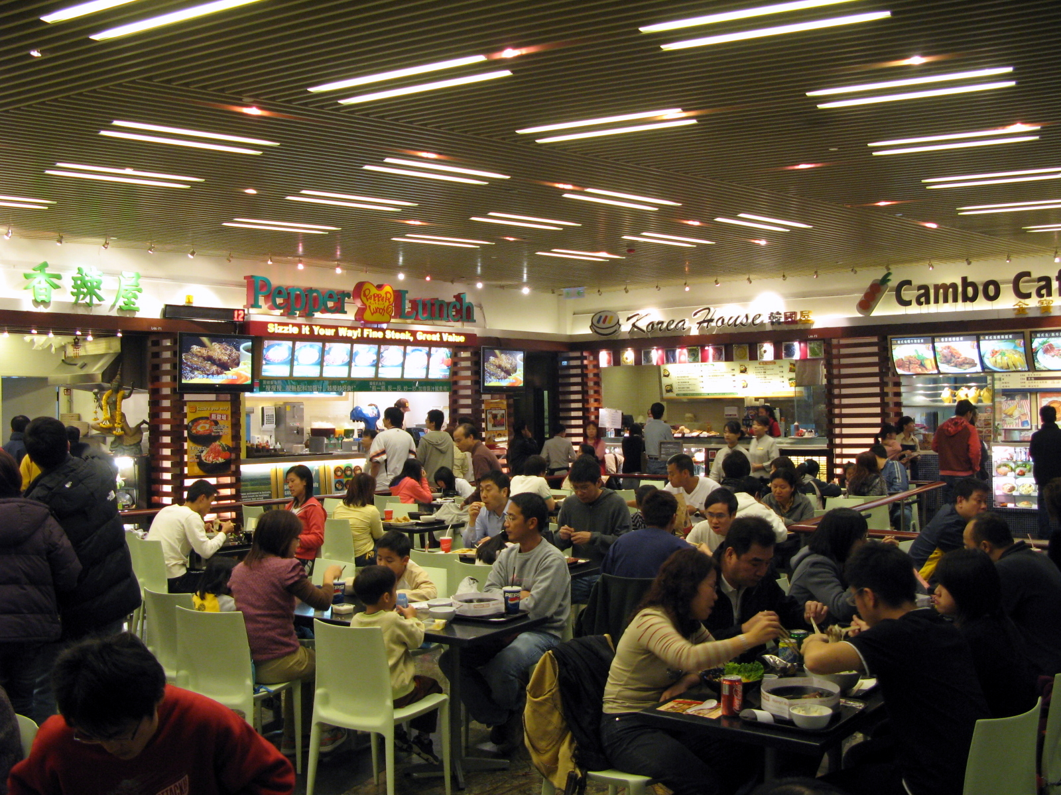

Slide 3
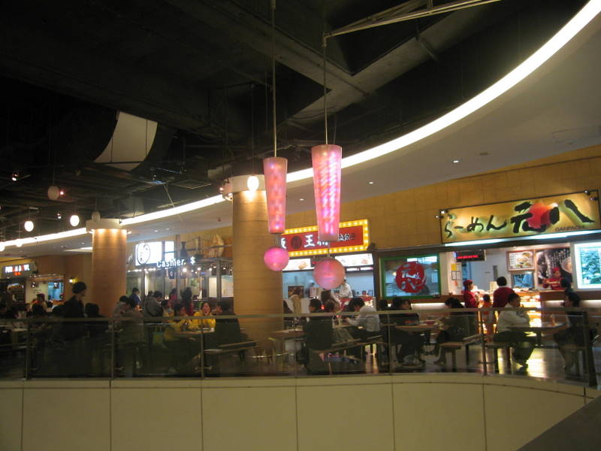

Slide 4
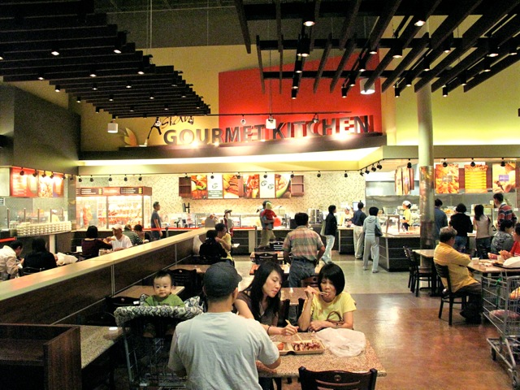

Slide 5
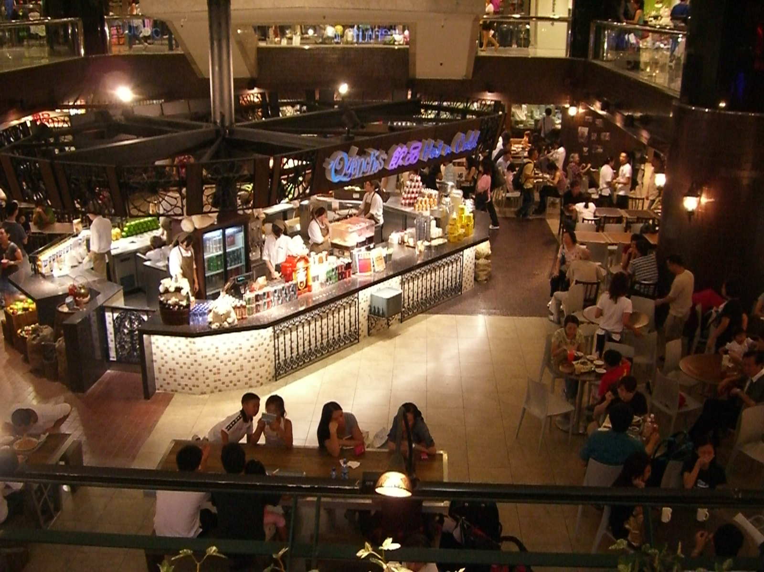

Slide 6
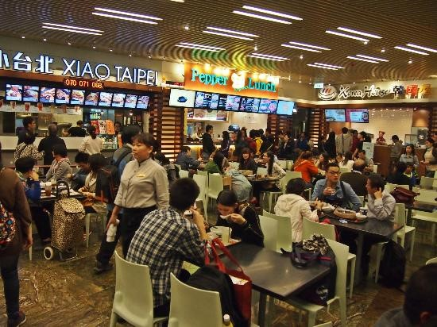

Slide 7
-n / -an / -ian | -ish | -ese | Others
Mexico → Mexican | Britain→British | China→ Chinese | Thailand→ Thai
Italy→ Italian | Sweden→ Swedish | Japan → Japanese | France → French
+ =

Slide 8
India
Indian
Asia
Asian
Europe
European

Slide 9
Ireland
Irish
Scotland
Scottish
Spain
Spanish

Slide 10
Vietnam
Vietnamese
Taiwan
Taiwanese

Slide 11
Thailand
Thai
The Philippines
Filipino/ Philippine

