Slide 1
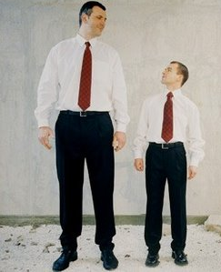
Comparison
Wong Tzu Yu Renee
The Hong Kong Institute Of Education

Slide 2
2 Volunteers
_______ is ________er than _____________

Slide 3
_______ is ________er than _____________

Slide 4
Exciting tall
Happy appealing
Interesting nice horrifying
Frightening large Boring

Slide 5
Exciting
appealing
Interesting horrifying
Frightening Boring
tall
Happy
nice
large
Words with 3 or more syllables

Slide 6
Interesting
Exciting
Frightening
Tall
Big
Happy
Tidy

Slide 7
Interestinger than V.S. more interesting than

Slide 8
*****Rule*****
3 or >3 syllables: +“more…than”
e.g. 1. Watching Doreamon is more interesting than washing dishes.
2. An ipad is more expensive than a book.
3. Sitting under a tree is more relaxing than playing computer games.

Slide 9
Practice time!!!!
5 stars next to things I like most
1 star for things I like least

Slide 10
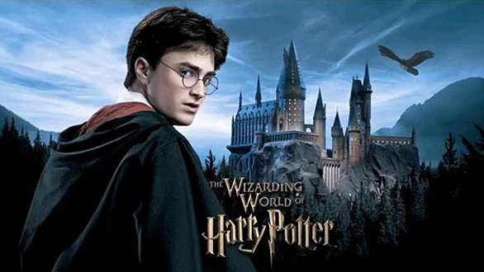
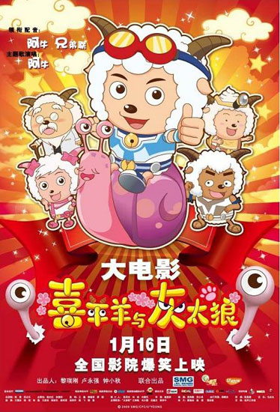
Interesting
Interesting
https://youtu.be/OSXvwoI3c5Y
https://youtu.be/6_Ukxzdxa18
Miss Wong thinks that
_______ is more_____ than _____.

Slide 11
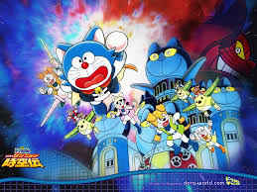
Exciting
Exciting
https://youtu.be/R2c11R3hN34
https://youtu.be/4S9a5V9ODuY
Miss Wong thinks that
_______ is ______ than _____.

Slide 12
Horrifying
Horrifying
https://youtu.be/R1v0uFms68U
Miss Wong thinks that
_______ is ____ ______ _____ _____.
https://youtu.be/OIzN8yKDnH4

Slide 13
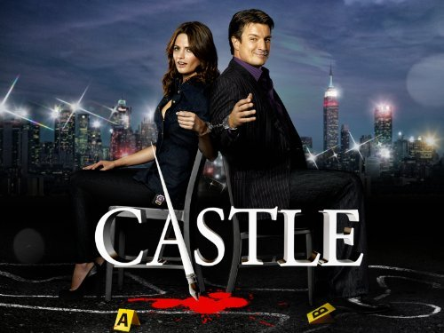
What do you think?
https://www.youtube.com/watch?v=ff-XiZzJLxw
https://youtu.be/aaorTM2wB9o

Slide 14
Areas for comparison
1. Attractiveness of the actor
2. Attractiveness of the actress
3. Fame of the actor
4. Fame of the actress
5. Interesting plot?
6. Suitable for teenagers?

