Slide 1
Make wishes
CHAU, Ka Ying
The Hong Kong Institute of Education

Slide 2
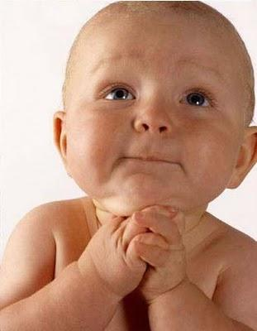
Make wishes
I have little milk.
I want more milk.
I have few teeth .
I want more teeth.

Slide 3
Make wishes
I have little milk.
I have few teeth .

Slide 4
little ?
few ?
Make wishes

Slide 5
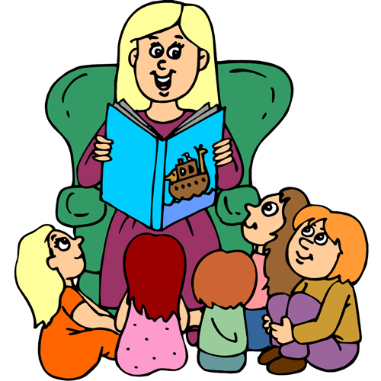
Make wishes
Listen first

Slide 6
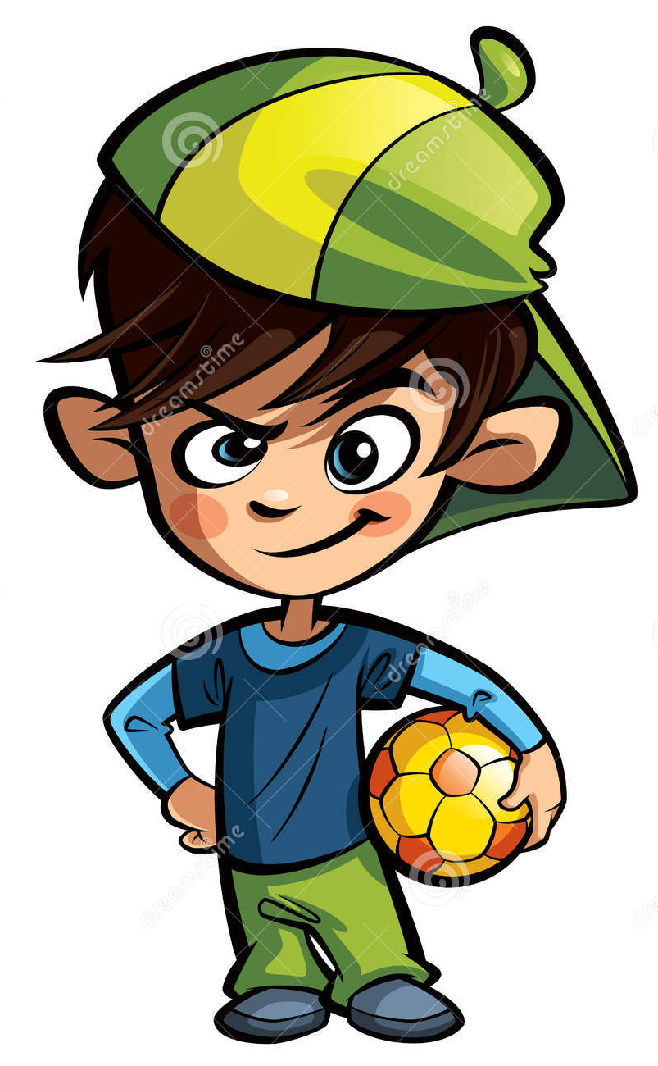
Once upon a time, there was a naughty boy called Tom. He didn’t go to school. He played all the time.

Slide 7
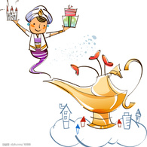
One day, he saw a beautiful lamp. He kicked it. A fairy came out of the lamp.

Slide 8
‘I can give you wishes,’ the fairy said. Tom was very happy and excited.

Slide 9
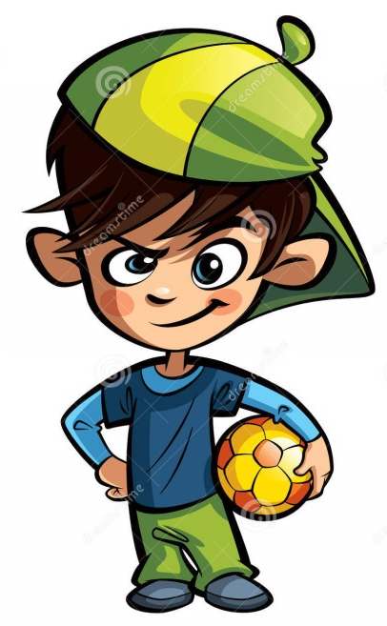
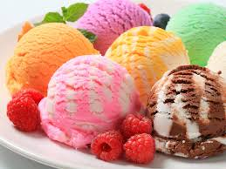
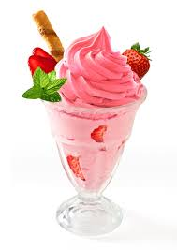
He said, ‘I have _______ _______. I need to share it with my sister.’ ‘So you want more ice cream, right?’ the fairy replied. ‘Yes, I want more ice cream,’ Tom said.

Slide 10
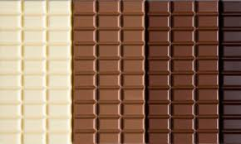
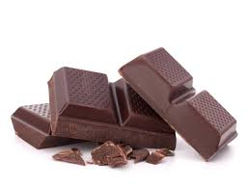
And I have _______ _______ as well,’ Tom said. ‘So you want more chocolate, right?’ the fairy asked. ‘Yes, I want more chocolate.’

Slide 11
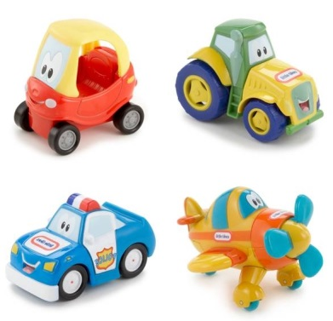
Tom said, ‘I have _______ _______. I need to share them with my brothers,’ he added. ‘So you want more toys, right?’ the fairy asked. ‘Yes, I want more toys.’

Slide 12
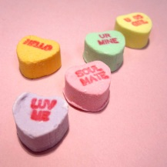
Tom said, ‘I have _______ _______. I feel sad, ’ he complained. ‘So you want more candies, right?’ the fairy replied. ‘Yes, I want more candies,’ he said.

Slide 13
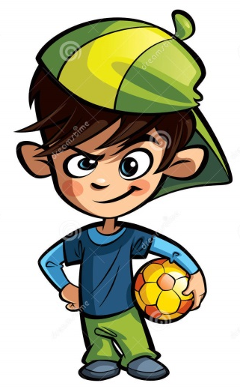
Then Tom thought of a new idea.
‘I have _______ _______!’ he said.
‘So you want more wishes, right?’ the fairy asked. ‘Yes, I want more wishes!’ he said. ‘You are such a greedy boy. I will not give you any wishes!’ the fairy said unhappily.

Slide 14
Once upon a time, there was a naughty boy called Tom. He didn’t go to school. He played all the time.

Slide 15
One day, he saw a beautiful lamp. He kicked it. A fairy came out of the lamp.

Slide 16
‘I can give you wishes,’ the fairy said. Tom was very happy and excited.

Slide 17
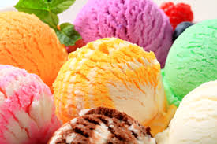
He said, ‘I have little ice cream. I need to share it with my sister.’ ‘So you want more ice cream, right?’ the fairy replied. ‘Yes, I want more ice cream.’

Slide 18
And I have little chocolate as well,’ Tom said. ‘So you want more chocolate, right?’ the fairy asked. ‘Yes, I want more chocolate.’

Slide 19
Tom said, ‘I have few toys. I need to share them with my brothers,’ he added. ‘So you want more toys, right?’ the fairy asked. ‘Yes, I want more toys.’

Slide 20
Tom said, ‘I have few candies. I feel sad, ’ he complained. ‘So you want more candies, right?’ the fairy replied. ‘Yes, I want more candies,’ he said.

Slide 21
Then Tom thought of a new idea.
‘I have few wishes!’ he said.
‘So you want more wishes, right?’ the fairy asked. ‘Yes, I want more wishes!’ he said. ‘You are such a greedy boy. I will not give you any wishes!’ the fairy said unhappily.

Slide 22
What did Tom want more? Write down the things he wanted more.
1. Ice cream
2. chocolate
3. toys
4. candies
5. wishes

Slide 23
The things can be classified into two groups.
Can you put them into the correct box?
1. ice cream 2. chocolate 3. toys
4. candies 5. wishes
Countable noun | Uncountable noun
toys | ice cream
candies | chocolate
wishes

Slide 24
I have few toys. I have little ice cream.
I have few candies . I have little chocolate.
I have few wishes
few ?
little ?

Slide 25
I have few toys. I have little ice cream.
I have few candies. I have little chocolate.
I have few wishes.
little → uncountable nouns
few → countable nouns

