Slide 1
Prepositions
LEE, Gwangmin
The Hong Kong Institute of Education

Slide 5
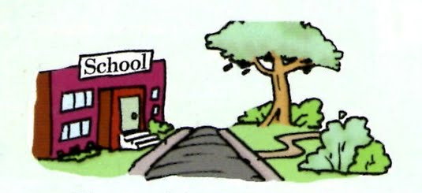
The school is across the park.

