Slide 1

LU, Yuxi Celine & MAO, Yuting Yvette
The Hong Kong Institute of Education

Slide 2
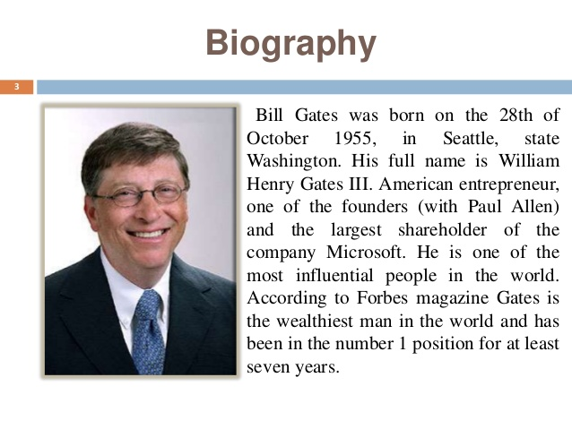



Slide 3
Teacher’s

Slide 4

graduate

Slide 5
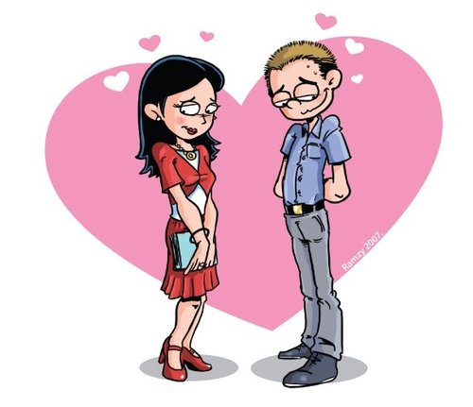
fall in love

Slide 6
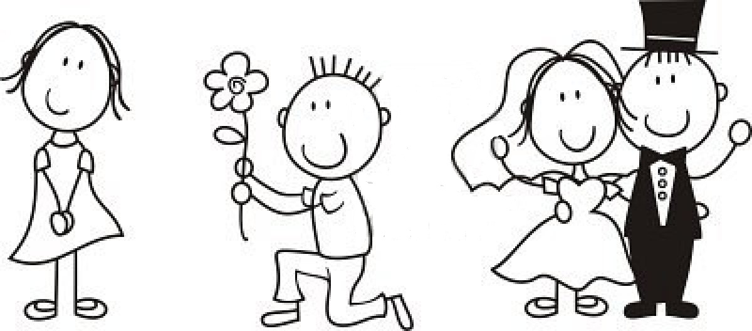
marry

Slide 7
Now listen again and identify the verbs used. Circle the words you hear.
(1) a. was born b. have been born c. bear | (2) a. lived b. have lived c. live | (3) a. was 22 b. have been 22 c. am 22 | (4) a. graduated b. have graduated c. graduates
(5) a. went b. have gone c. goes | (6) a. was 19 b. have been 19 c. am 19 | (7) a. met b. have met c. meet | (8) a. fell in love b. have fallen in love c. fall in love
(9) a. married b. have married c. marry | (10) a. moved b. have moved c. move | (11) a. got b. have got c. get | (12) a. worked b. have worked c. work
(13) a. had b. have had c. have | (14) a. was born b. has been born c. bears | (15) a. lived b. have lived c. live | (16) a. spent b. have spent c. spend
(17) a. travelled b. have travelled c. travel | (18) a. loved b. have loved c. love | (19) a. spent b. have spent c. spend

Slide 8





Listen to the teacher’s biography again and complete the timeline on worksheet 1.
18 years old

Slide 9

Group work!
Create the text together and make it as close to the original biography as possible.

Slide 10
Answers:
(1) a. was born b. have been born c. bear | (2) a. lived b. have lived c. live | (3) a. was 22 b. have been 22 c. am 22 | (4) a. graduated b. have graduated c. graduates
(5) a. went b. have gone c. goes | (6) a. was 19 b. have been 19 c. am 19 | (7) a. met b. have met c. meet | (8) a. fell in love b. have fallen in love c. fall in love
(9) a. married b. have married c. marry | (10) a. moved b. have moved c. move | (11) a. got b. have got c. get | (12) a. worked b. have worked c. work
(13) a. had b. have had c. have | (14) a. was born b. has been born c. bears | (15) a. lived b. have lived c. live | (16) a. spent b. have spent c. spend
(17) a. travelled b. have travelled c. travel | (18) a. loved b. have loved c. love | (19) a. spent b. have spent c. spend
I lived in Mainland China until I was 18.
I have lived most of my adult life in Hong Kong.
Do I live in mainland China now? How do you know?
Do I still live in Hong Kong? How do you know?

Slide 11

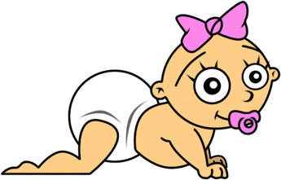
She has spent most of her adult life in HK
Timeline of my teacher
She was born in mainland China.
She met William and married him.
She had her first daughter.
2001
2006
2009
1983
2002
2008
Now
18 years old
She graduated from secondary school and went to Canada.
They move to Hong Kong and she became a teacher.
Her second daughter was born.

Slide 12
Teacher’s original text:
I was born in mainland China in 1983. I lived there until I was 18. I graduated from a secondary school and then I went to Canada for university. When I was 19, I met William and fell in love with him. I married William in Canada. In 2006, my family and I moved to Hong Kong. I got a job in XXX school. I have worked as an English teacher since then. Two years later, we had our first daughter here in Hong Kong. Our second girl was born in 2009.
My family and I have lived in Hong Kong for nine years and we often spend our holiday overseas. So far, we have travelled to 12 countries, such as England, Ireland and Italy. However, we love Hong Kong best. I have stayed most of my adult life in Hong Kong!

Slide 13
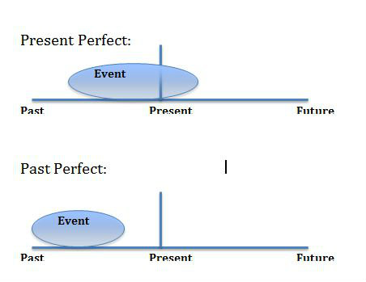
Simple past tense: describe finished actions.
Present perfect tense: unfinished actions.

