Slide 1
Present Progressive
CHAN, Shuk Ling Heather
The Hong Kong Institute of Education

Slide 2
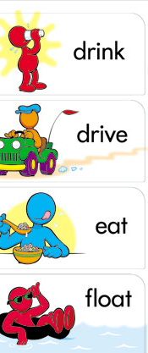
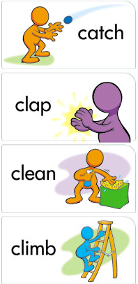
Notes:
https://www.pinterest.com/pin/199425089725899125/

