Slide 1
Water Cycle and Present tense
WONG, Tsz Yu Renee
The Hong Kong Institute of Education

Slide 2
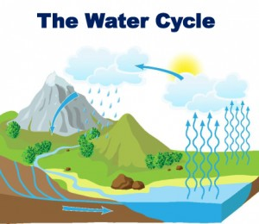
What are (1), (2) and (3)?
2
3
1

Slide 3
Wallpapering
Groups 1 & 2:
write down a noun about stage 1 of the water cycle- evaporation
Groups 3 & 4:
write down a noun about stage 2 of the water cycle – condensation
Groups 5 & 6:
write down a noun about stage 3 of the water cycle – precipitation

Slide 4
Lyrics filling
Listen to the song “ Water Cycle”.
Pay attention to the tense of the verbs.
https://www.youtube.com/watch?v=TWb4KlM2vts
* Fill in the blanks.
Notes:
*

Slide 5
Answer
The Water Cycle Takes the water and moves it Up and Down and all around the Earth Evaporation comes When the heat from the Sun Warms up all the groundwater Then it turns to water vapour Condensation takes over It goes up to the clouds Water vapour cools down And it changes to a liquid, now
Precipitation happens When the drops get big It falls like Rain, Snow, Sleet, and Hail upon my head I know it's the water cycle happening again Evaporation, Condensation, Precipitation

