Slide 1
Present Tense & Adverbs of Frequency
Lee, Gwangmin & Lee, Fung King Jackie
The Hong Kong Institute of Education
The Hong Kong Institute of Education ranked 3rd in Asia and 15th in the world in Education
(QS World University Rankings by Subject 2015)

Slide 2
What do you do every day?
I __________ use a computer.
I __________ read a book.
I __________ speak in English.
I __________ help mum to cook.
I __________ eat in the classroom.
I __________ run in school
I __________ help the teacher.
And she ___________ helps me too.
(Adapted from: https://www.youtube.com/watch?v=Rob0-WzHPkk)
sometimes
usually
often
often
never
never
always
always

Slide 3
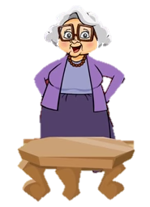
I _____________ get up at six o’clock.
I _____________ have breakfast.
I _____________ walk to the shops.
I _____________ ride my bicycle.
I _____________ watch television.
I _____________ clean the house in the morning.
Then I ____________ have a bath.
I ____________ collect my children at three p.m.
always
usually
sometimes
usually
never
always
sometimes
always
Adapted from:
https://www.youtube.com/watch?v=v9odRPdMGv8

Slide 4
Always = every day
Usually = 5 – 6 times a week
Often = 4 times a week
Sometimes = 3 times a week
Seldom = 1 -2 times a week
Never = 0 times a week

