Slide 1
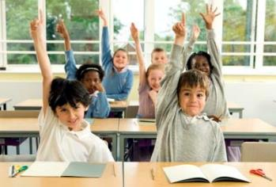
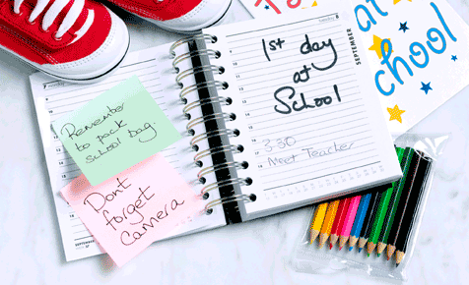
School life
Mao Yuting
The Hong Kong Institute of Education

Slide 2
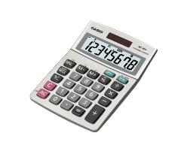
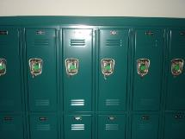
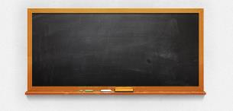
computer
notebook
folder
calculator
globe
locker
blackboard ….

Slide 3
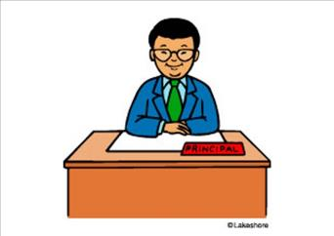
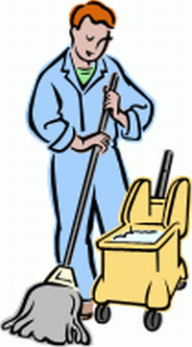
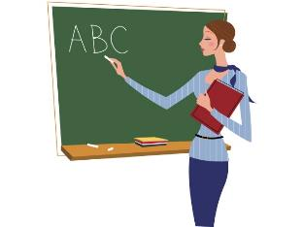
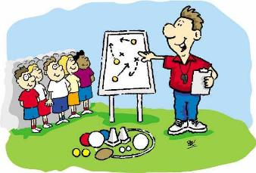
the principal
teacher
football coach
janitor
…

Slide 4
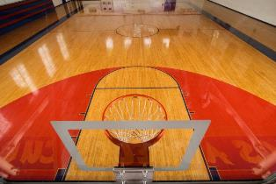
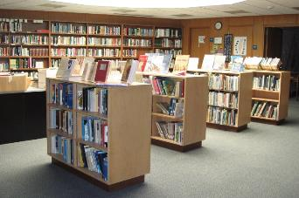
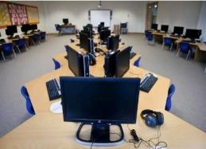
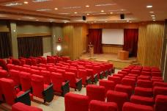
basketball court
library
auditorium
computer room
science lab gymnasium
….

Slide 5
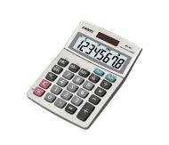
What is it?
It is a small device.
It is a small device. We use it for calculating.
It is a small device which we use for calculating.
calculator

Slide 6
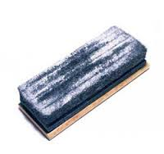
What is it?
It is a small thing.
It is a small thing. It can remove chalk marks on the blackboard.
It is a small thing which can remove chalk marks on the blackboard.
eraser / duster

Slide 7
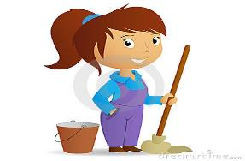
Who is this person?
She is a maid.
She is a maid. She cleans the classrooms for us.
She is a maid who cleans the classrooms for us.
janitor

Slide 8
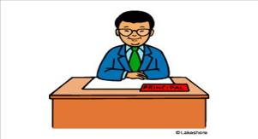
Who is this person?
He is a person.
He is a person. He is in charge of the school.
He is a person who is in charge of the school.
school principal

Slide 9
1. It is a small device. We use it for calculating.
It is a small device which we use for calculating.
2. It is a small thing. It can remove chalk marks on the blackboard.
It is a small thing which can remove chalk marks on the blackboard.
In both green sentences, there is a “magic” word linking two parts together. What is it?

Slide 10
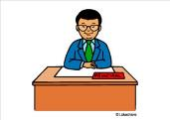
3. She is a maid. She cleans the classroom for us.
She is a maid who cleans the classrooms for us.
4. He is a teacher. He is in charge of the school.
He is a person who is in charge of the school.
In both green sentences, there is a “magic” word linking two parts together. What is it?

Slide 11
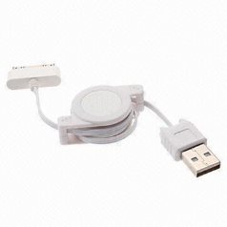
Which & Who – Relative pronoun!!!
Relative pronouns link two clauses together.
1st part + relative pronoun + 2nd part
Relative clause

Slide 12
Now, use a relative pronoun to join the sentences.
1. It is a small device. We use it for calculating.
It is a small device _______________________________.
2. It is a small thing. It can remove chalk marks on the blackboard.
It is a small thing __________________________________.

Slide 13
Underline the relative clause.
1. It is a small device. We use it for calculating.
It is a small device which we use for calculating.
2. It is a small thing. It can remove chalk marks on the blackboard.
It is a small thing which can remove chalk marks from the blackboard.

Slide 14
Identify the Subject, Verb, Object and the relative pronoun in the parts highlighted.
1. It is a small device. We use it for calculation.
It is a small device which we use for calculation.
2. It is a small thing. It can remove chalk marks from the blackboard.
It is a small thing which can remove chalk marks on the blackboard.

Slide 15
Relative pronoun ‘which’
1. It is a small device. We use it for calculating.
It is a small device (which we use for calculating).
S
V
O
Relative pronoun
S
V

Slide 16
Relative pronoun ‘which’
1. It is a small device. We use it for calculating.
It is a small device (which we use for calculating).
2. It is a small thing. It can remove chalk marks on the blackboard.
It is a small thing (which can remove chalk marks on the blackboard).
S
V
O
Relative pronoun
S
V
S
V
O
Relative pronoun
V
O
Relative pronoun “which” stands for object or subject of the verb.
We use ‘which’ for things.

Slide 17
Now, use a relative pronoun to join the sentences.
3. Ms. Lee is a maid. She cleans the classrooms for us.
Ms. Lee is a maid _______________________________.
4. He is a teacher. Naughty students have to see him.
He is a teacher _____________________________________.

Slide 18
Underline the relative clause.
1. Ms. Lee is a maid. She cleans the classrooms for us.
Ms. Lee is a maid who cleans the classrooms for us.
2. He is a teacher. Naughty students have to see him.
He is a teacher who/whom naughty students have to see.

Slide 19
Identify the Subject, Verb, Object and the relative pronoun in the parts highlighted.
1. Ms. Lee is a maid. She cleans the classrooms for us.
Ms. Lee is a maid who cleans the classrooms for us.
2. He is a teacher. Naughty students may meet him.
He is a teacher who naughty students may meet.

Slide 20
Relative Pronoun ‘who’
1. Ms. Lee is a maid. She cleans the classrooms for us.
Ms. Lee is a maid (who cleans the classrooms for us).
S
V
O
V
O
Relative pronoun

Slide 21
Relative Pronoun ‘who’
1. Ms. Lee is a maid. She cleans the classrooms for us.
Ms. Lee is a maid (who cleans the classrooms for us).
2. He is a teacher. Naughty students have to see him.
He is a teacher (who naughty students have to see).
S
V
O
V
Relative pronoun
O
S
V
O
Relative pronoun
S
V
Relative pronoun “who” stands for object or subject of the verb.
We use ‘who’ for people.

Slide 22
Practice!
Combine the two sentences with a relative pronoun.
1. It is an electronic machine.
We can use it to find useful information on the Internet.
It is an electronic machine which we can use it to find useful information on the Internet.
computer

Slide 23
Practice!
Combine the two sentences with a relative pronoun.
It is a ball-shaped object.
It shows people the map of the world.
It is a ball-shaped object which it shows people the map of the world.
globe

Slide 24
Practice!
Combine the two sentences with a relative pronoun.
3. It is a piece of cardboard.
We use it to keep loose papers.
It is a piece of cardboard which we use it to keep loose papers.
file

Slide 25
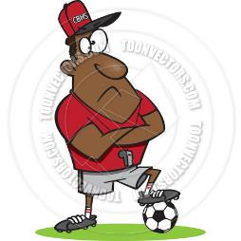
Practice!
Combine the two sentences with a relative pronoun.
4. Mr. Luk is a teacher.
He teaches us how to play football.
Mr. Luk is a teacher who he teaches us how to play football.
coach

Slide 26
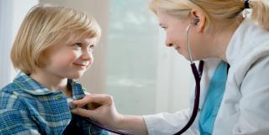
Practice!
Combine the two sentences with a relative pronoun.
5. She is a nice person.
She takes care of sick children.
She is a nice person who she takes care of sick children.
School doctor

Slide 27
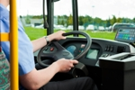
Practice!
Combine the two sentences with a relative pronoun.
6. He is a person.
He drives the school bus every day.
He is a person who he drives the school bus every day.
driver

Slide 28
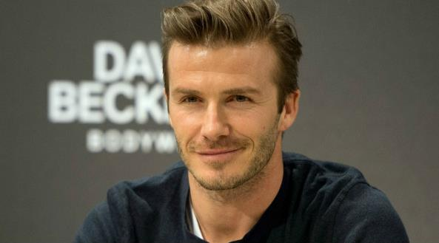
Guessing game– Big TV
Beckham

Slide 29
Guessing game– Big TV
flying carpet

Slide 30
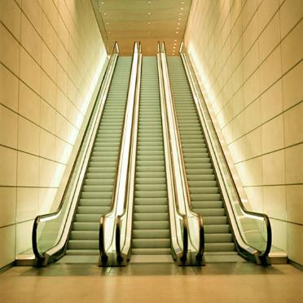
Guessing game– Big TV
escalator

Slide 31
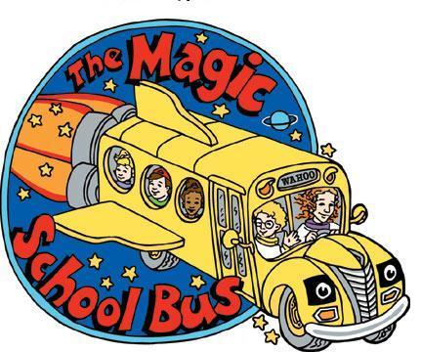
Guessing game– Big TV
Magic school bus

Slide 32
Guessing game– Big TV
magician

Slide 33
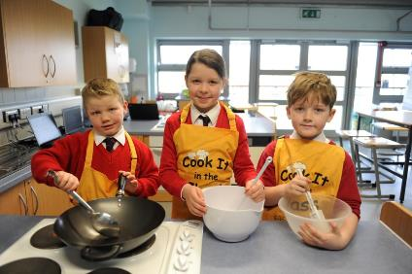
Guessing game– Big TV
Cooking lesson

Slide 34
The School Open Day 2015
You are being trained to be a student ambassador who can provide parents and guests with information about our school in the campus tour.

Slide 35
What the Student Ambassadors said in the past

Slide 36
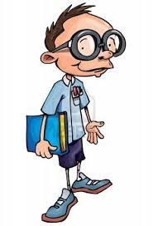
Room 105 is the Staff Room. Teachers mark our exam papers in the Staff Room.
Room 205 is the Student Activity Center. Dance club members have their Jazz class in the Student Activity Center.
Room 308 is the Multi-media Learning Center. Students watch movies together in the MMLC after school.
Student A

Slide 37
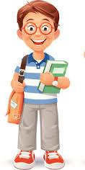
Room 105 is the Staff Room where teachers mark our exam papers.
Room 205 is the Student Activity Center where Dance Club members have their Jazz class.
Room 308 is the Multi-media Learning Center where students watch movies together after school.
Student B

Slide 38
1
Student A
Room 105 is the Staff Room. Teachers mark our exam papers in the Staff Room.
Room 205 is the Student Activity Center. Dance Club members have their Jazz class in the Student Activity Center.
Room 308 is the Multi-media Learning Center. Students watch movies together in the MMLC after school.
2
3
4
5
6
Room 105 is the Staff room where teachers mark our exam papers.
Room 205 is the Student Activity Center where Dance Club members have their Jazz class.
Room 308 is the Multi-media Learning Center where students watch movies together after school.
1
2
There is a “magic” word that is used by student B to link two parts together. What is it?
3
Student B

Slide 39
Room 105 | is | the Staff Room
Teachers | mark | our exam papers | in the Staff Room
S | V | O | Prepositional phrase of place
Room 105 | is | the Staff Room
where
Relative adverb
teachers | mark | our exam papers
S | V | O
Give more information about the place using 1 sentence

Slide 40
Room 205 | is | the Student Activity Center
Dance Club members | have | their Jazz class | in the SAC .
S | V | O | Prepositional phrase of place
Room 205 | is | the Student Activity Center
where
Relative adverb
Dance Club members | have | their Jazz class.
S | V | O
Give more information about the place using 1 sentence

Slide 41
Room 308 | is | the Multi-media Learning Center
Students | watch | movies | in the MMLC
S | V | O | Prepositional phrase of place
Room 308 | is | the Multi-media Learning Center
where
Relative adverb
students | watch | movies
S | V | O
Relative adverb “where” stands for prepostional phrase of place.
We use “where” for place.

Slide 43
What is room ___________________?
What do people do in ___________?
Room___ | is | __________(name of the room)
where
Relative adverb
S | V | O

Slide 44
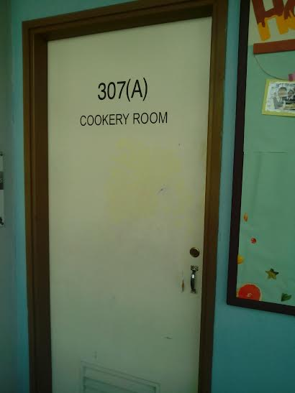
Hi ,what is room 307?
What do people do in this room?
Room 307 is the Cookery Room.
Students have their home economics lessons in the Cookery Room.
Room 307 is the Cookery Room where students have their home economics lessons in the Cookery Room.

Slide 45
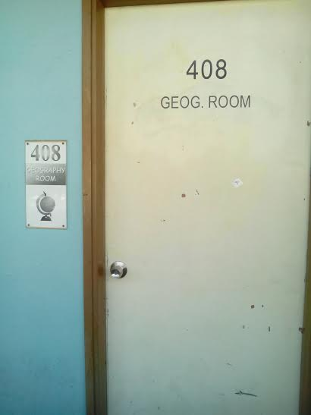
Hi ,what is room 408?
What do people do in this room?
You can find different maps in the geography room.
Room 307 is the geography room where you can find different maps in the geography room.

Slide 46
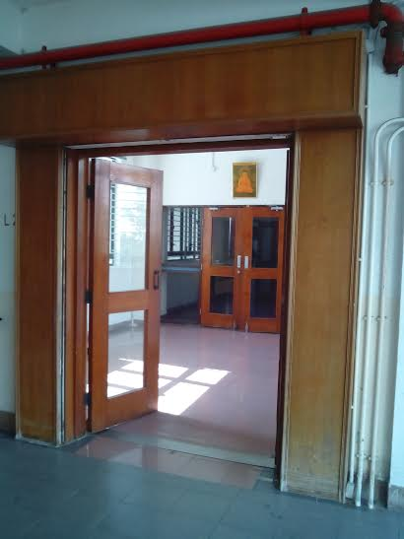
Hi, what is room 200?
What do people do in this room?
Students attend talks and assemblies in the school hall.
Room 200 is the school hall where students attend talks and assemblies in the school hall.

Slide 47
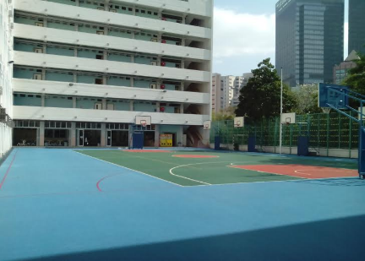
Hi, what is __________?
What do people do there?
The open area next to the tuck shop is the playground.
Students play basketball in the playground after school .
The open area next to the tuck shop is the playground where students play basketball in the playground after school .

Slide 48
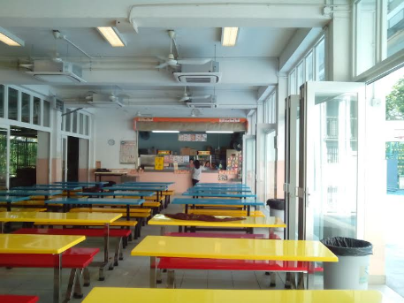
Hi, what ___________________?
What do people ___________?
The area next to the playground is the tuck shop.
You can buy snacks in the tuck shop!
The area next to the playground is the tuck shop where you can buy snacks in the tuck shop.

Slide 49
Congratulations!

Slide 50
Situation
You are now qualified student ambassadors.
You have a map with missing information.
You now have to talk to your partner and find out the missing information.

Slide 51
Materials
2 school maps
Use relative adverb “where” to provide information about school facilities and the activities held in different places.

Slide 53
My school -Hogwarts

