Slide 1
Subject-Verb Agreement
KIAN Hin Chi, Gideon
The Hong Kong Institute of Education

Slide 2
Activity 1 - Video watching and blank-filling
Video link 1: https://www.youtube.com/watch?v=hmUKdIc0y9I
Supplementary video link : https://www.youtube.com/watch?v=X8VWhVQzPGg

Slide 3
Bones
During growth, some of these bones fuse together and by adulthood, the total
number decreases to 206.
The heart
Your heart begins beating just 4 weeks after conception and doesn’t stop until you die.
Your heart beats an impressive 100,000 times a day.
Eyes
Unlike ears and noses, the eyes stay the same in your entire life.
Oddly enough, they perceive reality upside down before the brain flips it upright.
Nose
Our noses also behave like an air conditioner: warming up cold air, cooling down hot air
Skin
Humans shed about 600,000 particles of skin every hour.
Nails
Men’s nails grow faster than women’s nails. Fingernails grow almost 4 times faster than toenails.

Slide 4
Sentences from the supplementary video
The human eye blinks over 4,200,000 times a year.
A person produces enough saliva to fill 2 average size swimming pools during their life time.
The human body creates 2,500,000 new red blood cells every second.
An average person walks the equivalent of twice around the world in a lifetime

Slide 5
Group 1
Noun (Subject) | Verb
Your heart | begins, beats
The total number | decreases
The brain | flips
The human eye | blinks
A person | produces
The human body | creates
An average person | walks

Slide 6
Group 2
Noun (Subject) | Verb
Some of these bones | fuse
You | die
The eyes | stay
They | perceive
Our noses | behave
Humans | shed
Men’s nails | grow
Fingernails | grow
We | come

Slide 7
Group 2
Noun (Subject) | Verb
Some of these bones | fuse
You | die
The eyes | stay
They | perceive
Our noses | Behave
Humans | Shed
Men’s nails | grow
Fingernails | grow
We | come

Slide 8
1.What is in common between the verbs in group 1?
All verbs end with ‘s’. They are singular verbs.
2.What is the difference between the verbs in group 1 & group 2?
None of the verbs in group 2 ends with “s”.
3.In the present tense, we have to add “s” to the verbs after some nouns. What are these nouns?
Nouns: singular
4.For some nouns and pronouns, we do not need to add “s”. What are these nouns?
Nouns: plural

Slide 9
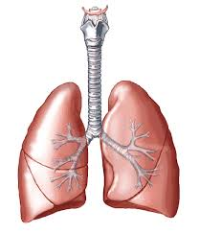
Activity 2 - Fill in the blanks - facts about lungs.

Slide 10
Your lungs ___move ______ oxygen from the air you breathe into your bloodstream. They ____take__ away carbon dioxide (CO2), which you need to breathe out.
Your left and right lungs _____are____ not exactly the same. The left lung ______is____ slightly smaller. This ___allows_________ room for your heart.
It ___is___ possible for some people to live with one lung only. Although it ____limits_ your physical ability, you are still able to live a relatively normal life. Many people around the world __live______ with just one lung.

Slide 11
Activity 3 - Card Matching Game
Examples
________(use) over a quarter of the oxygen used by the human body.
The brain
Your heart
_________(beat) around 100,000 times a day, 36,500,000 times a year.

Slide 12
Answers of the examples
The brain | __uses___(use) over a quarter of the oxygen used by the human body.
Your heart | __beats_(beat) around 100,000 times a day, 36,500,000 times a year.

Slide 13
Answers
The brain | uses over a quarter of the oxygen used by the human body.
Your heart | beats around 100,000 times a day, 36,500,000 times a year.
Red blood cells | carry oxygen around the body.
Your nose and ears | continue growing throughout your entire life.
It | takes the body around 12 hours to completely digest eaten food.
The human heart | creates enough pressure to squirt blood 30 feet.
Women’s hearts | beat faster than men’s.
Women | blink twice as many times as men do.
Sunburn | damages the blood vessels extensively.
A human head | remains conscious for about 15 to 20 seconds after it has been removed from the body.

Slide 14
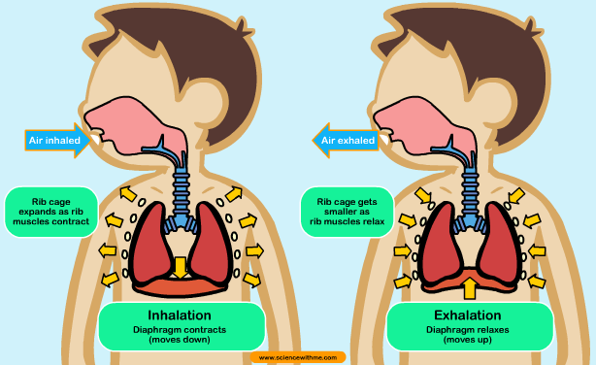
Writing – Describing the respiratory system (for intermediate learners)
Video link: https://www.youtube.com/watch?v=ydX8Lw4q2Mk
When do we need more oxygen intake? Why do we need more oxygen at that time?
What is the link between energy and breathing?
What do we breathe in and breathe out?
How does air come in and go out of the body?
What does nose hair do?
What is the diaphragm?
What are bronchioles?
What is the use of alveoli?
Do fish have lungs? How do they breathe?

Slide 15
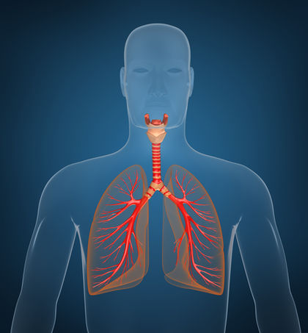
Writing – Describing the respiratory system (for advanced learners)
Video link: https://www.youtube.com/watch?v=hc1YtXc_84A
Guiding questions
What do we breathe in and breathe out?
(Hints: Where do oxygen and carbon dioxide travel to?)
When do we need more oxygen intake? Why do we need more oxygen at that time?
How does our body respond to the increased demand for oxygen? (e.g. How do the lungs and the respiratory system respond?)
What is the benefit of exercising?

