Slide 1
Passive Voice Senior Primary
Mak, Tin Lun Colin; Lee, Fung King Jackie
The Education University of Hong Kong

Slide 2
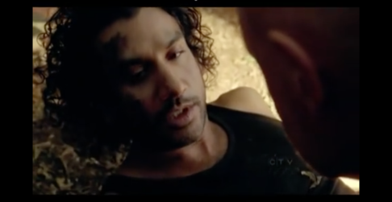
What happened?
We were attacked.
Source: https://youtu.be/dzeI93MszMk?t=11s

Slide 3
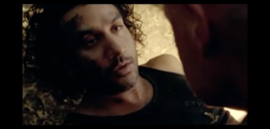
We were attacked.
Who attacked them?
I don’t know.
Someone attacked them.

Slide 4
1. Someone attacked us.
2. We were attacked.
“ BE + Past Participle”
Passive Voice

Slide 5
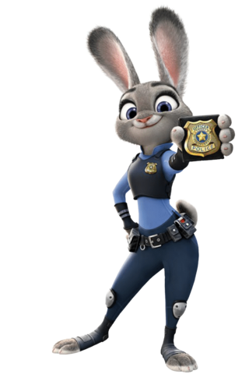
Judy Hopps
Rabbit
Police officer
https://www.youtube.com/watch?v=OCxjDkCxL1c&list=PLe7rCRMc2z9USj46WcEgbY0UzwxlHfyzM&index=3

Slide 6
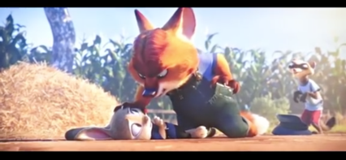
Look at the sentences.
1. The sheep were bullied by the fox.
2. The fox bullied the sheep.

Slide 7
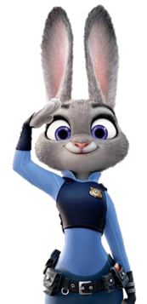
Judy has finished investigating a bank robbery case.
Look at the pictures and write a news report on the case.

Slide 8
1
2
3
4

