Slide 1
Lesson 1
Senior Primary
Mak, Tin Lun Colin; Lee, Fung King Jackie
The Education University of Hong Kong

Slide 2
Turn
up
down
on
off
Turn
Turn
Turn
Turn

Slide 3
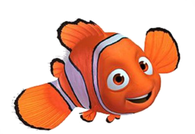
The room is very dark! Let me turn on the lights!

Slide 4
I don’t need the lights now. Can you turn them off?

Slide 5
Turn up
Turn down

Slide 6
What will you do when you feel hot?
I’ll turn on the fan!
I’ll turn up the fan!
What about if you are cold?
I’ll turn off the fan!
I’ll turn down the fan!

Slide 7
Look
up
after
for
into
Look
Look
Look
Look

Slide 8
What does “look up” mean?

Slide 9
If you don’t know the words, you can look up the meanings in a dictionary.

Slide 10
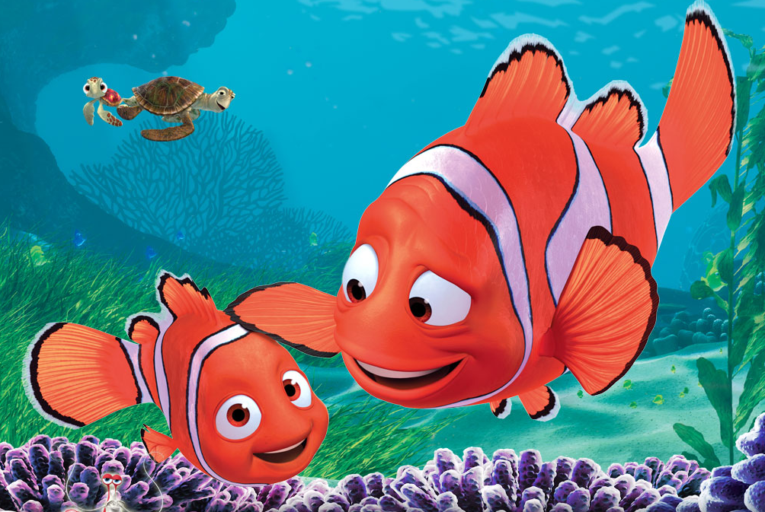
Marlin looks after Nemo when he is sick.
I look after the pets I love.

Slide 11
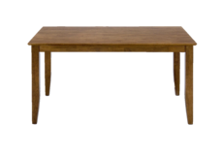
Oh no! I have lost my wallet! Can you help me look for it, please?
It is under the table!

Slide 12
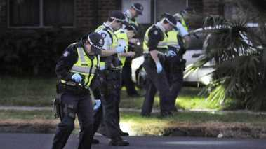
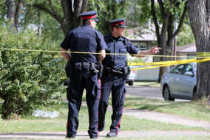
The police are trying to find the killer! They are looking into the case. They are investigating the case.

Slide 13
1. We don’t know this word. What should we do?
You should ( look up / look into) the word in the dictionary.
2. What should you do to your favourite pet?
We should ( look up / look after) our favourite pet.

Slide 14
3. I want to learn more about the accident. What should I do?
You should (look into / look after) the case.
4. Your friend has lost her pet! You should help her (look into / look for
/ look after) it.

