Slide 1
Lesson 2
Au. Lai Yee; Lee, Fung King Jackie
The Education University of Hong Kong

Slide 2



Lesson Overview
Recap
Read a story about a light bulb together.
Write our own stories*.
(We will write the beginning of the story together!)
Share our stories with our classmates.

Slide 3
Lesson Objective
At the end of the lesson,
we will be able to…
write and share a short story
  using the eight phrasal verbs
  we have learnt before.

Slide 4


Phrasal verbs we learnt in the last lesson
Let’s read together!
Turn on
Turn off
Turn up
Turn down
?
Look up
Look after
Look for
Look into

Slide 5

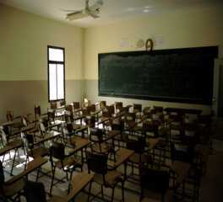
Recap
Do you still remember their meanings?
Try to answer the following questions!
It is too dark in the classroom. You should ask the teacher to…
?
?
turn on the lights.
turn off the lights.

Slide 6

Recap
Do you still remember their meanings?
Try to answer the following questions!
Your teacher plays the class a song but you can’t hear it well.
You should ask the teacher to…
?
turn up the volume.
turn down the volume.
?

Slide 7
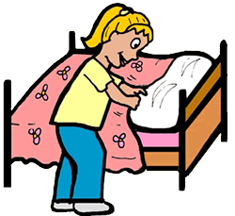
Recap
Do you still remember their meanings?
Try to answer the following questions!
?
If you don’t know what “phrasal” means, you can…
look up the word in the dictionary.
look after the word in the dictionary.
?

Slide 8
Recap
Do you still remember their meanings?
Try to answer the following questions!
?
If you want to solve a problem, you should…
look into the problem carefully.
look after the problem carefully.
?

Slide 9
STORY TIME

Slide 10
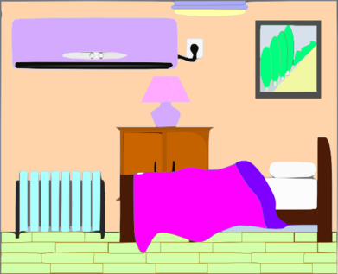


Liam The Lightbulb
on
Liam is a lightbulb in Boo’s bedroom.

Slide 11
Liam The Lightbulb
on
He never gets to rest because Boo never turns off the light.

Slide 12



Liam The Lightbulb
on
on
Boo doesn’t turn off the light when she’s not in her room.

Slide 13
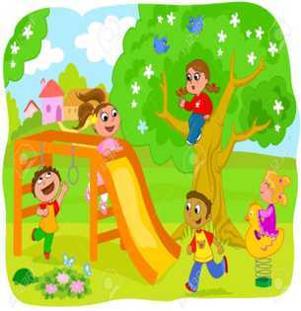

Liam The Lightbulb
on
Boo doesn’t turn off the light when she’s not at home.

Slide 14
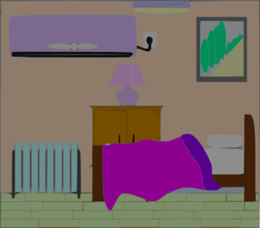

Liam The Lightbulb
on
Finally, Liam is too tired. Liam can no longer work.
Boo can’t turn on the light again.

Slide 15
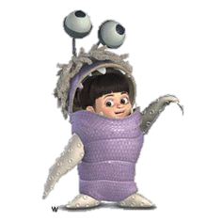
Liam The Lightbulb
Talk with your group members about these questions:
How do you feel about the story?
What would you do if you were Boo?
What phrasal verbs can you find in the story?

Slide 16
WRITING TIME

Slide 17

Writing time
Now we are going to write a short story.
The first part of the story has been given.
You have to continue the story on the worksheet.
You must use at least 1 phrasal verb you learnt in the last lesson for each picture.

Slide 18
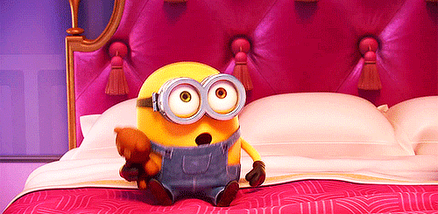
Writing time
My name is Bob. I always bring my cute little teddy bear with me.

Slide 19






Writing time
Choose one to work on!
1 | 2 | 3 | 4
?

Slide 20
Picture 1
Sometimes I can’t find my cute little teddy bear.
Choose one to write about:
1. You lose your cute little teddy bear. What will you do?
2. You lost your cute little bear for the fifth time this week. If you can find it, what will you do?
?
Which phrasal verb can you use?
Next page

Slide 21
Picture 2
Sometimes I go to the public library with my cute little teddy bear.
Choose one to write about:
1. You love listening to music. However, at the library you need to keep quiet. What will you do?
2. Why do you go to the library? Is it because you need help with your homework? What will you do?
Which phrasal verb can you use?
Next page

Slide 22
Picture 3
After school, I sometimes stay in my classroom to study with my cute little teddy bear.
Choose one to write about:
1. You find some very difficult topics. You want to understand the topics better. What will you do?
2. You are the only one in the classroom and all the lights are on. What will you do?
Which phrasal verb can you use?
Next page

Slide 23
Picture 4
I go back home from school with my cute little teddy bear.
Choose one to write about:
1. It is evening already when you are home. It is quite dark in your flat. What will you do?
2. You are at home now with your pet dog and it is dinner time. What will you do?
3. It is raining and thundering loudly outside and you are watching TV. What will you do?
Which phrasal verb can you use?
Next page

Slide 24
SHARING TIME

Slide 25
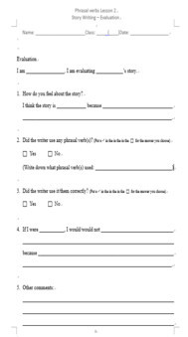
Story Sharing
Pay attention when your classmates are speaking.
After listening to their stories, remember to evaluate the stories using p.4 of the worksheet.

Slide 27



Phrasal verbs
In this lesson, we have…
  → written a short story
  using the eight phrasal verbs.
Good job!

Slide 28
Phrasal verbs we have learnt
Let’s read together!
Turn on
Turn off
Turn up
Turn down
?
Look up
Look after
Look for
Look into

Slide 29
THE END

