Slide 1
Possessive Pronouns
(Possessive Adjectives)
Yeung, Ching Yee Annie; Lee, Fung King Jackie
The Education University of Hong Kong

Slide 2
Do you still remember this family?

Slide 3
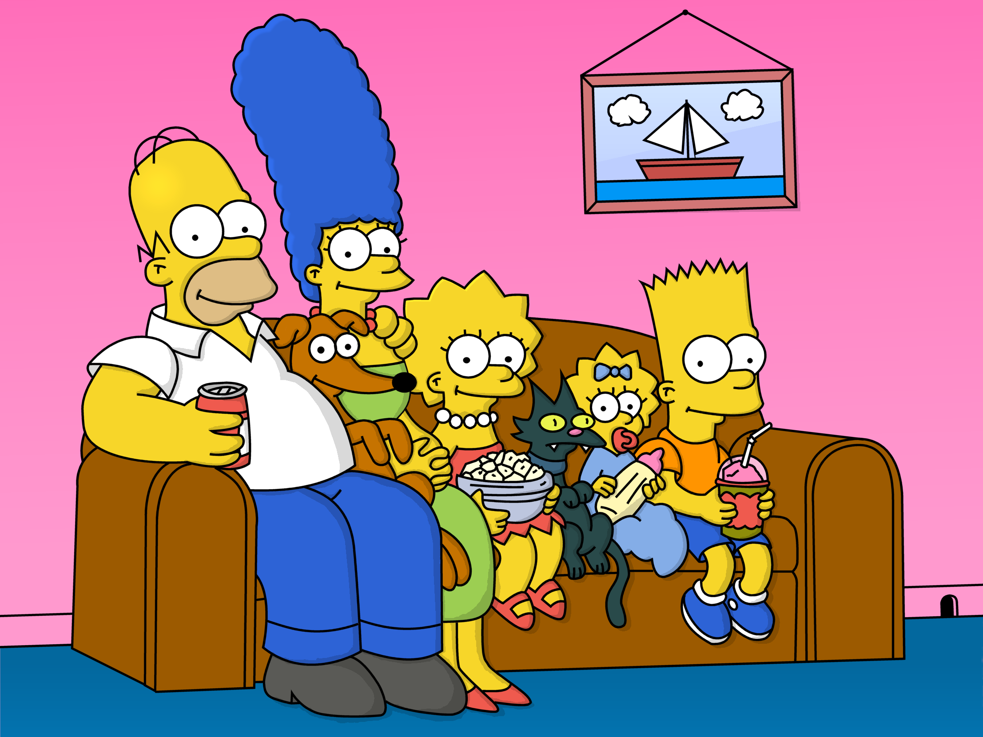
The Simpson
Family
Mommy
Sister
(Lisa)
Daddy
Brother (Bart)
Lucky
Maggie
Mary

Slide 4
Let’s read a story about the Simpson family!

Slide 5
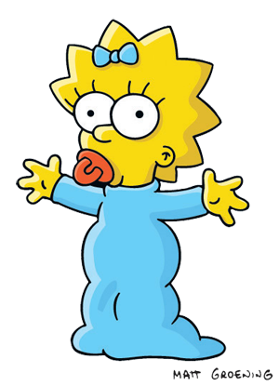
My family
I am Maggie. There are five people and two pets in my family. My mother loves helping people. My mother is a nurse. My father saves people’s lives. My father is a doctor.
My mother and father love all of us. My mother and father take care of us. My family has two pets. My family always play with them. Lucky is a dog. Lucky loves bones best. Mary is a cat. Mary likes fish best.
Now, it’s time for the class to share!

Slide 6
Replace the repeated nouns with pronouns.

Slide 7
My family
I am Maggie. There are five people and two pets in my family. My mother loves helping people. My mother is a nurse. My father saves people’s lives.
My father is a doctor.
My mother and father love all of us. My mother and father take care of us. My family has two pets. My family always play with them. Lucky is a dog. Lucky loves bones best. Mary is a cat. Mary likes fish best.
Now, it’s time for the class to share!

Slide 8
My family
Subject Pronouns
I am Maggie. There are five people and two pets in my family. My mother loves helping people. My mother is a nurse. My father saves people’s lives.
My father is a doctor.
My mother and father love all of us. My mother and father take care of us. My family has two pets. My family always play with them. Lucky is a dog. Lucky loves bones best. Mary is a cat. Mary likes fish best.
Now, it’s time for the class to share!
She
He
They
We
It
It
you

Slide 9
Let’s read another version of the story!

Slide 10
My family
My name is Maggie. There are five people and two pets in my family. My mother loves helping people. What is her job? She is a nurse. My father saves people’s lives. What is his job? He is a doctor.
My mother and father love us and also our pets. Their names are Lucky and Mary. Lucky is a dog. Its favourite food is bones. Mary is a cat. Its favourite food is fish.
Can you share something about your family too?

Slide 11
Pay attention to the coloured words. What are they?

Slide 12
My family
Possessive Pronouns
My name is Maggie. There are five people and two pets in my family. My mother loves helping people. What is her job? She is a nurse. My father saves people’s lives. What is his job? He is a doctor.
My mother and father love us and also our pets. Their names are Lucky and Mary. Lucky is a dog. Its favourite food is bones. Mary is a cat. Its favourite food is fish.
Can you share something about your family too?

Slide 13
Do you know these words in Chinese?

Slide 14
My family
她的
我的
My name is Maggie. There are five people and two pets in my family. My mother loves helping people. What is her job? She is a nurse. My father saves people’s lives. What is his job? He is a doctor.
My mother and father love us and also our pets. Their names are Lucky and Mary. Lucky is a dog. Its favourite food is bones. Mary is a cat. Its favourite food is fish.
Can you share something about your family too?
他的
他們的
我們的
牠的
你的

Slide 15
Subject pronouns | Chinese meanings | Possessive pronouns | Chinese meanings
I | 我 | my | 我的
you | 你 | your | 你的
he | 他 | his | 他的
she | 她 | her | 她的
it | 牠/ 它 | its | 牠的/ 它的
we | 我們 | our | 我們的
they | 他們 | their | 他們的

