Slide 1
Red Rockets and Rainbow Jelly
(by Sue Heap & Nick Sharratt)
Cheng, Baoqiong Paula; Li, Zijia Sharon
The Education University of Hong Kong

Slide 2
What colours can you see?

Slide 3
red

Slide 4
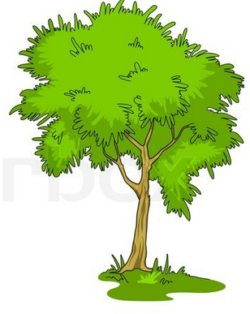
green

Slide 5
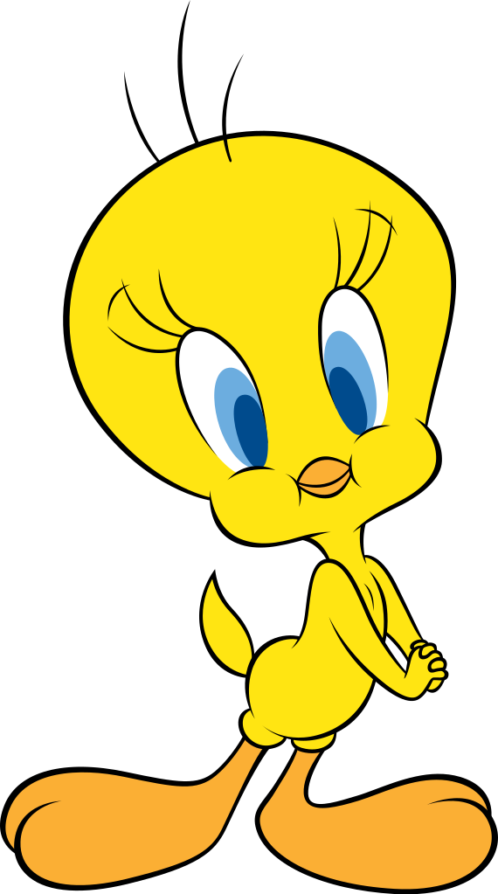
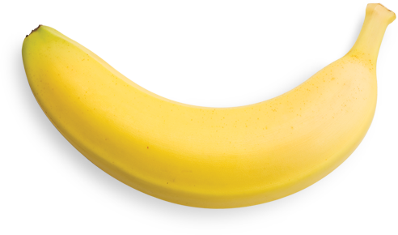
yellow

Slide 6
purple

Slide 7
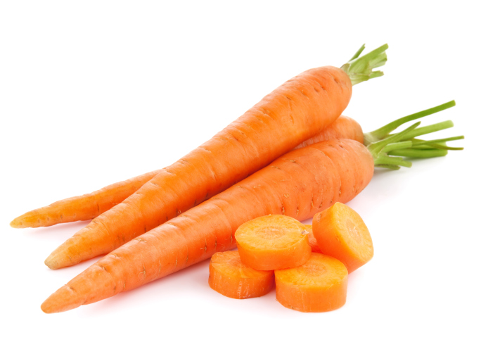
orange

Slide 8
brown

Slide 9
black

Slide 10
white

Slide 11
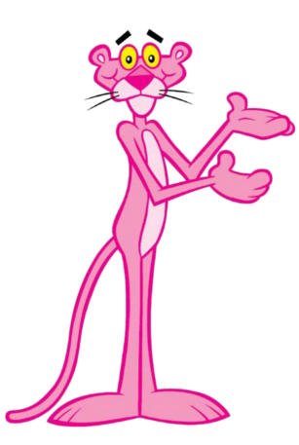
pink

Slide 12
blue

Slide 13
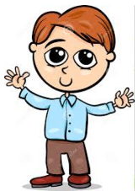
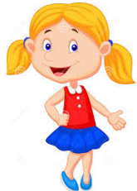
This is Nick. This is Sue.

Slide 14
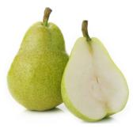
Nick likes red apples.
Sue likes green pears.

Slide 15
Nick likes yellow socks.
Sue likes yellow ducks.

Slide 16
Nick likes orange hair.
Sue likes purple hair...

Slide 17
...and purple flowers.

Slide 18
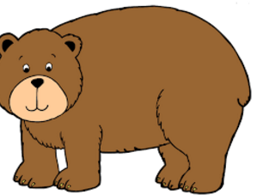
Nick likes brown bears and black cats.

Slide 19
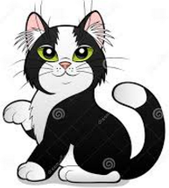
Sue likes black and white cats and black and white hats.

Slide 20
Nick likes red cars.
Sue likes pink and orange cars.

Slide 21
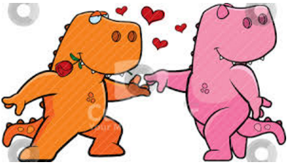
Nick likes pink and orange dinosaurs.

Slide 22
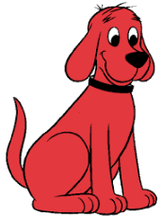
Sue likes red rockets and red dogs.

Slide 23
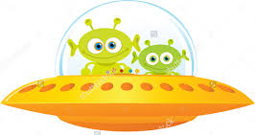
Nick likes green aliens.
Sue likes green and yellow aliens.

Slide 24
Nick likes green and red and pink and orange and yellow and purple jelly.

Slide 25
Sue likes everything blue.

Slide 26
Sue likes Nick.
Nick likes Sue.

Slide 27
Check understanding!

Slide 28
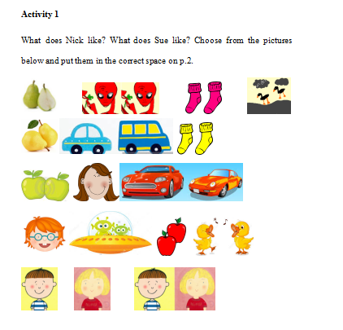

Slide 29
Activity 1: Put the pictures in the correct spaces.
1. ____________ likes red apples.
2. likes green pears.

Slide 30
Activity 1: Put the pictures in the correct spaces.
3. ____________ likes yellow socks.
4. likes yellow ducks.

Slide 31
Activity 1: choose the correct pictures and put them in the spaces.
5. ____________ likes orange hair.
6. likes red cars.

Slide 32
Activity 1: Put the pictures in the correct spaces.
7. ____________ likes green aliens.

Slide 33
Activity 2:
(a) Fill in the blanks. You may find the answers in the reader.
1. __________ __________ purple hair and purple flowers.
2. __________ __________ brown bears and black cats.
3. __________ __________ pink and orange cars.
4. __________ __________ pink and orange dinosaurs.
5. __________ __________ red rockets and red dogs.
6. __________ __________ green and yellow aliens.
(b) Circle the verbs.

Slide 34
Activity 2:
(a) Fill in the blanks. You may find the answers in the reader.
1. Sue likes purple hair and purple flowers.
2. Nick likes brown bears and black cats.
3. Sue likes pink and orange cars.
4. Nick likes pink and orange dinosaurs.
5. Sue likes red rockets and red dogs.
6. Sue likes green and yellow aliens.
(b) Circle the verbs.

Slide 35
Activity 2:
(a) Fill in the blanks. You may find the answers in the reader.
1. Sue likes purple hair and purple flowers.
2. Nick likes brown bears and black cats.
3. Sue likes pink and orange cars.
4. Nick likes pink and orange dinosaurs.
5. Sue likes red rockets and red dogs.
6. Sue likes green and yellow aliens.
(b) Circle the verbs.

Slide 36
Activity 2:
(c) How about you? What do you like? Complete the following three sentences with your own ideas.
I like ____________ ____________. (e.g. red cars)
I ____________ ____________ ____________ .
____________ ____________ ____________ ____________.

Slide 37
Circle Game

Slide 38
1. Draw and colour your favrouite fruit. 2. Stand in a circle, and hold the picture. 3. Take turns to tell what your classmates’ favourite fruits are (e.g. Andy likes green pears, … and Mary likes purple grapes, etc.). Optional: Memory game 4. Remember your classmates’ favourite fruits. 5. Each student turns over the picture so that others can’t see the picture. 6. Take turns to tell what each classmate’s favourite fruit is. The classmate then turns over the picture to check the answer.
Steps:

Slide 39
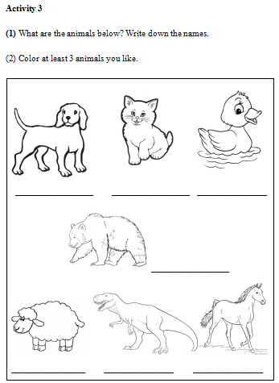

Slide 40
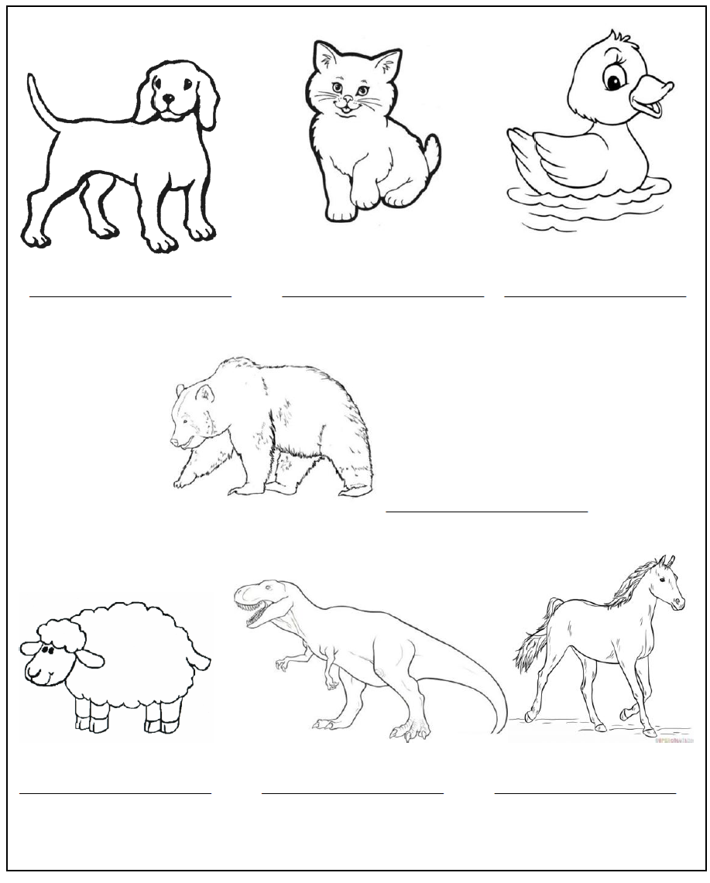
Activity 3 Animals
(1) What are the animals below? Write down the names.

Slide 41
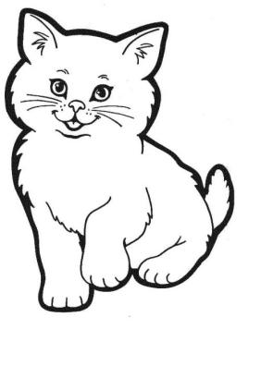
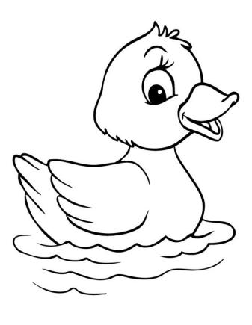
Activity 3: (1) Write down the animal names.
dog cat duck

Slide 42
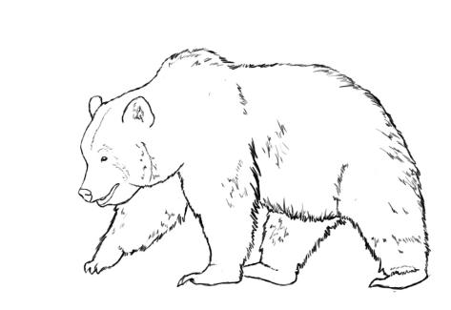
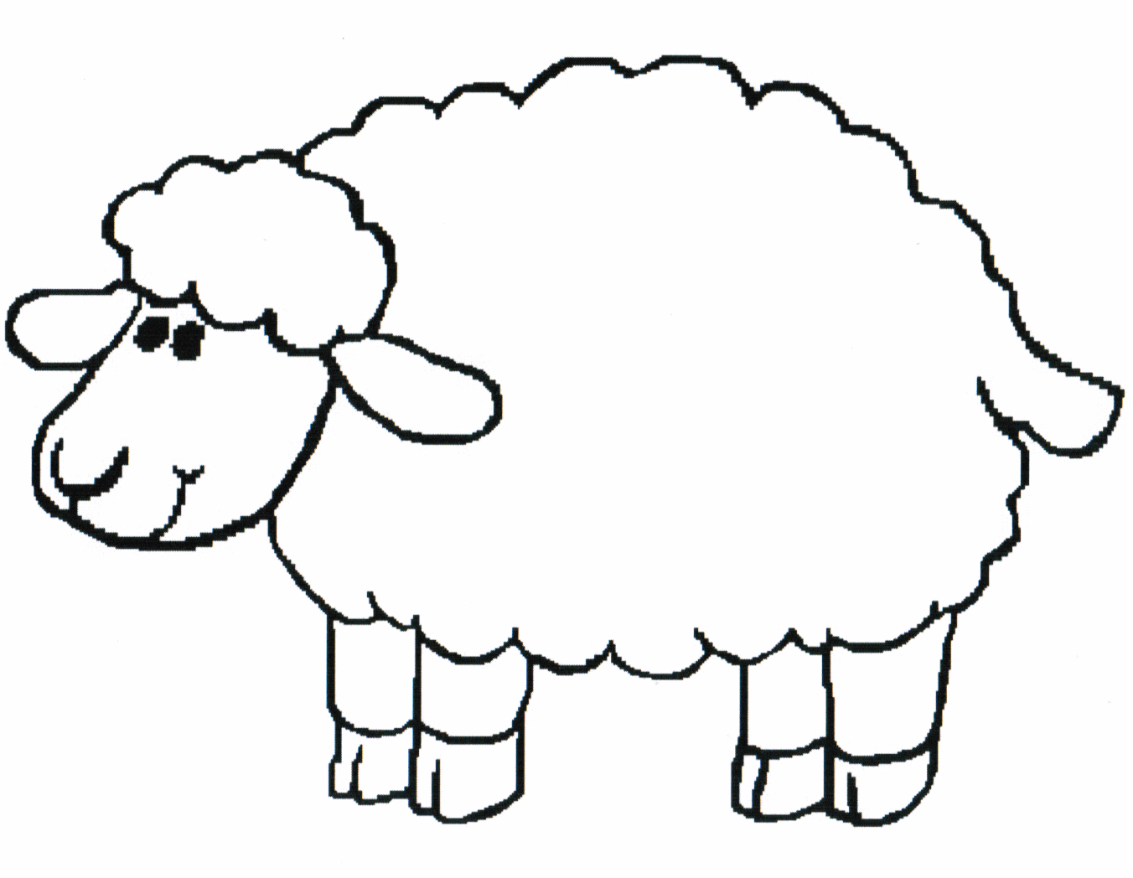
Activity 3: (1) Write down the animal names.
bear sheep

Slide 43
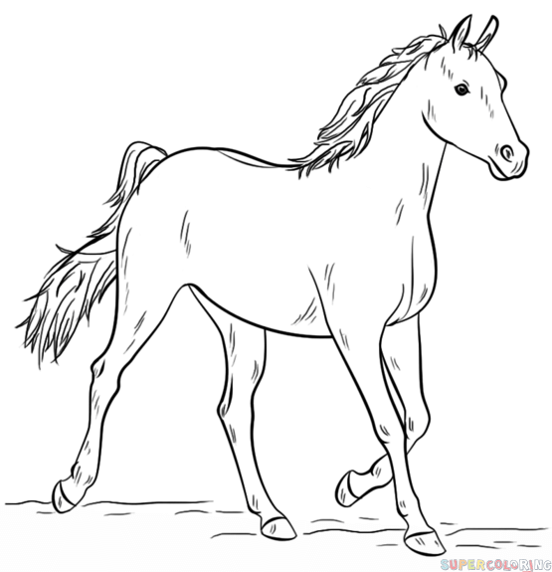
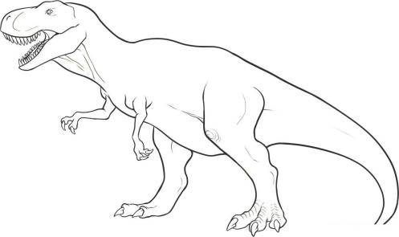
Activity 3: (1) Write down the animal names.
dinosaur horse

Slide 44
What animals does Sue / Nick like?

Slide 45
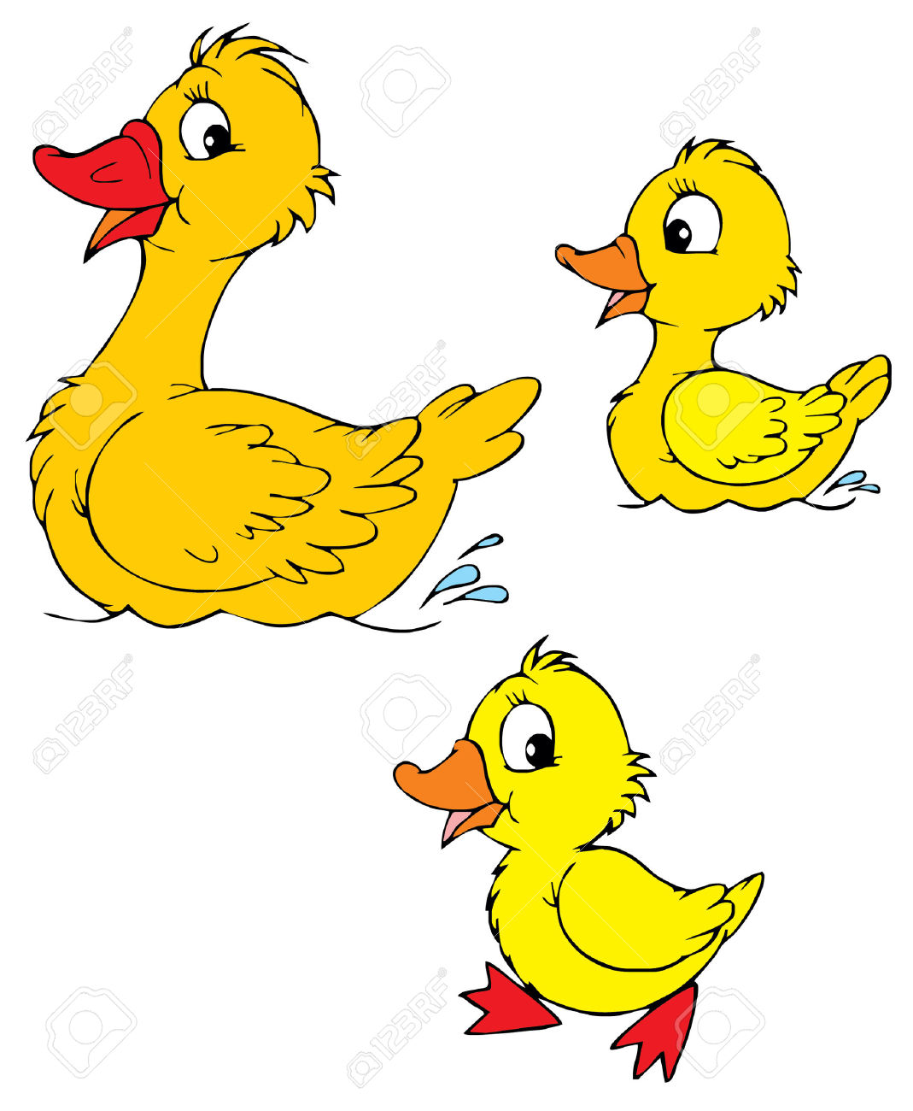
yellow
ducks

Slide 46
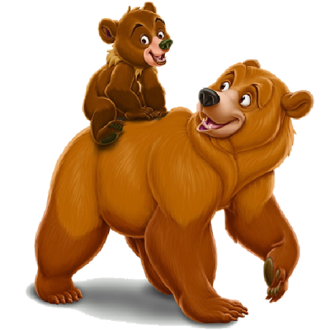
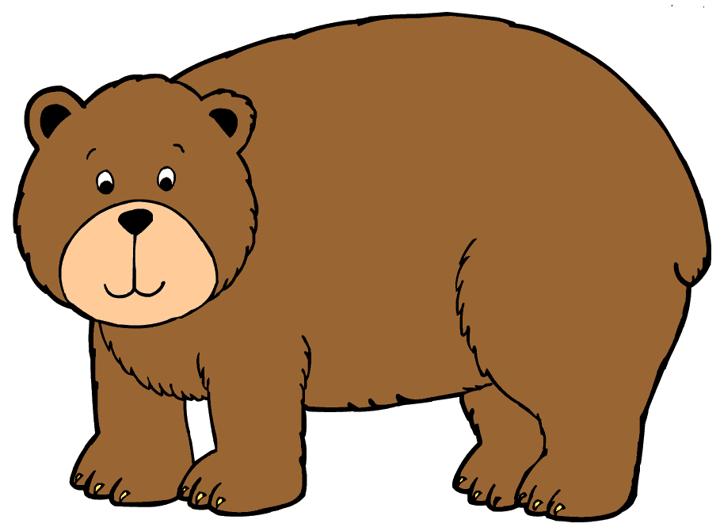
bears
brown

Slide 47
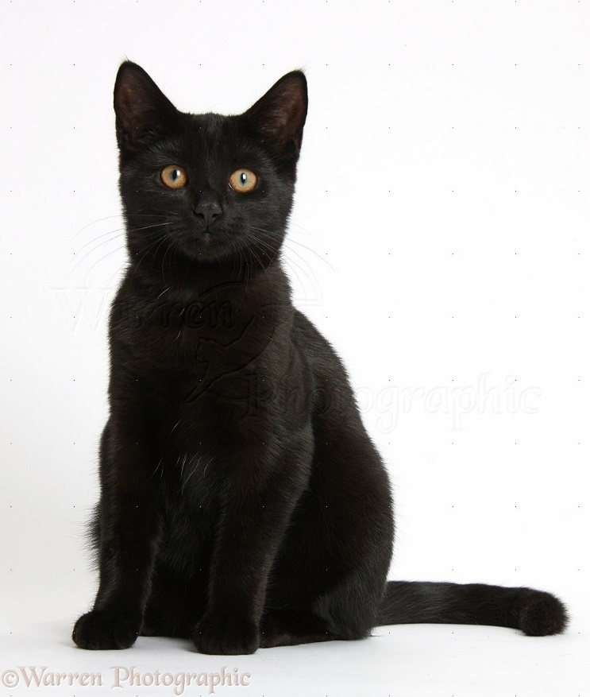
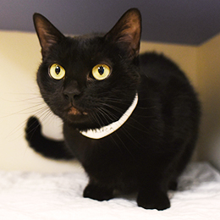
cats
black

Slide 48
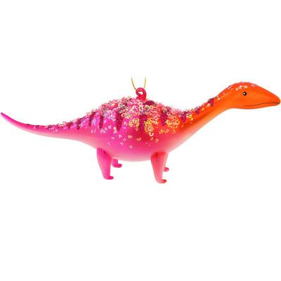
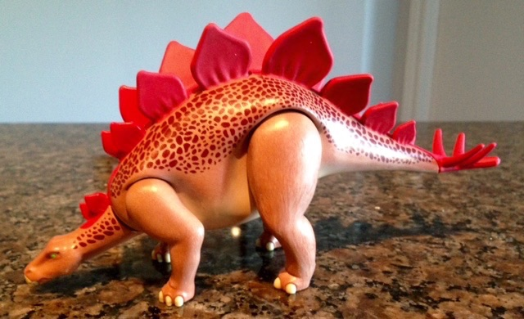
dinosaurs
pink and orange

Slide 49
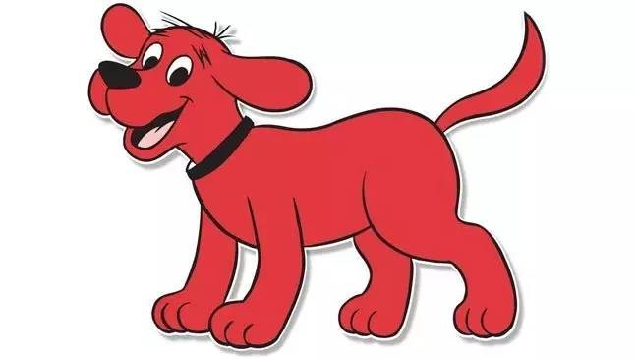
dogs
red

Slide 50
Outing: farm

Slide 51
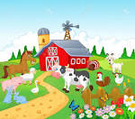
What animals can you see on a farm?

Slide 52
②
③
④
⑤
①

Slide 53
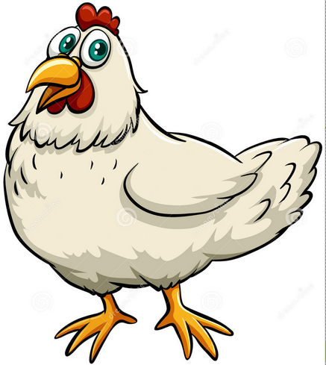
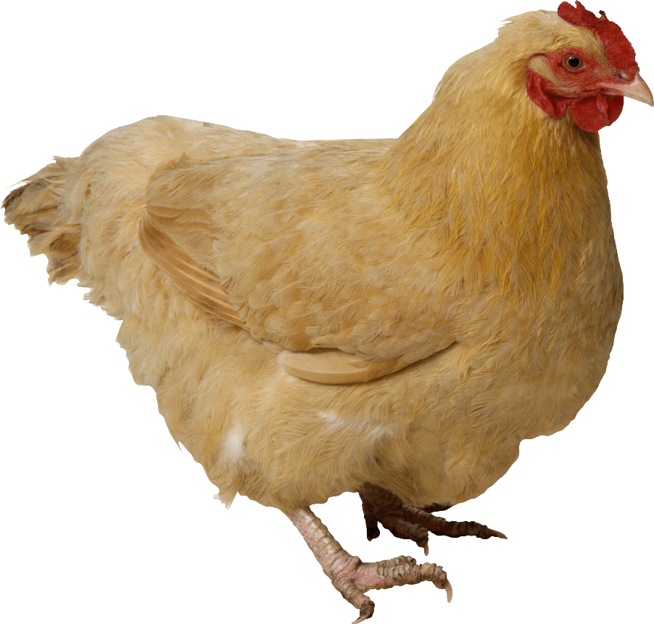
①
brown
white
chickens & chickens

Slide 54
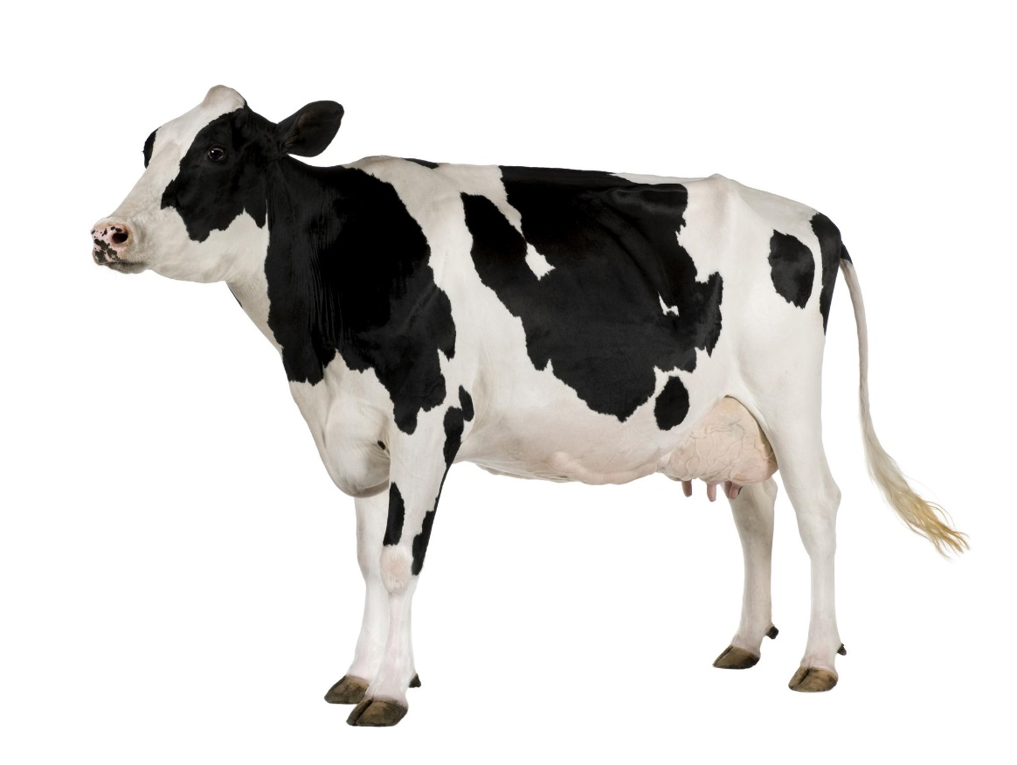
②
black and white
cows

Slide 55
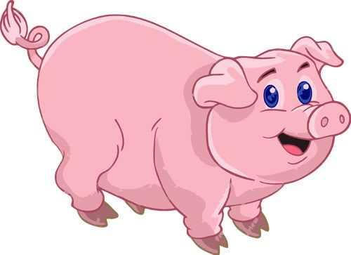
③
pink
pigs

Slide 56
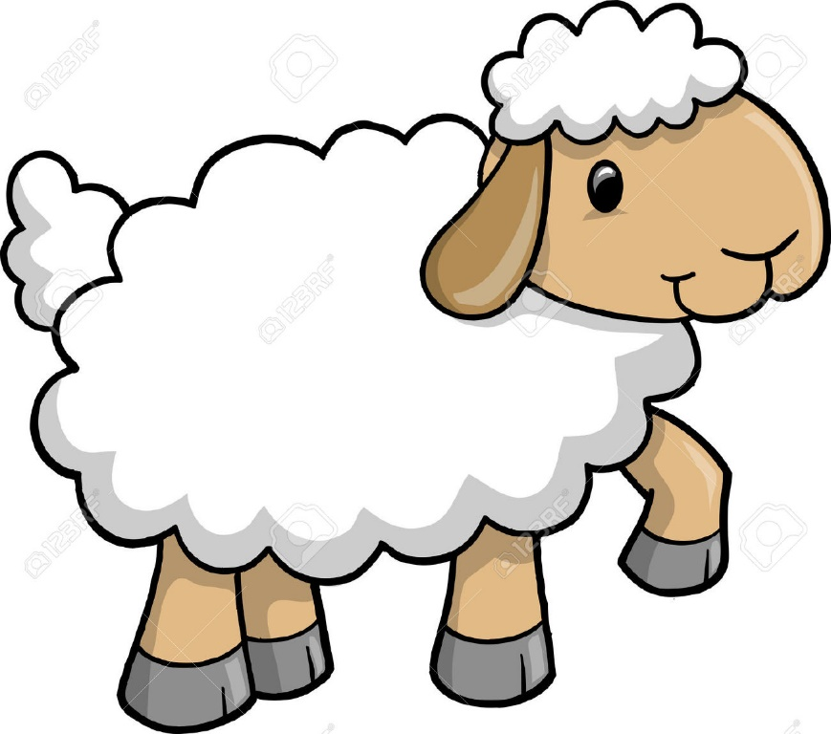
④
White
sheep

Slide 57
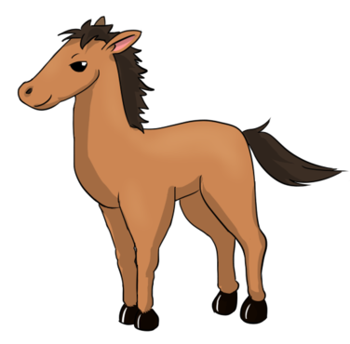
⑤
horses
brown

Slide 58
Outing: zoo

Slide 59
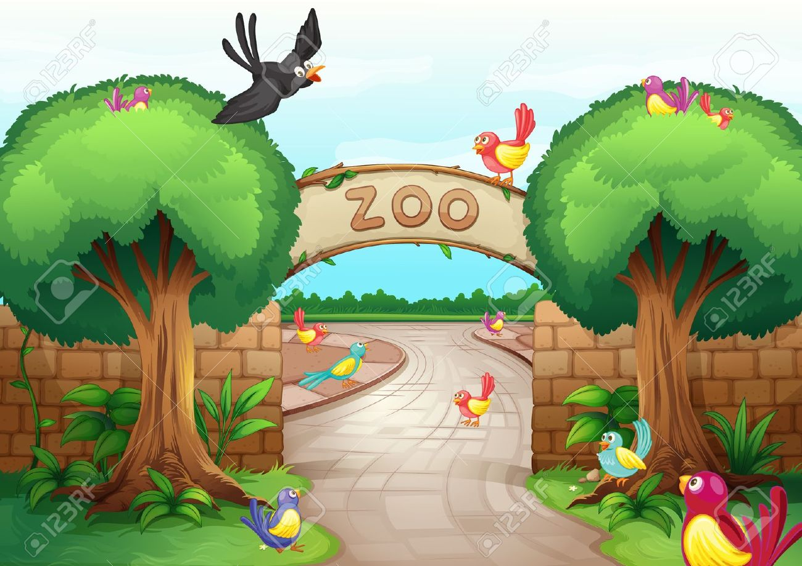
What animals can you see in a zoo?

Slide 60
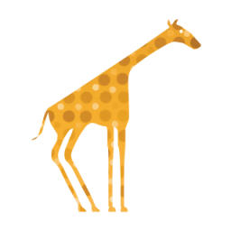
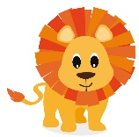
③
④
⑤
②
①

Slide 61
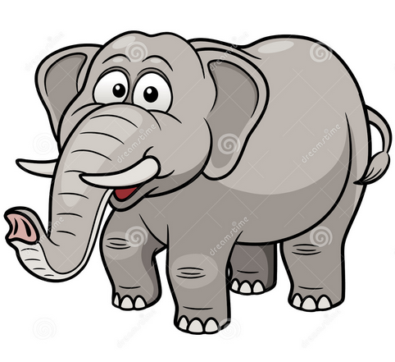
①
grey
elephants

Slide 62
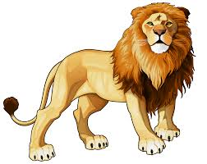
②
brown
lions

Slide 63
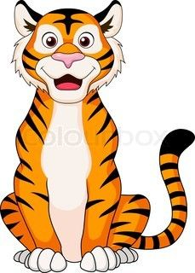
③
tigers
orange and black

Slide 64
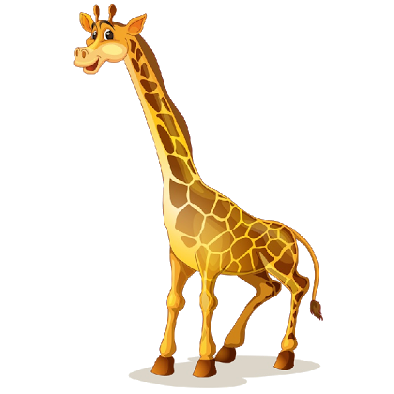
④
giraffes
yellow and brown

Slide 65
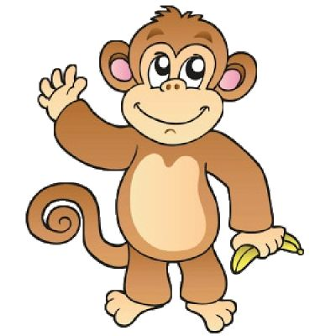
⑤
brown
monkeys

Slide 66
Activity 3: (2) Colour at least 3 animals you like.

Slide 67
Activity 3:
(3) Complete the following sentences.
I am ________________ (student name).
I like _____________ ______________. (e.g. I like brown bears.)
_________________________________________.
_________________________________________.

Slide 68
Activity 4: Ask your friends what animals or things they like.

Slide 69
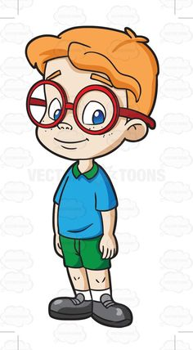
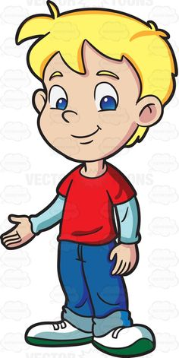
Hi, Tommy. What animals or things do you like?
Peter
I like brown bears. What about you?
Tommy
I like green dinosaurs.
Peter

