Slide 1
Reported Speech (Junior Secondary)
Poon, Ka Chun Jason; Lee, Fung King Jackie
The Education University of Hong Kong

Slide 2
Part 1 – What did Noby say?
Read the conversations between Noby and his mother two days ago.

Slide 3
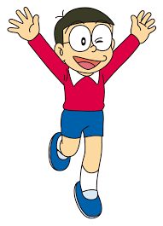
Part 1 – What did Noby say?
Mum, there’s a baseball competition this afternoon. I can’t find my PE uniform.
You always forget where your PE uniform is!

Slide 4
Part 1 – What did Noby say?
Mum, it’s raining heavily. I have to take a taxi.
Okay.
Let me give you the money.

Slide 5
Part 1 – What did Noby say?
Mum, the competition has been cancelled due to the rain. I’m so upset.
Come back home immediately after school!

Slide 6
Part 1 – What did Noby say?
Mum, please buy me this comic book.
Let me see your test paper first!

Slide 7
Part 1 – What did Noby say?
Hmm … I don’t want the comic book now.
Why not? Did you fail again?

Slide 8
Part 2 – What did Noby say?
Noby’s father has just returned home from a business trip. Noby’s mother tells him what Noby did two days ago.
Read what Noby’s mother says.

Slide 9
Part 2 – What did Noby say?
Darling, Noby made me so grumpy two days ago! He told me that there was a baseball competition that afternoon. He said he couldn’t find his PE uniform. He always forgets his uniform! Before he left home in the morning, he said it was raining heavily so he had to take a taxi. I gave him the money, but he was still late for school!

Slide 10
Part 2 – What did Noby say?
In the afternoon, he called me and said that he was upset because the competition had been cancelled due to the rain. I asked him to come back immediately after school and not to play with his friends outside. But he still came home late!

Slide 11
Part 2 – What did Noby say?
He even asked me to buy him that comic book. I told him to let me see his test paper first. He hesitated and said that he didn’t want the comic book then. I believe he must have failed the test!

Slide 12
Part 2 – What did Noby say?
Can you find out any differences between the sentences spoken by Noby and his mother in Part 1 (direct speech) and the sentences said by Noby’s mother when she reported what Noby did to his father in Part 2 (reported speech)?

Slide 13
Part 2 – What did Noby say?
Punctuation
The quotation marks are taken away.
Tenses
simple present ⇨ simple past
present continuous ⇨ past continuous
present perfect ⇨ past perfect

Slide 14
Part 2 – What did Noby say?
Pronouns
I ⇨ he
my ⇨ his
you ⇨ me
me ⇨ him
Time words
this afternoon ⇨ that afternoon
now ⇨ then

Slide 15
Part 4 – What did Noby say?
When we rewrite direct speech into reported speech, we have to make changes to the verb forms, pronouns and time words.
Read the table on page 3 (Part 4).
Why do we have to make these changes? What is the problem if we do not make these changes?

Slide 16
Part 4 – What did Noby say?
If we do not change the tenses…
Example:
‘It is raining heavily so I have to take a taxi,’ said Noby.
Noby said that it is raining heavily so he has to take a taxi.
At the time of reporting, is it still raining? Does Noby still have to take a taxi?

Slide 17
Part 4 – What did Noby say?
If we do not change the pronouns…
Example:
‘It is raining heavily so I have to take a taxi,’ said Noby.
Noby said that it was raining heavily so I had to take a taxi.
Did Noby’s Mum have to take a taxi?

Slide 18
Activity 1 – What did Noby say?
If we do not change the time words…
Example:
‘There’s a baseball competition this afternoon,’ said Noby.
Noby said that there was a baseball competition this afternoon.
Did the baseball competition take place in the afternoon two days ago or today?

Slide 19
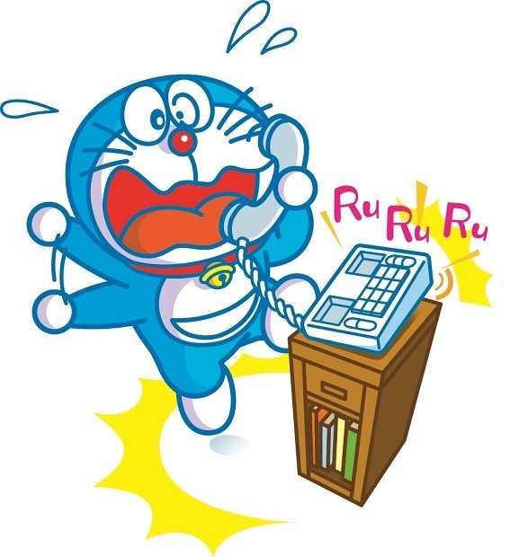
Activity 1 – What did Noby say?
Noby has to come home late again.
Noby called twice and Doraemon answered the phone.

Slide 20
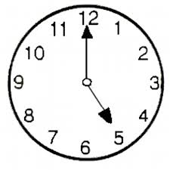
Activity 1 – What did Noby say?
Hi, this is Noby. I’m sorry that I’ll come home late. I have to stay behind. I’m doing my Maths exercises at school now. Then I’ll practise baseball with my friends. I’ll come back at eight o’clock.

Slide 21
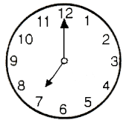
Activity 1 – What did Noby say?
Hi, this is Noby again. I don’t have my wallet. I have to come home on foot. I’m on my way now.

Slide 22
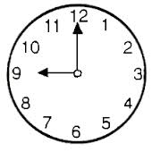
Activity 1 – What did Noby say?
Noby hasn’t returned home yet.
Doraemon is reporting what Noby said to his mother.
Finish the sentences on Worksheet 1.

Slide 23
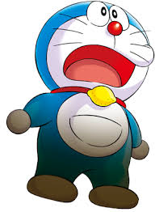
Activity 1 – What did Noby say?
Noby called at five o’clock. He said that he would come home late. He added that (1) he had to stay behind. He told me that (2) he was doing his Maths exercises at school then. He (3) said that he would practise baseball with his friends. He also said that he would come back by eight.

Slide 24
Activity 1 – What did Noby say?
He called at seven again. He said (4) he didn’t have his wallet. He (5) added that he had to come home on foot. He (6) said that he was on his way then.

Slide 25
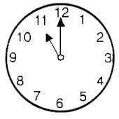
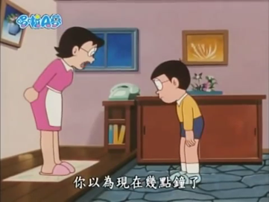
Activity 1 – What did Noby say?
Noby was back finally…

Slide 26
Homework
The family had a big meal tonight. This was the first time Mum had cooked so well and made the family happy. They talked about the dinner.
Later, the two teenagers talked with their cousin on the phone about the dinner.
Rewrite the sentences using the reported speech.

Slide 27
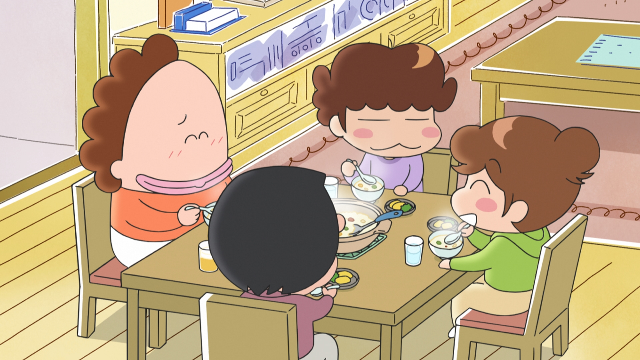
Homework
Complete Worksheet 2 as homework.

Slide 28
Activity 2 – Office Gossip
Watch the video. Listen to the conversations.
https://www.youtube.com/watch?v=t__Kbprp-8Y
How do Amanda and Alfred report the sentences previously said?
Act as Amanda and Alfred, and write the sentences in the boxes.

Slide 29
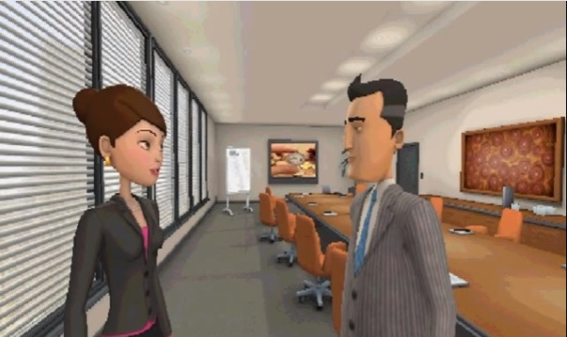
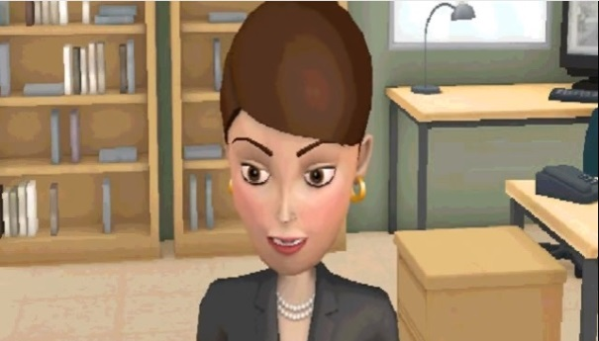
Activity 2 – Office Gossip
I want you to tell me everything.
I asked Alfred …

Slide 30
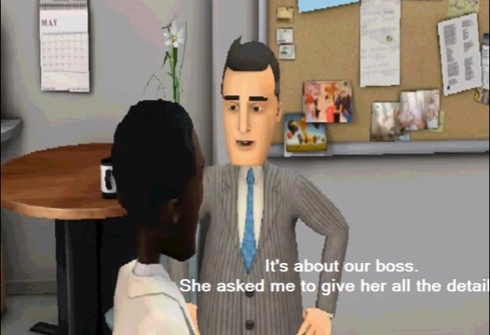
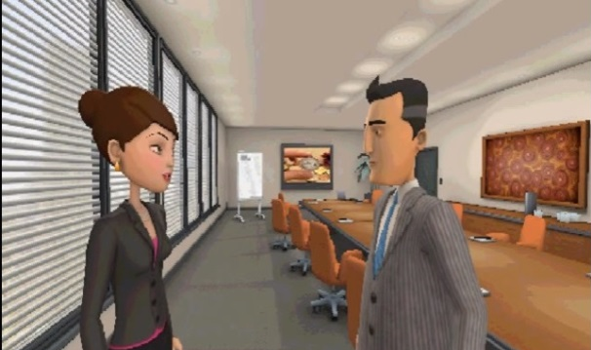
Activity 2 – Office Gossip
Please, give me all the details.
Amanda asked me …

Slide 31
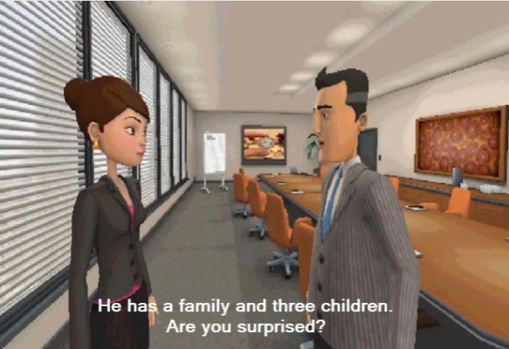
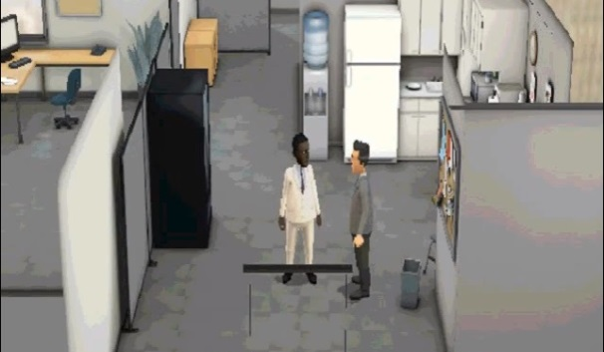
Activity 2 – Office Gossip
Are you surprised?
I asked Amanda …

Slide 32
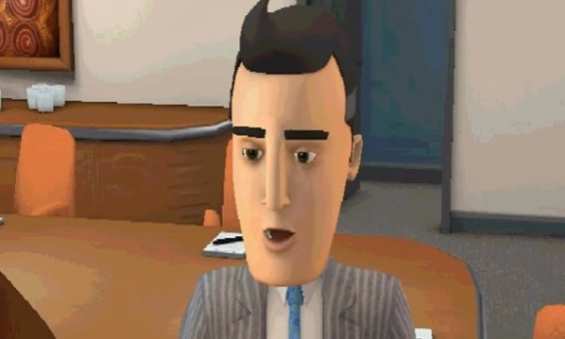
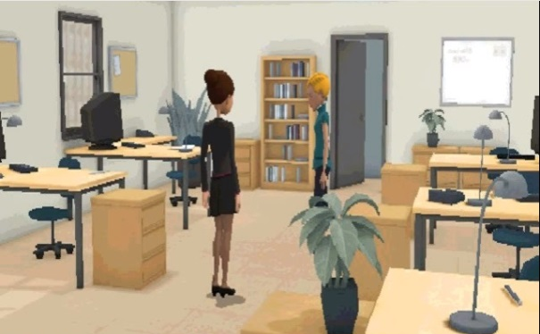
Activity 2 – Office Gossip
Your boss is not single!
Alfred told me …

Slide 33
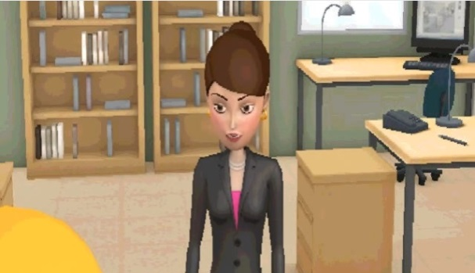
Activity 2 – Office Gossip
George has a family and three children.
Alfred said …

Slide 34
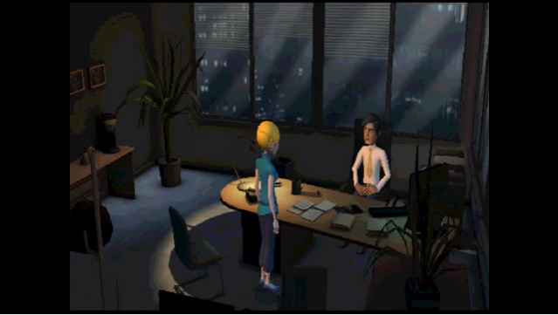
Activity 2 – Office Gossip
After that…

Slide 35
Activity 2 – Office Gossip
Juliet is very upset after listening to Amanda. She then goes to George’s office and talks to him. What is she going to say to George? Think of the ending of the story.
Work with a partner, and play the role of Juliet and George respectively. Write the dialogue between Juliet and George. Use reported speech when you report what Amanda said.

Slide 36
Activity 2 – Office Gossip
Share your ending with the class!

Slide 37
Activity 3 – Chinese Whispers
Get into groups of 6. Form a line.
The first student will get a strip. Read the message and remember the sentence(s). Whisper the message to the one behind you.
The 2nd student reports the message to the 3rd student using reported speech, and the 3rd student to the 4th. This process continues until it goes to the last student in the line.

Slide 38
Activity 3 – Chinese Whispers
Each student can say the message twice.
Use only English and you should not let the others hear what you say except the student behind you.
Use reported speech (except the first student). Change the pronouns and/or verb tenses.
The last student reports the message to the teacher.

Slide 39
Activity 3 – Chinese Whispers
The group that provides the most accurate answer within the shortest time will win the game.

