Slide 1
Be a helpful person!
Reported Speech
(Senior Primary)
Poon, Ka Chun Jason
Lee, Fung King Jackie
The Education University of Hong Kong

Slide 2
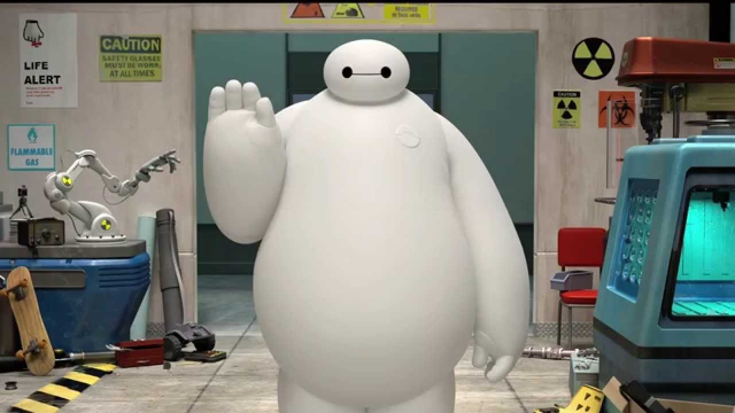
Activity 1: See the doctor
Who is he?
What does he do?

Slide 3
Activity 1: See the doctor
He is Doctor Baymax!
He helps patients (sick people).
He gives advice and tells them what (not) to do.

Slide 4
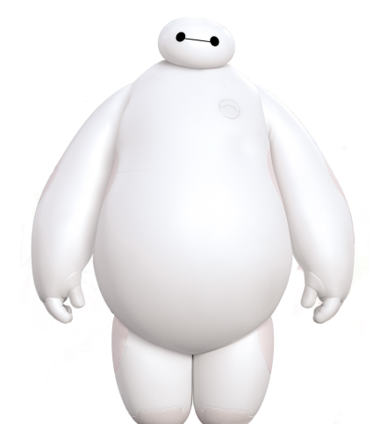
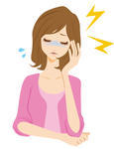
Case 1
What’s the matter with you?
I have ______________.
a headache

Slide 5
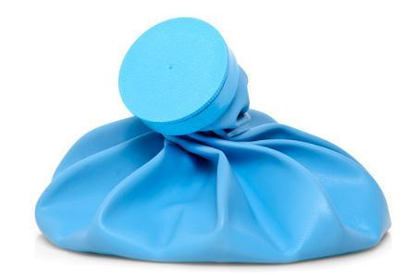
Case 1
_________ the ___________ on your forehead.
Put
ice bag

Slide 6

Case 1
Doctor Baymax told me to _________ the ice bag on my forehead.
put

Slide 7
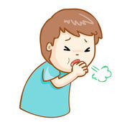
Case 2
What’s the matter with you?
I have ______________.
a cough

Slide 8


Case 2
________ some ___________.
Drink
hot water

Slide 9
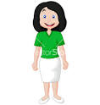
Case 2
Doctor Baymax _____ me _________ some hot water.
told
to drink

Slide 10
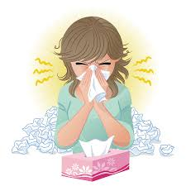
Case 3
What’s the matter with you?
I have ______________.
a running nose

Slide 11
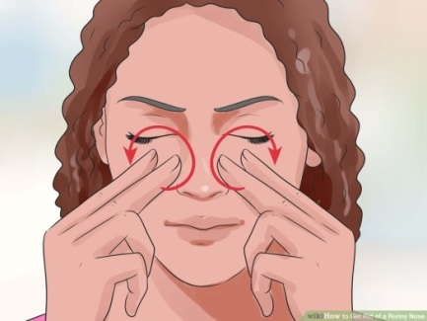

Case 3
_____________ your nose, between your eyes and earlobes.
Massage

Slide 12


Case 3
Doctor Baymax _______ me ________________ my nose, between my eyes and earlobes.
told
to massage

Slide 13
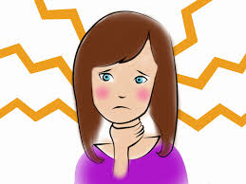
Case 4
What’s the matter with you?
I have ______________.
a sore throat

Slide 14

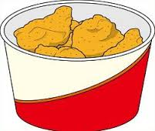
Case 4
Don’t ________ any
______________.
eat
fried food

Slide 15
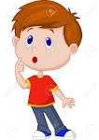
Case 4
Doctor Baymax _______ me not _______ any fried food.
told
to eat

Slide 16
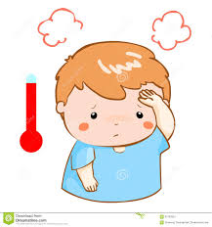
Case 5
What’s the matter with you?
I have ______________.
a fever

Slide 17
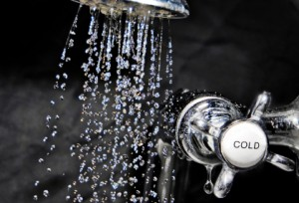
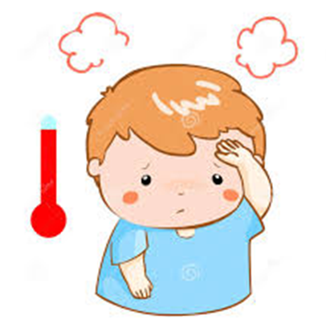
Case 5
COLD
_________ ______ a cold ___________.
Don’t
have
shower

Slide 18

Case 5
Doctor Baymax ________ me _______ ________ a cold shower.
told
not
to have
COLD

Slide 19
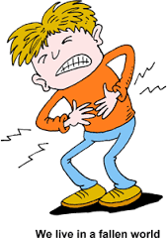
Case 6
What’s the matter with you?
I have ______________.
a stomachache

Slide 20
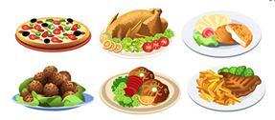
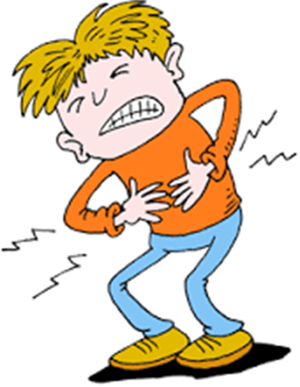
Case 6
_______ _____ too _______ at a time.
Don’t
eat
much

Slide 21

Case 6
Doctor Baymax ________ me _____ ________ too much at a time.
told
not
to eat

Slide 22
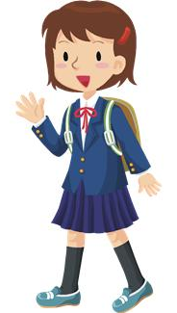

Activity 2:
Be a helpful monitor
Imagine you are the class monitor.
You help your class teacher and classmates.

Slide 23

Activity 2:
Be a helpful monitor
Your classmates have something
to tell your class teacher, Mr. Poon.
They have written memos.
Mr. Poon has written the replies on
some strips of paper. But they are
all mixed up.

Slide 24
Activity 2:
Be a helpful monitor
Read the words on the strips carefully.
Match Mr Poon’s replies with the memos written by your classmates.
Report what the class teacher
said to your classmates.

Slide 25
Students’ memos
I cannot come to school on Friday because I have
a piano exam.
Angel

Slide 26

Mr. Poon’s response
Give me the parent’s letter for your absence. Don’t miss the exam admission ticket.
Mr. Poon

Slide 27
Students’ memos
I want to join the Speech Festival but I don’t know what I should do.
Benny

Slide 28
Mr. Poon’s response
Find Miss Wong to get the registration form. Submit it to her next week.
Mr. Poon

Slide 29
Students’ memos
I have lost my
student card. What should
I do?
Cathy

Slide 30
Mr. Poon’s response
Go to the General Office and get a student card application form. Don’t lose the card again!
Mr. Poon

Slide 31
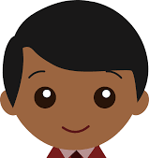
Students’ memos
I have forgotten to bring my Maths workbook. I need to hand it in tomorrow.
Dan

Slide 32
Mr. Poon’s response
Come to see me during the lunch break. Don’t go away after school.
Mr. Poon

Slide 33
Reporting instructions
Please help Mr. Poon to tell your classmates the messages.
Example:
  Angel, Mr. Poon asked you
  to give him the parent’s letter.
  He also reminded you not to
  miss the exam admission ticket.

Slide 34
Reporting instructions
Benny, Mr. Poon asked you to find Miss Wong to get the registration form. He told you to submit it to her next week.

Slide 35
Reporting instructions
Cathy, Mr. Poon asked you to go to the General Office and get a student card application form. He told you not to lose the card again.

Slide 36
Reporting instructions
Dan, Mr. Poon asked you to go to see him during the lunch break. He told you not to go away after school.

Slide 37
Activity 3: Let’s help our friends!
Work in groups of 3.
Discuss the following questions in groups.
  What problems do you and your friends have?
  (You may refer to Worksheet 3.)
  What advice would you give your friend to help him/her solve the problem?

Slide 38
Activity 3: Let’s help our friends!
On Worksheet 3, write down your own problem(s). You may write 2-3 problems.
Take turns to share your problems with your friends and seek advice from them.
One student will give advice.
The third student is the listener and has to report the advice later.

Slide 39
Activity 3: Let’s help our friends!
Example:
  Student A: I am short-sighted. My eyes feel tired easily.
  Student B: Do not play computer games for
  too long.
  Student C: Student A is short-sighted. Student B told him/her not to play computer games for too long.

Slide 40
Some of our problems…
I sometimes feel sad.
I want to be slimmer.
I often forget to do
my homework.
I feel sleepy in class.
I am skinny. I want to put on weight.
I often argue with
my friends.

Slide 41
Some of our problems…
I sometimes fail in
my dictations.
I am often late for school.
I want to make more friends.
I have too much work
to do.
I am short-sighted.
I feel nervous when
I stand in front of the class.

Slide 42
Activity 3: Let’s help our friends!
Round 1
  Student A talks about his/her problem.
  Student B gives him/her advice.
  Student C listens and records the problem and the advice.

Slide 43
Activity 3: Let’s help our friends!
Round 2
  Student B talks about his/her problem.
  Student C gives him/her advice.
  Student A listens and records the problem and the advice.

Slide 44
Activity 3: Let’s help our friends!
Round 3
  Student C talks about his/her problem.
  Student A gives him/her advice.
  Student B listens and records the problem and the advice.

Slide 45

Activity 3: Let’s help our friends!
Share your interesting ideas with the class!

