Slide 1
Subject pronouns
Siu, Ka Ka Katy; Lee, Fung King Jackie
The Education University of Hong Kong

Slide 2
What is this word?

Slide 3
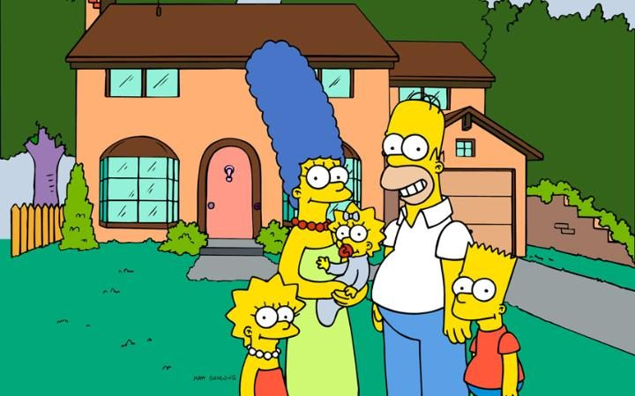
Let’s listen to a song about a family
Do you know this family?
https://www.youtube.com/watch?v=BIQionV6BPw

Slide 4
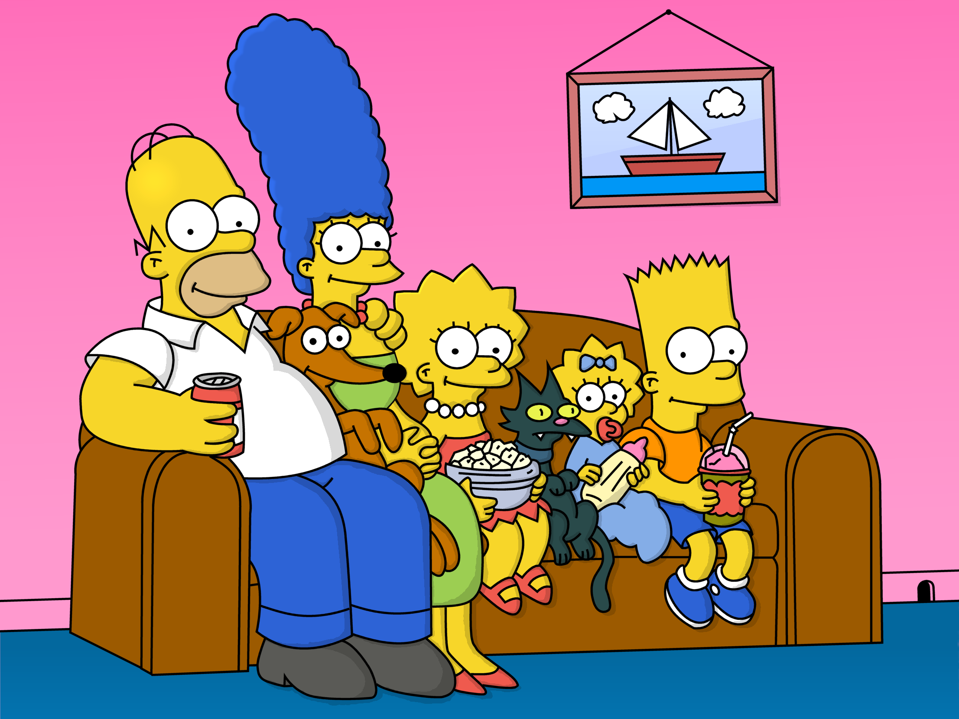
The Simpson
Family
Mommy
Sister
(Lisa)
Daddy
Brother (Bart)
Lucky (a dog)
Maggie
Mary (a cat)

Slide 5
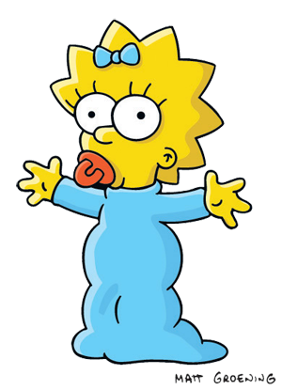
My family
I am Maggie. My mother and father love me very much. My mother is a nurse. My mother loves helping people. My mother works together with my father. My father is a doctor. My father is very hardworking. My father saves people’s lives.
My mother and father love my sister and brother too. My sister and brother always play with me. My sister and brother teach me ABC every night. My father, my mother, my sister, my brother and I love our pets - Lucky and Mary too. Lucky is a dog. Lucky loves bones best. Mary is a cat. Mary likes fish best.
She
She
He
He
They
We
It
It

Slide 6
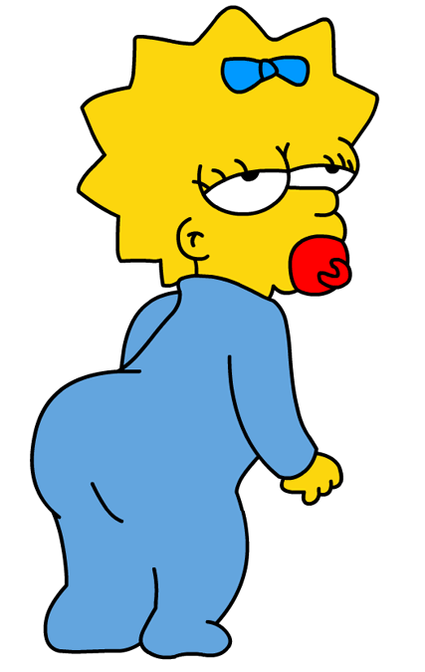
My family
她
他
This is Sam. My mother and father loves me very much. My mother is a nurse. ______ loves helping people. ______ works together with my father. My father is a doctor. ______ is very hardworking. ______ saves people’s lives.
My mother and father love my sister and brother too. My sister and brother always play with me. ______ teach me ABC every night. _____ love our pets - Lucky and Mary too. Lucky is a dog. ______ loves bones best. Mary is a cat. ______ likes playing with me!
She
She
He
He
他們
我們
They
We
It
It
牠
牠

Slide 7
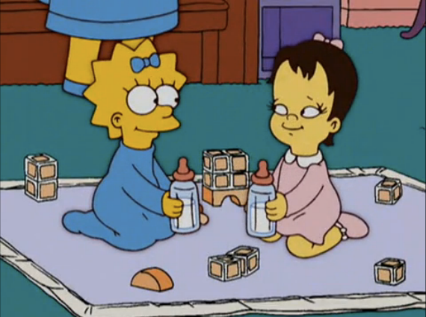
我
你
I
Hi! Jenny. ___ am fine. Thank you.
Hi! Maggie. How
are _____?
you
I’d love to. But ____ can’t come. I have to visit grandpa and grandma.
Will you come to my home and play tonight?
I

Slide 8
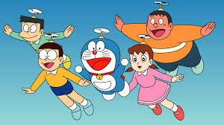
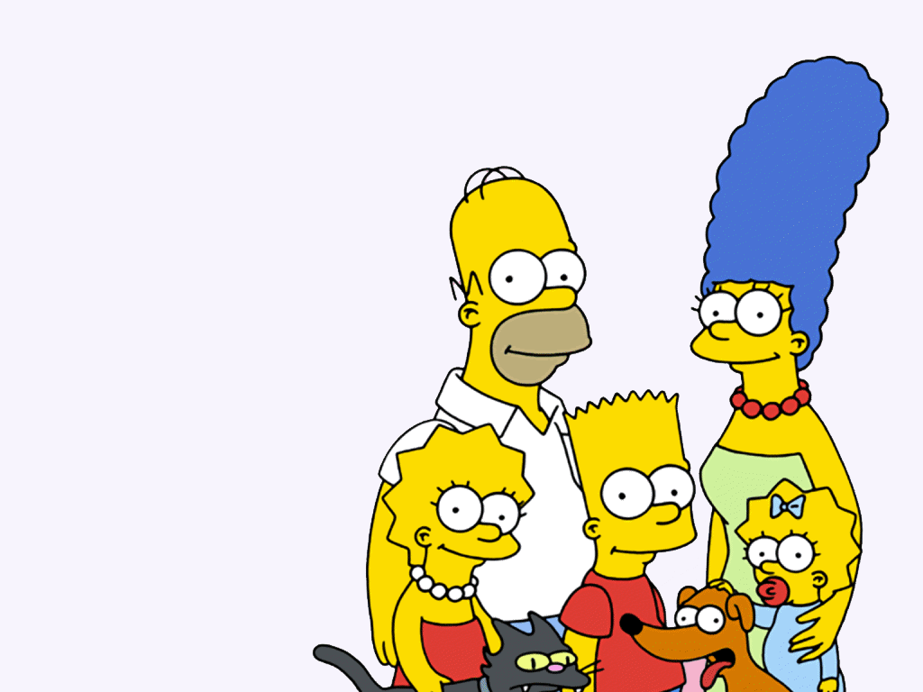
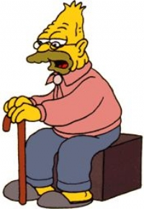
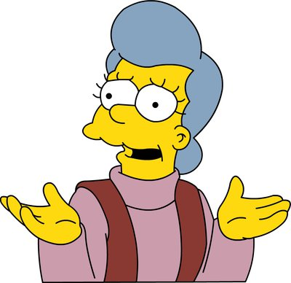
They
He
She
You
I
We
It

