Slide 1
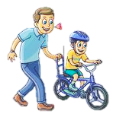
The Bike Lesson (written by Stan and Jan Berenstain)
Lesson 3

Slide 2
Do you still remember…?
What is the book about?
Who are the characters?
What do they do in the book?

Slide 3
Let’s read the book again
How many “Bike Lessons” are there?

Slide 4
Activity 1 Task A
When we are riding a bicycle…
What should we do?
What shouldn’t we do?
Complete the summary in Task A. You may use the words in the word box.

Slide 5
Safe Cycling Tips
get on
We should be careful when we __________ the bike.
We shouldn’t ride too fast. We should slow down or ______ when we go down the slope.
We should _________ the bike when we see a ‘danger’ sign.
stop
get off

Slide 6
Safe Cycling Tips
ride right through
We shouldn’t __________________ when we come to a puddle.
We should ________ when we go down a hill.
We shouldn’t take any _______ we like.
We should always ride on the ___________.
slow down
road
left hand side

Slide 7
We can use …
should
shouldn’t
when we talk about safety rules or acts.

Slide 8
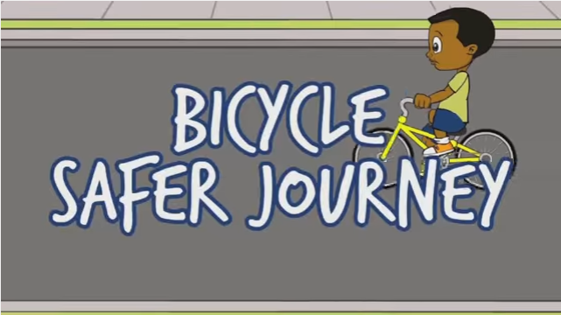
Other safe cycling tips
Let’s watch another video and find out what we should do and what we shouldn’t do when we go cycling.
https://www.youtube.com/watch?v=dkoVxBnnGko

Slide 9
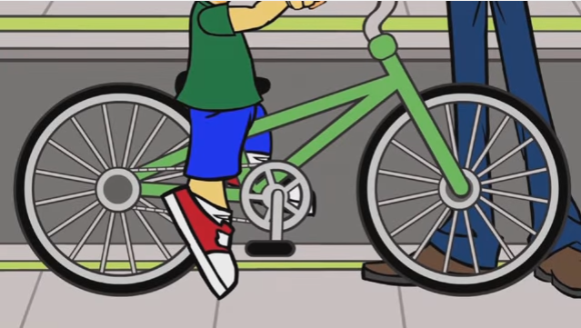
Other safe cycling tips
Watch the clip 0:00 – 0:53.
Children shouldn’t ride a big bike. They should ride a bike with the right size.

Slide 10
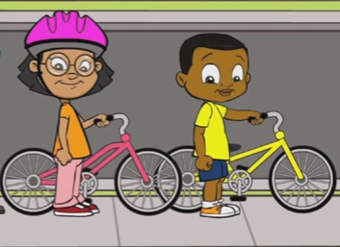
Other safe cycling tips
Watch the clip 0:53 – 1:08.
We shouldn’t wear dark clothes. We should wear bright clothes.

Slide 11
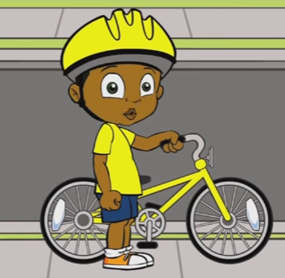
Other safe cycling tips
a helmet
Watch the clip 1:08 – 1:30.
We should put the reflectors on the bike.
We should wear our helmets.
reflectors

Slide 12
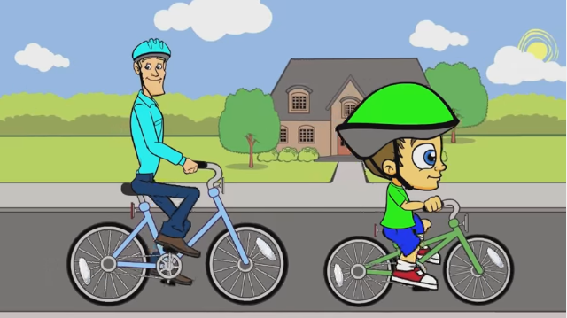
Other safe cycling tips
Watch the clip 2:08 – 2:26.
We should ride with an adult.

Slide 13
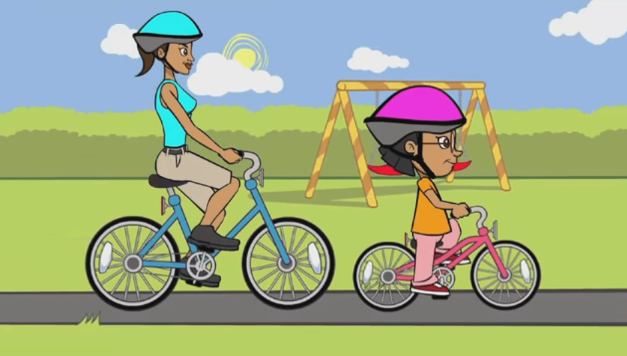
Other safe cycling tips
Watch the clip 2:26 – 2:35.
We should ride in a park. (But we should also look for the signs!)

Slide 14
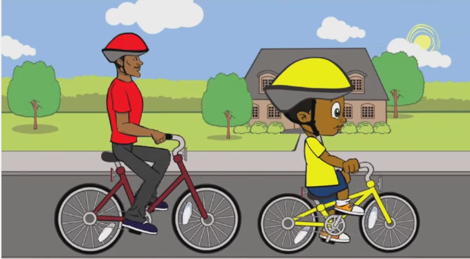
Other safe cycling tips
Watch the clip 2:26 – 2:35.
We should ride on roads when there are not many cars.

Slide 15
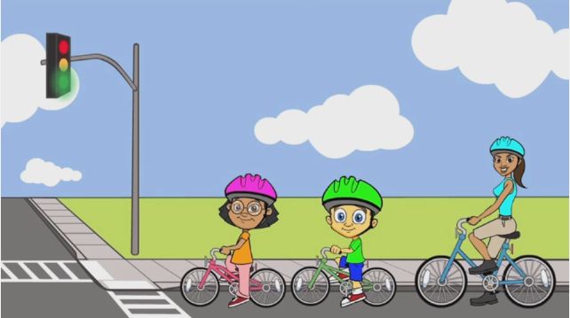
Other safe cycling tips
Watch the clip 2:49 – 3:17.
We should look at the traffic lights. We need to look and listen to what is around us.

Slide 16
Activity 1 Task B
When we are riding a bicycle…
What should we do?
What shouldn’t we do?
Put the letters (C – H) in the correct boxes.

Slide 17
Worksheet 2 Task B
Look at what is around us. (example)
Ride in a shopping centre. (example)
Ride a big bike.
Wear bright clothes.
Wear our helmet.
Ride with our friends.
Stop when we see a red signal.
Ride on roads when there are many cars.

Slide 18
Worksheet 2 Task B
Look at what is around us. (example)
Ride in a shopping centre. (example)
should |  | shouldn’t
 | A |  | B

Slide 19
Worksheet 2 Task B
Ride a big bike.
Wear bright clothes.
should |  | shouldn’t
 | A D |  | B C

Slide 20
Worksheet 2 Task B
Wear our helmets.
Ride with our friends.
should |  | shouldn’t
 | A D E |  | B C F

Slide 21
Worksheet 2 Task B
Stop when we see a red signal.
Ride on roads when there are many cars.
should |  | shouldn’t
 | A D E G |  | B C F H

Slide 22
Worksheet 2 Task B
When we are riding a bicycle…
What should we do?
What shouldn’t we do?
Talk about what we should and shouldn’t do when riding a bike.

Slide 23
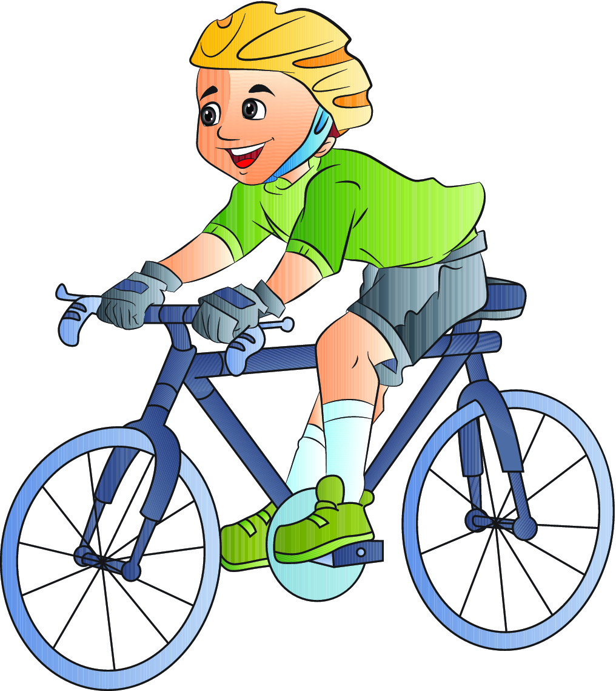
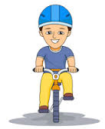
Worksheet 2 Task B
We should look at what is around us.
We shouldn’t ride in a shopping centre.

Slide 24
Worksheet 2 Task B
We shouldn’t ride a big bike.
We should wear bright clothes.

Slide 25
Worksheet 2 Task B
We should wear our helmet.
We shouldn’t ride with our friends.

Slide 26
Worksheet 2 Task B
We should stop when we see a red signal.
We shouldn’t ride on roads when there are many cars.

Slide 27
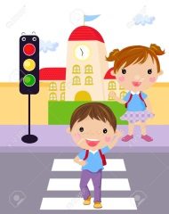
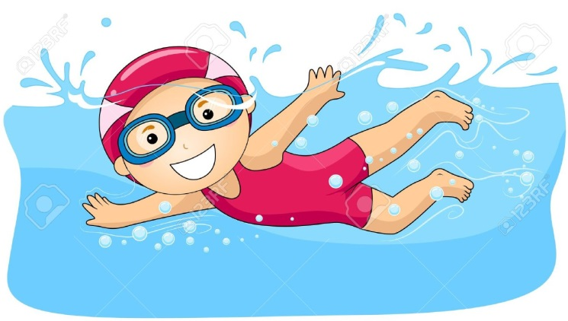
Do you do these…?
crossing the road
swimming
What should / shouldn’t we do in these activities?
cooking

Slide 28
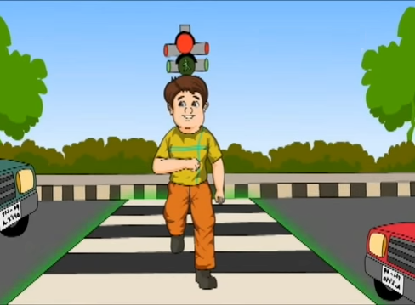
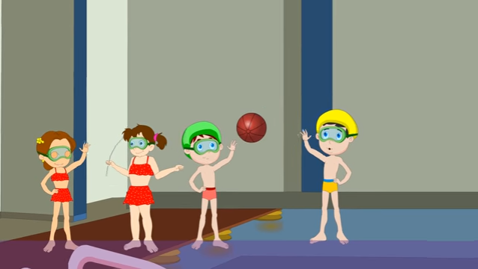
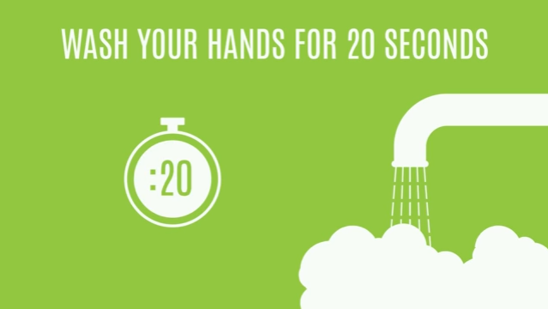
Road Safe https://www.youtube.com/watch?v=uPahaW6VDek
Safety Rules of Swimming https://www.youtube.com/watch?v=Xrp_I6-wmWE
Kitchen Safety For Kids https://www.youtube.com/watch?v=DoSq9T6OejA

Slide 29
Safe road crossing tips
Use the z______ crossing.
C_____ the railings.
Go when the red man is on.
W____ slowly when crossing the road.
Run after a k_____.
Use the s_______.
ebra
limb
alk
ite
ubway

Slide 30
Safe swimming tips
Bring electrical devices or g_____ into the water.
P___ around the swimming pool.
W___ slowly.
Hit the water with our f____.
S_____ when someone is in trouble.
Swim alone.
lass
lay
alk
eet
hout

Slide 31
Safe cooking tips
R___ up our sleeves.
W____ our hands for 5 seconds only.
Keep the cooking surfaces c_____.
Cook without an a____.
Be c_____ with sharp knives and tools.
T____ off the appliances when we finish cooking.
oll
ash
lean
dult
areful
urn

Slide 32
Let’s make a poster!
Safe _________ tips
should
shouldn’t

Slide 33
Let’s make a poster!
Now share your poster with us!

