Slide 1

What’s the time, MR Wolf?
(by Carol Jones)
Zheng, Shuping Nichole; Zhu, Yi Chloe
The Education University of Hong Kong

Slide 2
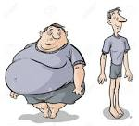
Body Shapes

Slide 3
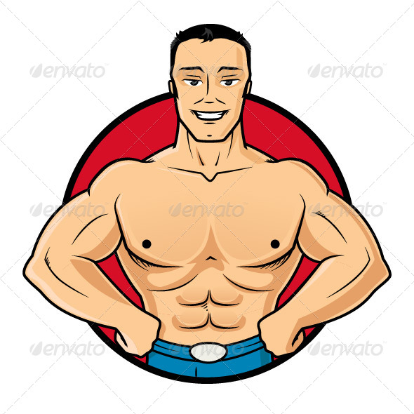
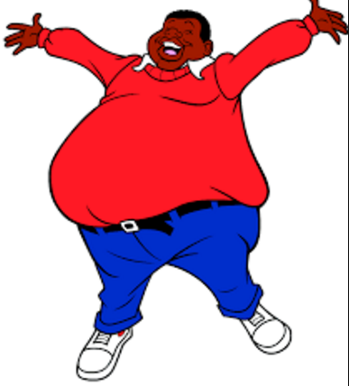
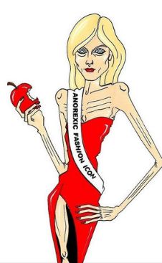
Which body shape do you like?
A B C

Slide 4
Describe the body shape in picture A.
A
Fat
Overweight
Can you think of more words similar to “fat”?
Words from the Reader:
Plump, chubby , round, portly,

Slide 5
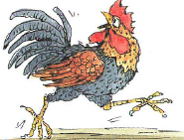

A plump body
'Plump’ means slightly fat in a fairly pleasant way.
'Plump’ is especially used to describe women or children.

Slide 6

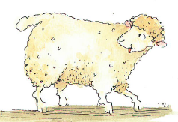
chubby (legs)
‘Chubby’ means slightly fat in a way that looks healthy and attractive.

Slide 7
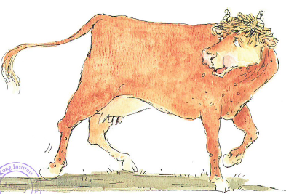
round rump

Slide 8
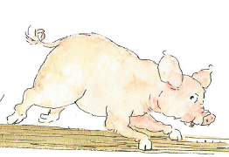
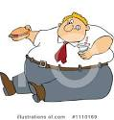
portly pink figure
‘Portly’: fat and round (especially of middle-aged or old men)

Slide 9
Question
Which sentence is more unpleasant?
A. The man is fat.
B. The girl is chubby.
C. The child has plump rosy cheeks.
Sentence A is more unpleasant.
It’s rude to use ‘fat’ to describe people.

Slide 10
The words you have just learnt have a meaning similar to ‘fat’. The word ‘fat’ sounds rude. Do you know the words that sound more pleasant?
Rude | Neutral | Polite
fat | overweight | plump
 | round | portly
 |  | chubby

Slide 11
Describe the body shape in picture B.
Thin
Can you think of more
words similar to “thin”?
lean, skinny , slim
B

Slide 12
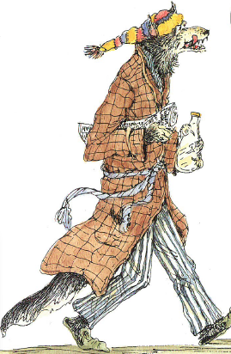
A lean body
‘Lean’: thin and healthy

Slide 13
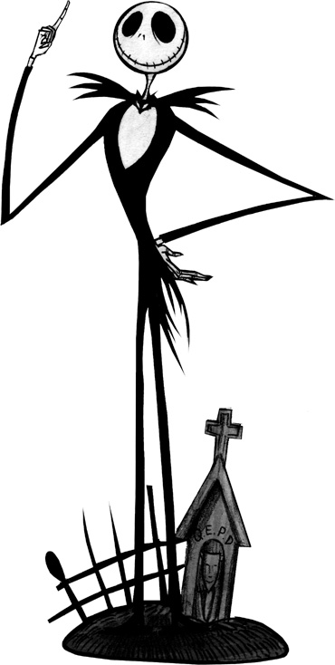
skinny
‘Skinny’ means being thin in an unhealthy and
unattractive way.

Slide 14

Slim
‘Slim’ means being thin in a fit and attractive way.

Slide 15
Question
Which sentence sounds more pleasant?
A. You are thin .
B. You are skinny.
Sentence A is more polite.
It’s rude to use ‘skinny’ to describe people.

Slide 16
All the words you have just learnt mean ‘thin’. Some words sound more pleasant. What are they?.
Rude | Neutral | Polite
skinny | thin | lean
 |  | slim

Slide 17
Describe the body shape in picture C.
Find the right word in the Reader.
Firm
C
‘Firm’ can be used to describe a fit and strong body shape .

Slide 18
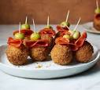
Food for Mr. Wolf’s Party

Slide 19

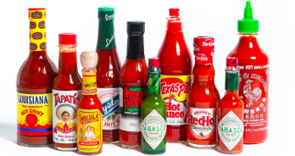
What sauces do you know?

Slide 20
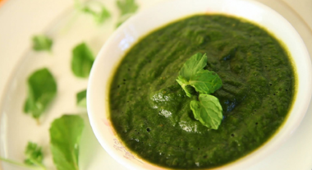
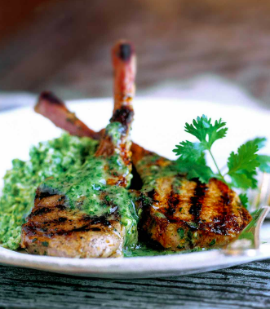
Mint Sauce
It tastes sweet and sour.
It is usually served with lamb.

Slide 21
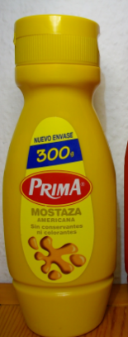
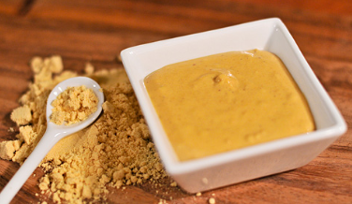
Hot Mustard Sauce
It tastes spicy.
It is usually added to sandwiches and hamburgers.

Slide 22
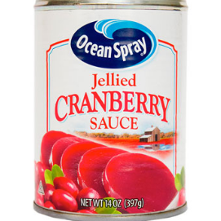
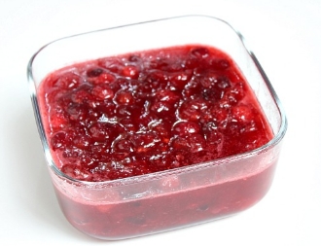

Cranberry Sauce
It tastes sweet.
It is usually served with Thanksgiving dinner and Christmas dinner in the U.S.

Slide 23
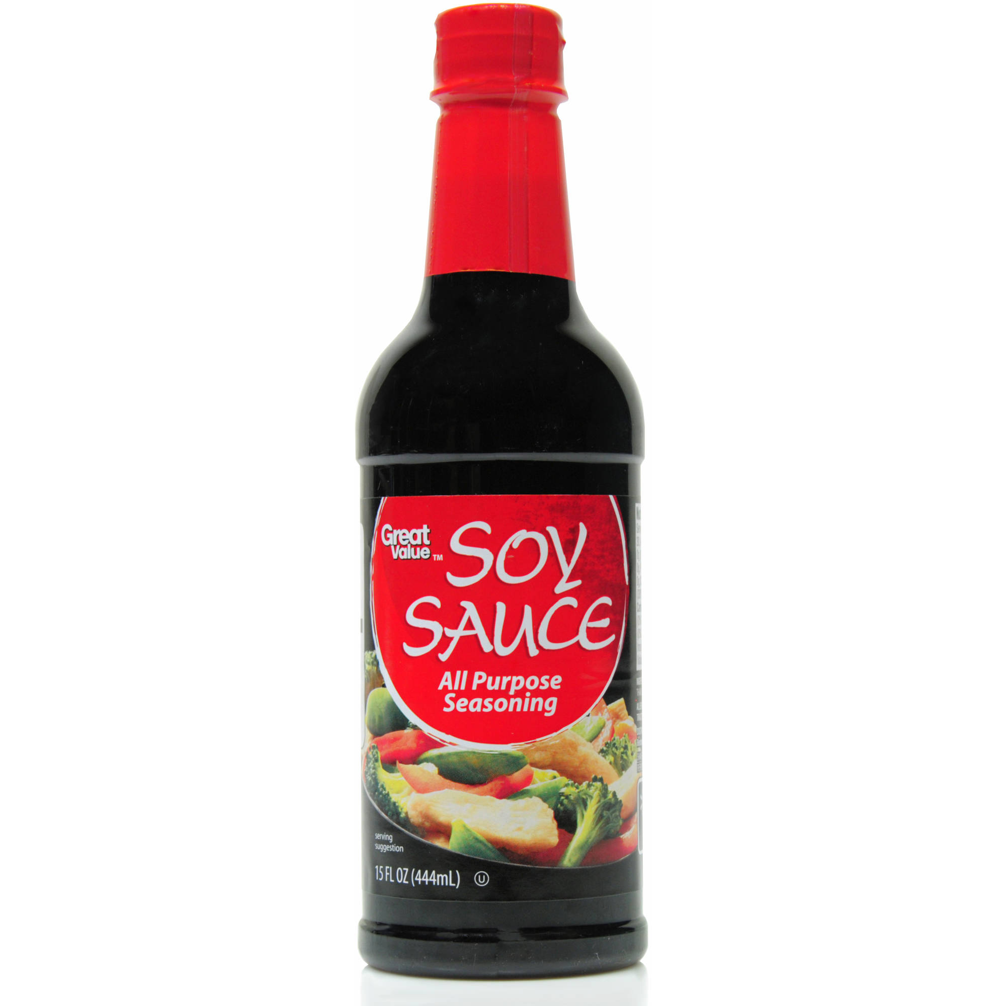
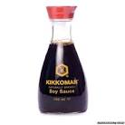
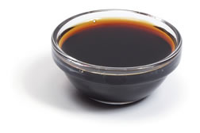
Soy Sauce
It tastes salty.
It is made from soybeans.
It is usually used as a seasoning in Asian cuisines.

Slide 24
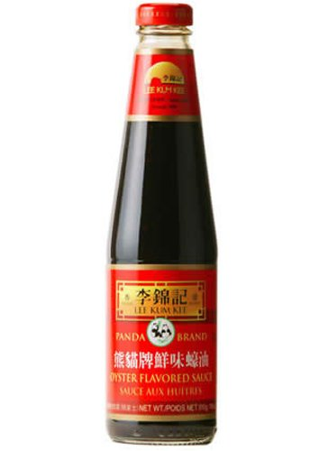
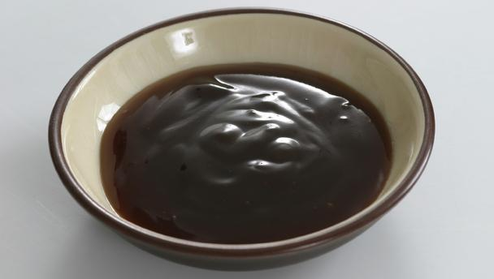
Oyster Sauce
It tastes salty and sweet.
It is thick.
It is made by oysters.
It is usually used as a seasoning in Asian cuisines.

Slide 25
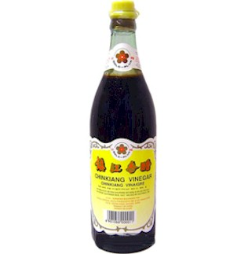
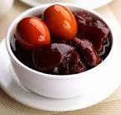
Vinegar
It tastes sour.
It can stimulate your appetite.
- It is usually used as a seasoning in Asian cuisines.

Slide 26
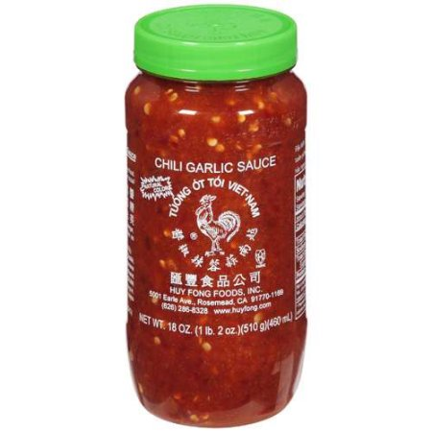
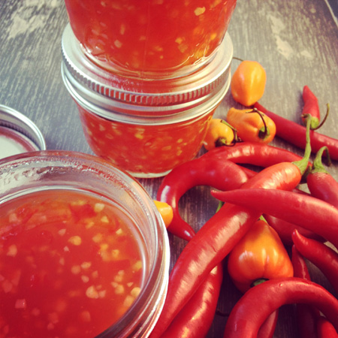
Chili Sauce
It tastes spicy and hot.
It is usually used as dipping sauce or seasoning in cooking.

Slide 27
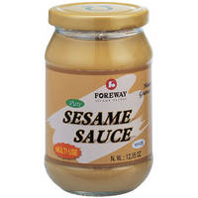
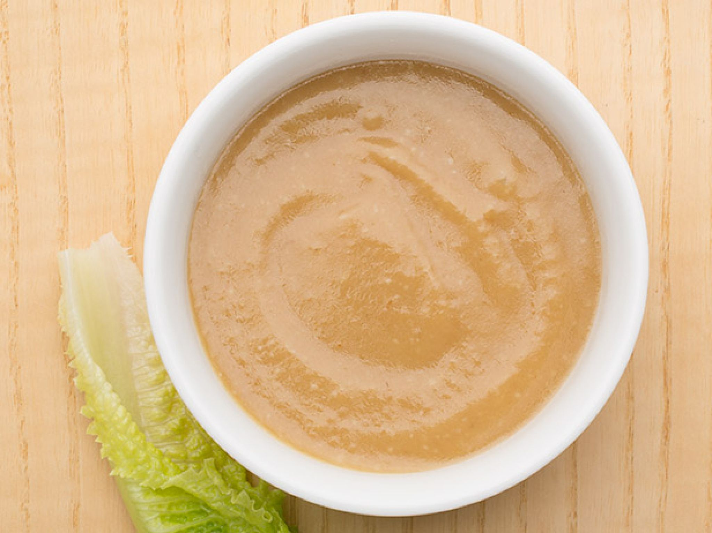
Sesame Sauce
It tastes rich.
It is made by sesame.
It is usually used as dipping sauce.

Slide 28
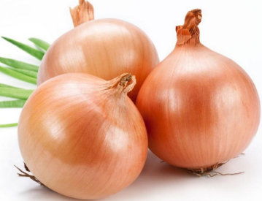
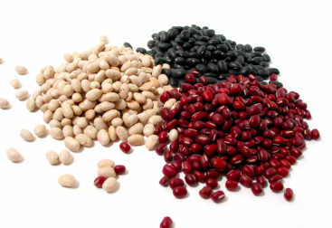
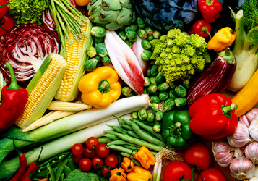
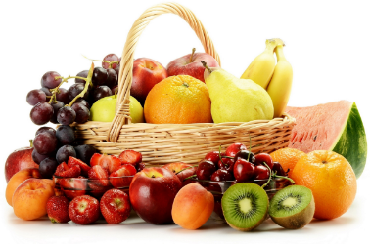
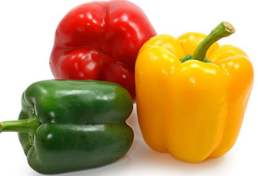
What are the other sauces you know?
Let’s talk about our favourite sauces!

Slide 29
Describe your favourite sauce!
The following sentences can help you.
My favourite sauce is made of ____________.
It tastes___________.
It can be served with ___________.
It can be added to _____________.

Slide 30
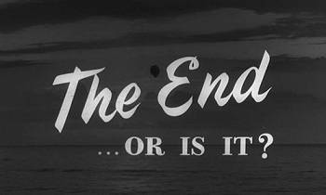
Story Ending Re-writing Activity

Slide 31
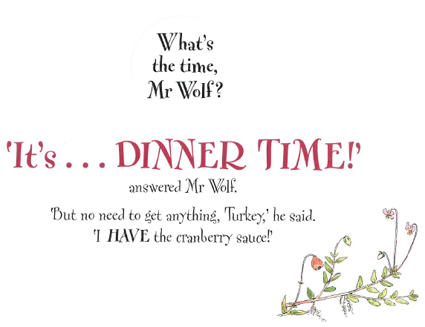
What may happen in the end?

Slide 32
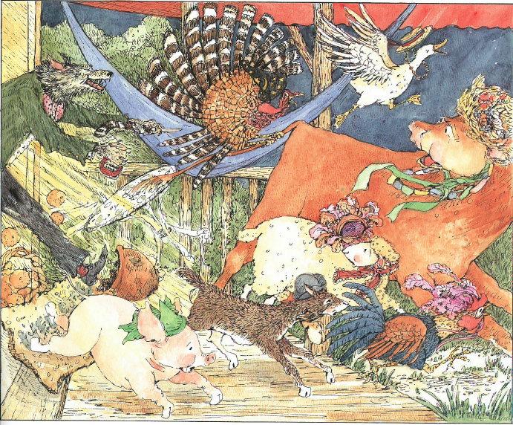
Look at the animals’ faces. How do they feel?

Slide 33
Why are they scared? What’s in Mr Wolf’s hands?

Slide 34
What is your guess?
Mr wolf ate all the animals.
Is this the ending?
Let’s see the final picture in the Reader.

Slide 35
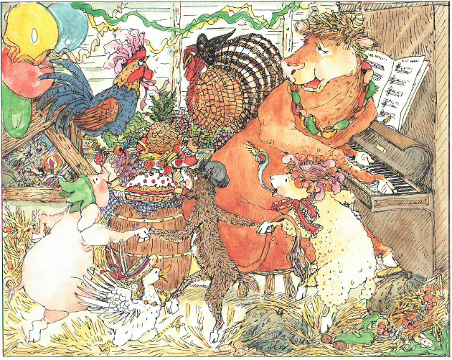
What are the animals doing?
How do they feel now?

Slide 36
Where is Mr wolf?

Slide 37
Do you like the ending?
Can you write a new ending to tell us what happened to the animals?
Draw pictures.

Slide 38
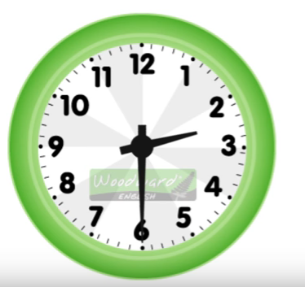
How to tell the time

Slide 39
Find the answer of following questions and tell your partner.
When did Mr. Wolf have his breakfast?
When did Mr. Wolf go shopping?
When did Mr. Wolf go swimming?
When did Mr. Wolf begin the party?
At eight o’clock.
At ten o’clock.
At twelve o’clock.
At six o’clock.

Slide 40
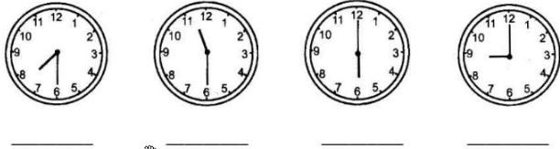
How to tell the time
What do you know?
half past …
… o’ clock
half past seven
half past eleven
six o’clock
nine o’clock

Slide 41
Watch the video
Part A ( 0:00 – 1:57 )
Part B ( 1:58 – 3:19 )
https://www.youtube.com/watch?v=fq2tRfHu5s8

Slide 42
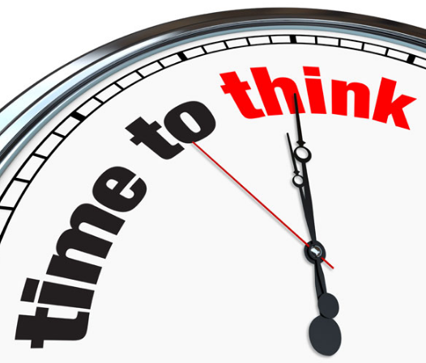
Questions
When do we use ‘to’ or ‘past’?

Slide 43
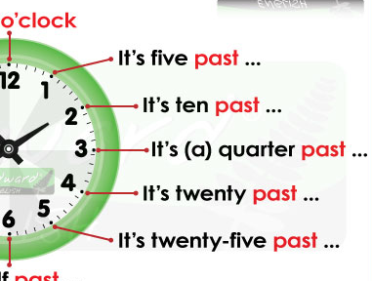
For minutes 1-30, we use past.

Slide 44
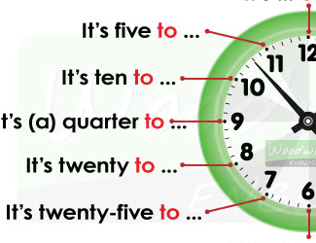
For minutes 31-59 we use to.

Slide 45

Practice Time
http://www.visnos.com/demos/clock
Raise your hand when you are ready to tell the answer.

Slide 46

What do you do
at different times of a day?

Slide 47
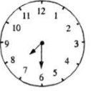
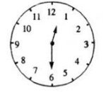
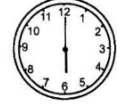
It’s time to do __________.
It’s time for ______(noun).
It’s half past seven.
It’s time to go to school.
It’s time for school.
It’s half past twelve.
It’s time to have lunch.
It’s time for lunch.
It’s six o’clock.
It’s time to watch TV.
It’s time for TV.
Key word: TV

