Slide 1
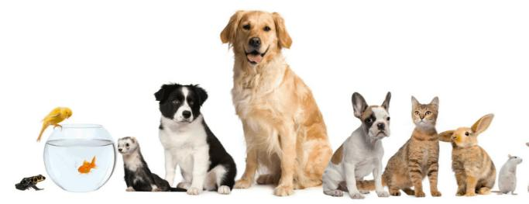
Love for Animals – wh-questions
Yan, Tsoi Lam Chow, Ka Yan Cao, Yu
The Education University of Hong Kong

Slide 2
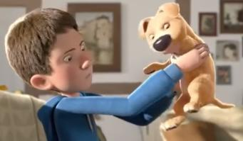
Part A –Video Watching
Watch a video clip about a boy and a dog.
While watching, you need to write two
wh-questions about the story.
After watching, we will share and answer your questions.
https://www.youtube.com/watch?v=3XA0bB79oGc

Slide 3
Question words
Question words | Meaning | Examples
 | person (subject / object) | ___________ is that man? That’s my uncle. ___________ has saved you? ___________ did you see?
 | person (object) | ___________ did you see? To ___________ have you given the chocolates? With _________ do we collaborate?
 | idea action thing | ___________ do you think? ___________ are you doing? ___________ is that?
 | place | ___________ is your school?
 | time | ___________ do you go to school? At 7:00.
 | reason | ___________ do you sleep late? I’ve to finish my work.
 | by what method manner emotion | ___________ do you go to school? By MTR. ___________ will you deal with the problem? ___________ do you feel?
 | choice | ___________ should we choose, beef or pork?
 | possession | ___________ is this pen? ___________ pen is this?
Who
Whom
What
Where
When
Why
How
Which
Whose

Slide 4
Question phrases
Whose + __________ | Whose side are you on? Whose blood do you think it is really? Whose turn was it this time? Whose funeral was it then?
Which + ____________ | Which airfield was used for agent drops? Which novels or stories are well used as class readers in schools?
What + ____________ | What sort of programmes will we see? What help will I get from my Social Services Department?
How + ______________ or _________________ | How deep is my boredom? How important is that to the balance of trade? How bad is the problem? How often do you blog? How well do you know this guy? How exactly did it happen?
Noun
Noun
Noun
Adjective
Adverb

Slide 5
Part B(1) – Question words
Read the lines below. Use the best question word / question phrase to complete the dialogue.
Kim, the manager of an animal shelter, is talking to
Chris, one of the volunteers.
Time limit: 4 mins

Slide 6
1. __________ will you feed the animals?
I’m getting ready now.
2. __________ are the gloves?
When
Where
They are in the box. 3. _________ have you put in the dish?
Just some dried fruits.
4. _________ animals should I feed first, the rabbits or the hamsters?
Which
What

Slide 7
The hamsters.
5. _________ plate of fruit is this?
Whose
It’s mine. 6. __________ is the rabbit?
How heavy
It weighs 2.5kg.
Oh dear! It is overweight. You shouldn’t give it too many snacks.
7. _________ is the lady outside? She is looking at us.
Oh no! My mom is looking for me.
Who

Slide 8
8. _________ do you look so worried?
Why
She doesn’t like me working here at the animal shelter. She thinks it’s a waste of time.
Poor you!
9. _________ can I help you?
How
Please tell her the animals here need me.

Slide 9
Part B(2) – Word Order
(1) What is the difference between a statement and a question?
Read the following lines. Underline the subject of each statement and circle the verb. The first one has been done for you as an example.
Example:
1. Often infected people are rejected by family and friends.

Slide 10
Word Order of Statements
No other organisation can help.
Both programmes are the largest of their kind in the country.
Nobody has explained this to her.
In a statement, the subject comes ____________ the verb.
before

Slide 11
Word Order of Wh-questions
(2) Read the questions below. Underline the subject of each question and circle the verb. The first one has been done for you as an example.
Example:
1. When does the show start?

Slide 12
‘When are you moving in?’ ‘Tomorrow.’
How could she be so blind?
Why is opera fashionable now?
What colour are the seats in the House of Lords?
When does summer end and autumn begin?

Slide 13
Word Order Summary
In a statement, the subject comes _________ the verb.
e.g. No other organization can help.
In a question, the subject comes _______ the (helping) verb.
e.g. When does the show start?
before
after

Slide 14
Part B(3) - Dummy ‘do’
When do we add the helping verb/auxiliary ‘do’ to form a question?
Read the lines below. Write down the question numbers in the box below. The first two have been done for you as examples.

Slide 15
1. When can you start? | Questions with “do”
2. ‘When did you see these two men?’ Holmes asked. | 2,
3. ‘Why do you ask me?’
4. ‘When will the hijackers set them free?’
5. ‘When did you see him again?’
6. ‘What’s happening?’ screamed Mr Robb. ‘Why aren’t we moving?’ | Questions without “do”
7. What size is your bed? | 1,
8. What type of bed do you own?
9. How has this happened?
10. Why is the dog running at me?
3, 5, 8
4, 6, 7, 9, 10

Slide 16
Dummy ‘do’ Summary
When do we add the helping verb/auxiliary ‘do’ to form a question?
Answer: The helping verb ‘do’ is added in Questions 2, _____, _____ and _____ because these sentences do not have verbs such as _can,_______________________.
3
5
8
will, is, has

Slide 17
Part B(4) – Verb Phrase Structure
Circle the main verb in each question.
The first one has been done for you as an example.
Example:
1. Why do you want me to tell a lie to the police?

Slide 18
What is the verb form after ‘do’?
2. Why did you do that?
3. Why do you keep a room like this?
4. Where does he come from?
5. What does she learn?
6. What does she plan to do with the photograph?

Slide 19
Verb Phrase Structure Summary (1)
When it follows the helping verb do / does / did, the main verb is in the *base / present tense / past tense / -ing / past participle form.
e.g. What does she *learn / learns / learning / learnt?

Slide 20
Part B(4) – Verb Phrase Structure
(b) What is the verb form after ‘be’ (is / am / are / was / were)?
Circle the main verb in each question.
The first one has been done for you as an example.
Example:
1. When was Jesus Christ born?

Slide 21
Which way was it facing in the oven?
Why are you sitting here when all your friends are playing?
How long am I supposed to wait?
How was the British Empire built?
When was the cake eaten?

Slide 22
Verb Phrase Structure Summary (2)
When it follows the helping verb ‘be’ (is, am, are, was, were), the main verb is:
(1) a/an ______________________ to form the continuous tense
e.g. Why are you *cry / cries / crying / cried?
or
(2) a ____________________ to form the passive voice
e.g. When was the money *steal / steals / stole / stolen / stealing?
ing-form/
present participle
past participle

Slide 23
Part C – Proofreading exercise
Read the questions your classmates wrote. Correct the mistakes. Put down a tick (✓) if the question is correct.

Slide 24
Proofreading Exercise
1. | When the students have the Art lesson?
2. | Which brush is Paul use to draw?
3. | Tim is talking to who?
4. | Where is the flag hung?
5. | What does Ali doing?
do
does
To whom is Tim talking? /
Who/Whom is Tim talking to?
is
6. | Which brush does Paul uses?
use

Slide 25
Proofreading Exercise
7. | When did the students have the Art lesson? [They have the lesson at 10:00 am.]
8. | Why did Sam enjoys the Art lesson? [He enjoys the lesson because he likes artwork.]
9. | When are the students have the Art lesson?
10. | Who is Tim talking with?
11. | Why is Sam enjoys the Art lesson?
do
does
enjoy
do
does
enjoy

Slide 26
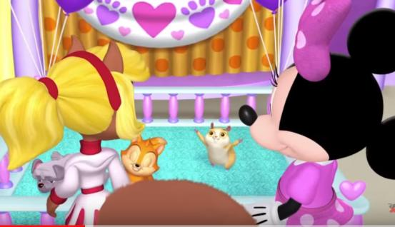
Part D(1) Video watching – Pet adoption
https://www.youtube.com/watch?v=s4n5mxjgn8Y

Slide 27
Part D(2) Answer the following questions.

Slide 28
A rabbit.
What was the first animal adopted?
What pet did the duck take home?
Why did Gilbert look worried?
A dog.
He was worried that he wouldn’t be adopted.

Slide 29
What
did
____________ pet __________ the squirrel take?
She took a cat home.
5. ________________________________________?
Pig Mum wanted to adopt a pet because she wanted to find a little baby for Baby Oinky.
6. ________________________________________ ?
Joey took Gilbert home.
Why did Pig Mum want to adopt a pet?
Who/Whom did Joey take home?

Slide 30
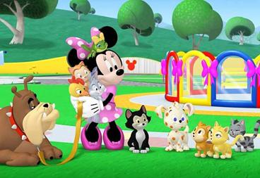
You are Minnie. Your former classmate has come to adopt a pet. Ask your classmate questions to see whether he/ she will be a good pet owner.
Part D(3)

Slide 32
Tips:
You can ask them questions on the following:
the number of people living at home
the type of home (apartment, house, rent etc.)
the home size
the kind of pet they want to adopt
the reason for adoption
the age of the pet
the size of the pet
the place where the pet will be kept
the frequency they will take the pet for a walk
the person responsible for the care of the pet, etc.

Slide 33
Interview time!

Slide 34
In this lesson, we have learned…
The wh-words and wh-phrases
The word order of wh-questions
e.g. When are you moving in? (Verb before Subject)
When to use the helping verb “do” to form a question
e.g. Why do you ask me?
Verb Phrase structure
After “do”, we use base verb. After ‘be’, we use -ing / past participle
e.g. What did you say? e.g. Why is the baby crying?
How was the money stolen?

